Slide 1
Mineral Properties
GLY 4200 - Lecture 2 –Fall, 2019
© D. L. Warburton 2019
Notes:
Mineral identifications are made on the basis of a combination of tests for different properties. No single test, or single property, is enough to identify a mineral. Like fingerprints, a complete set is necessary for unambiguous identification.
By examining minerals, and carefully noting their properties, it is often possible to identity a mineral, or arrive at a short list of possibilities. Six of the laboratory assignments will be devoted to examining minerals, and improving your observational and note-taking skills.

Slide 2
Hardness
Hardness may be measured in several ways
Moh’s scale – developed by Austrian mineralogist Friedrich Mohs in 1824
Absolute scales – Brinell, Knoop, Rockwell, Vicker’s
Notes:
The hardness scale was established by the Austrian mineralogist, Friedrich Mohs, in 1824. The Mohs’ hardness scale places ten common or well-known minerals on a scale from one to ten. One is the softest mineral and ten is the hardest.

Slide 3
Moh’s Scale
1 Talc
2 Gypsum
3 Calcite
4 Fluorite
5 Apatite
6 Orthoclase
7 Quartz
8 Topaz
9 Corundum
10 Diamond
Notes:
To use the hardness scale, you try to scratch the surface of an unknown sample with a mineral or substance from the hardness scale (these are known samples). If the unknown sample cannot be scratched by feldspar (6) but it can be scratched by quartz (7), then it's hardness is between 6 and 7. An example of a mineral that has a hardness between 6 and 7 is pyrite (6 to 6.5)

Slide 4
Practical Scale
Fingernail 2.2
Copper penny 3.2
Pocket knife 5.1
Glass 5.5
Steel file 6.5
Streak plate 7
Notes:
If you don't have minerals from the hardness scale on hand, here are some common objects and their hardness values.
If an unknown sample cannot be scratched by your fingernail (2.2) but it can be scratched by a penny (3.2), then it's hardness is between 2.2 and 3.2. An example of a mineral that has a hardness between 2.2 and 3.2 is calcite (3).

Slide 5
Moh’s Scale Versus Absolute Hardness
Notes:
Image: http://csmres.jmu.edu/geollab/Fichter/MetaRx/mohcleav.PDF
Non-linear character of the Moh’s scale

Slide 6
Tenacity
Brittle
Ductile
Elastic
Flexible
Malleable
Notes:
Tenacity describes how the mineral behaves when subjected to deformation:
Brittle - The minerals breaks or crumbles easily, such as fluorite.
Ductile - The mineral can be drawn into thin wires.
Elastic - The mineral can be deformed by force, but returns to its original shape when the deforming force is removed.
Flexible - The mineral can be bent or deformed by force and remains deformed when the force is removed.
Malleable - Can be flattened into sheets with hammering, such as native gold, silver and copper.

Slide 7
Cleavage Causes
In some minerals, bonds between layers of atoms aligned in certain directions are weaker than bonds between different layers
In other minerals, the number of bonds per unit area (bond density) is low
In these cases, breakage occurs along smooth, flat surfaces parallel to those zones of weakness
Notes:
When a mineral sample is broken with a hammer, it breaks along planes of weakness that are part of its crystalline structure. These breaks are cleavages. Some minerals break only in one direction.

Slide 8
Multiple Cleavage Directions
In some minerals, a single direction of weakness exists, but in others, two, three, four, or as many as six may be present

Slide 9
Cleavage Angles
Where more than one direction of cleavage is present, it is important to determine the angular relation between the resulting cleavage surfaces: are they perpendicular to each other (right angle), or do they meet at an acute or obtuse angle?

Slide 10
Cleavage Illustration
Various types of cleavage
One directional cleavage is sometimes called “basal” cleavage
Notes:
Source: http://www.geosci.unc.edu/classes/Geo11Labs/geonote/minfig1.html
Some common forms of cleavage are cubic, rhombohedral, and basal.
Cubic cleavages form cubes (example, halite).
Rhombohedral cleavages form six-sided prisms (example, calcite).
Basal cleavages occur along a single plane parallel to the base of the mineral (example, topaz).

Slide 11
Basal Cleavage
Cleavage in biotite mica

Slide 12
2-D@60º
Amphibole
Notes:
The angles between cleavage planes may be diagnostic.
In the {110} of amphiboles, ∠ = 56̊
In the {110} planes of pyroxene, ∠ = 87̊

Slide 13
2-D@90º
Orthoclase

Slide 14
3-D not @ 90º
Calcite
Picture also illustrates double refraction

Slide 15
American and British Systems
American
Perfect
Good
Fair
Poor
British
Eminent
Perfect
Distinct
Imperfect
Notes:
If a mineral breaks easily and cleanly in one or more directions, its cleavage is considered perfect. For example, calcite cleaves perfectly along three planes.
As the quality of the break decreases, cleavage may be described as good, distinct, and poor or none.
Some minerals cleave perfectly in one direction and poorly in others. For example, gypsum cleaves perfectly on one plane and poorly along two others.

Slide 16
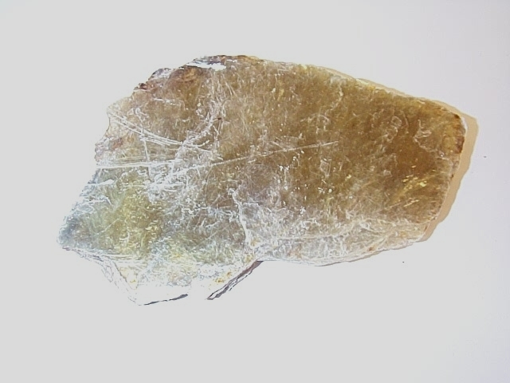
Perfect
Mica

Slide 17
Good
Fluorite – 4 directions
Notes:
Image: http://www.minsocam.org/MSA/collectors_corner/id/mineral_id_keyi6.htm

Slide 18
Fair
Augite, a type of pyroxene
Notes:
Image: http://euclid.dne.wvfibernet.net/~jvg/Env105/minpix/augite06.jpg

Slide 19
Poor
Apatite

Slide 20
Parting
Similar to cleavage but not present in all specimens
Usually due to a defect, such as twinning

Slide 21
Fracture
Mineral breakage other than along a cleavage or parting plane
Several types
Conchoidal
Fibrous or splintery
Hackly
Uneven
Notes:
The fracture of a mineral is how it breaks other than along cleavage planes. The fracture may be described as:

Slide 22
Conchoidal
Quartz
Notes:
Conchoidal - a 'shell-like', convex or concave fracture displaying curved fracture or undulation rings concentric to the point of impact and lines or fractures radial from the point of impact, as in quartz, flint and obsidian.

Slide 23
Fibrous
Notes:
Fibrous - thread-like such as is seen in asbestos

Slide 24
Splintery
Actinolite, a type of amphibole
Notes:
Image: http://www.geol.ucsb.edu/faculty/hacker/geo102C/lectures/actinolite.jpg

Slide 25
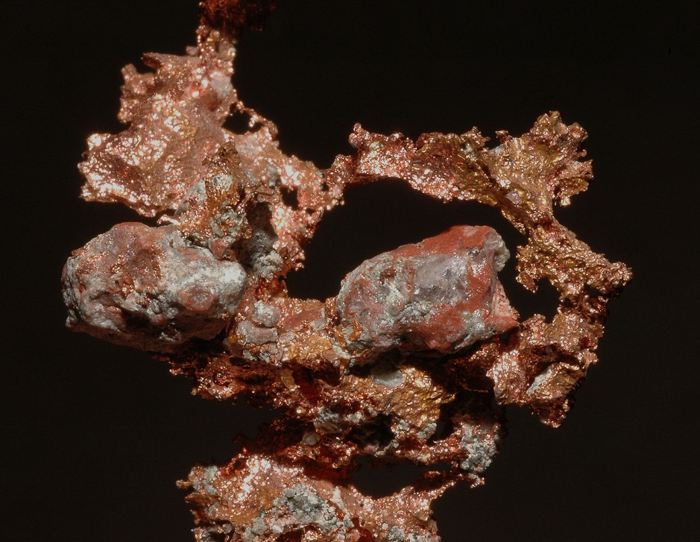
Hackly
Native copper – probably from Keweenaw Peninsula, Michigan
Notes:
Hackly - Jagged sharp ridges, such as in native copper.
Uneven - A rough fracture surface. This is the most common type of fracture.

Slide 26
Density
Mass/volume
SI units: kg/m³
Common units: g/cm³

Slide 27
Specific Gravity
Ratio of the weight of the mineral, divided by the weight of an equal volume of water
Dimensionless
Notes:
Special equipment is usually needed to find out a mineral’s exact specific gravity.
With a little practice, you can guess a mineral’s specific gravity by hand. Some mineral samples will feel heavier than others, even if all your samples are the same size. The heavier ones have a greater specific gravity. Here are some examples of common minerals and their specific gravity ranges:

Slide 28
SG Examples
Modifier | Mineral | SG
Light | Sulfur, graphite | 1-2
Medium | Gypsum, Quartz | 2-3
Medium Heavy | Fluorite, beryl | 3-4
Heavy | Corundum, most metal oxides | 4-6
Extreme | Native gold, platinum | 19⁺

Slide 29
Luster
Reflection of light from a mineral’s surface
Observe on a freshly broken, untarnished surface
Broad categories: metallic, semi-metallic and non-metallic
Non-metallic, the most common, is split into a number of sub-categories
Notes:
Luster is the way the surface of a mineral reflects light. Luster should be observed on a cut or freshly broken, untarnished surface. There are two general types of luster -- metallic and non-metallic. The mineral's appearance due to the amount and quality of light reflected from its surfaces.
Depending on the quality of light a mineral reflects it may appear:

Slide 30
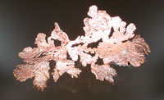
Metallic Luster
Left - Gold, 3cm tall, California
Right - Copper, 10 cm across, Bolivia
Notes:
Source: http://www.minsocam.org/MSA/collectors_corner/id/mineral_id_keyi3.htm

Slide 31
Submetallic
Euxenite, Wyoming, 2cm across
Notes:
Source: http://www.minsocam.org/MSA/collectors_corner/id/mineral_id_keyi3.htm
Euxenite is a Yttrium Calcium Erbium Lanthanum Cerium Uranium Thorium Niobium Tantalum Titanium Oxide. (sometimes referred to as a trash can mineral) or more commonly as a rare earth oxide, found in granitic pegmatites
Named for from the Greek (εύξεινος), hospitable or friendly to strangers

Slide 32
Non-metallic
Adamantine
Vitreous
Subvitreous
Resinous
Pearly
Silky
Greasy
Waxy
Dull or earthy

Slide 33
Non-metallic: Adamantine
Diamond, Zaire 1 cm.
Having the hard, sparkly look of a diamond
Notes:
Source: http://www.minsocam.org/MSA/collectors_corner/id/mineral_id_keyi3.htm

Slide 34
Non-metallic: Vitreous
Pollucite 3cm. across
Notes:
Source: http://www.minsocam.org/MSA/collectors_corner/id/mineral_id_keyi3.htm
Vitreous - the luster of broken glass, e.g.. quartz
Subvitreous - as vitreous, less well developed
Zeolite mineral, important as a significant ore of caesium and sometimes rubidium.

Slide 35
Non-metallic: Resinous
Sphalerite, 4 cm across, Spain
Having the look of amber – not quite glassy
Notes:
Source: http://www.minsocam.org/MSA/collectors_corner/id/mineral_id_keyi3.htm
Resinous - the luster of resin, e.g.. amber and opal

Slide 36
Non-metallic: Pearly
Stellerite, Pakistan, 2 cm across
Having the iridescent look of mother-of-pearl (though usually just barely)
Often found on the cleavage face of a mineral having perfect cleavage
Notes:
Source: http://www.minsocam.org/MSA/collectors_corner/id/mineral_id_keyi3.htm
Zeolite mineral

Slide 37
Non-metallic: Silky
Gypsum, variety satin spar, 10cm across
Silky, having the look of silk, fine parallel fibers of mineral – such as chrysotile "asbestos"
Notes:
Source: http://www.minsocam.org/MSA/collectors_corner/id/mineral_id_keyi3.htm
Silky - the luster of silk in fibrous minerals such as satin spar gypsum, or asbestos

Slide 38
Non-metallic: Greasy or Oily
Nepheline and cancrinite (yellow) 2cm across, Maine
Having the look of an oil-coated substance
Notes:
Source: http://www.minsocam.org/MSA/collectors_corner/id/mineral_id_keyi3.htm
Greasy or oily - The appearance of grease or wax, e.g. turquoise
Waxy - The appearance of paraffin

Slide 39
Non-metallic: Dull
Anglesite, 2 cm across, Wisconsin
Having a plain looking surface that is not submetallic
Note: oxidized metallic minerals are called dull metallic
Notes:
Source: http://www.minsocam.org/MSA/collectors_corner/id/mineral_id_keyi3.htm
Dull - A plain surface that is not metallic Example: bauxite

Slide 40
Non-metallic: Earthy
Kaolinite after orthoclase, England, 2cm across
Having the look of soil or clay
Notes:
Source: http://www.minsocam.org/MSA/collectors_corner/id/mineral_id_keyi3.htm
Earthy - The look of soil or clay (may have a distinct odor as well)

Slide 41
Luster Modifers
Splendent
Shining
Dull
Notes:
Depending on the quantity or intensity of light a mineral reflects it may appear:

Slide 42
Diaphaneity
The transmission of light through a mineral
Sometimes called transparency
Categories
Transparent
Translucent
Opaque

Slide 43
Transparent
Heulandite, Moonen Bay, Duirinish, Isle of Skye
Notes:
Image: http://www.curriehj.freeserve.co.uk/heuls.jpg
You can see objects through a transparent mineral
Zeolite

Slide 44
Translucent
Fluorite
Notes:
Image: http://www.irocks.com/feist/GF5D.JPG
You can see light, but not objects through a translucent mineral. (Lower portion of the picture)

Slide 45
Opaque
Almandine, Mt. Lemmon, Arizona
Notes:
Image: http://www.cs.cmu.edu/afs/cs/user/adg/www/images/minerals/algarnets/almandine.jpg
You can't see anything through an opaque mineral.

Slide 46
Color
Idiochromatic – The color of the mineral seldom varies, and is therefore diagnostic
Allochromatic – Color varies due to impurities, or viewing angle
Notes:
Usually, we notice the color of a mineral first.

Slide 47
Idiochromatic
Sulfur
Notes:
Upper Image: http://universe-review.ca/I13-14-sulfur.jpg
Lower Image: http://www.iun.edu/~geos/Zoran%20IUN/G%20101/Photos/sulfur.jpg
Some minerals are easily identified by color because they are never any other color (idiochromatic).
For example, malachite is always green. However, keep in mind that color by itself isn't enough to identify a mineral.

Slide 48
Allochromatic
Tourmaline (watermelon)
Notes:
Image: http://www.gggems.com/images/Tourmaline%20slice/Tourmaline_slice_red_triangle_82_gr_XXL.jpg
Chemical impurities often change the color of a mineral without changing its basic make-up. For example, quartz in its purest form is colorless and clear as glass. Quartz with traces of iron becomes violet (amethyst). With traces of manganese, it turns pink (rose quartz). If quartz is exposed to radiation, it turns brown (smoky quartz). Minerals with many colors are allochromatic.
Color is therefore not always an indication of identity in a vitreous specimen, although it is a more reliable indicator with opaque minerals.

Slide 49
Streak Color
Color obtained by rubbing a mineral across an unglazed porcelain plate, known as a streak plate
Streak plates are usually white, but may be black
Color is due to a powder, with many crystals oriented in random directions, and is much more consistent than color in hand specimen

Slide 50
Streak Color Image
Varieties of Hematite
Photos by Pamela Gore
Notes:
Upper Image: http://www.minsocam.org/MSA/K12/images/hematite.gif
Lower Image: http://www.minsocam.org/MSA/K12/images/streakplte.jpg
Powder may also be produced by scratching the mineral with a knife. The color of the streak is always the same, whether or not the mineral has impurities.

Slide 51
Streak Color Image
Quartz, whether it is smoky (left) or amethyst (right), always gives a white streak (web information)
What is wrong with this image?
Notes:
Image: http://www.childrensmuseum.org/geomysteries/cube/images/quartz_streak.jpg
Powder may also be produced by scratching the mineral with a knife. The color of the streak is always the same, whether or not the mineral has impurities.

Slide 52
Iridescence
Left - Covellite develops a deep blue iridescence, 4cm across, Montana
Right - Iridescent pyrite, 4cm across, Australia
Notes:
Source: http://www.minsocam.org/MSA/collectors_corner/id/display/iridescent.htm
Iridescence is the production of a rainbow of colors caused by interference of light in thin films of different refractive indices and varying thickness (the oil sheen on water is an example of this). It is often called sheen.
Minerals with metallic luster, such as bornite and chalcopyrite are good examples of minerals which exhibit iridescence.
A couple of cases where it does not involve metallic minerals are the way fracture surfaces in quartz may show it, and the way some fluorite crystals may exhibit it on the surfaces of their faces.

Slide 53
Play of Colors
Labradorite, 20cm wide, Madagascar, Seaman Museum specimen
Notes:
Source: http://www.minsocam.org/MSA/collectors_corner/id/display/iridescent.htm
Another exception is the type of iridescence known as labradoresence or play of colors, found in labradorite and a very few other minerals.

Slide 54
Opalescence
Precious opal cabochons (largest is 15mm), Australia
These are triplets, formed with a dark background layer, a middle layer of precious opal and a surface layer of quartz to help protect the softer opal from wear and tear.
Notes:
Source: http://www.minsocam.org/MSA/collectors_corner/aam/opal.htm
Opalescence, as the word suggests, refers to an opal-like play of light, reflections off the mineral producing flashes of color that may appear somewhat like a patch-work of different "grains" of color that aren’t really there: Move the sample minutely and the color disappears from that spot. It is sort of like taking a pearly luster to the nth degree.

Slide 55
Source of Opalescence
Scanning electron micrograph of amorphous silica spheres closest packed in an Australian fire opal showing red interference colors
Sphere size is ~2500 Angstroms
Photo courtesy of Hans-Ude Nissen
Cover of Reviews in Mineralogy vol. 29 "Silica"
Notes:
This regular array of balls of opal act like a diffraction grating that will refract various wavelengths (approximately the same wavelength as the diameter of the spheres).
Different sizes of spheres will diffract different wavelengths of light thus giving rise to the various flash of different colors.
Monograph is from 1994.
Luminescence is the emission of light by a mineral other than the reflected light of the sun or a lamp – the mineral "glows" due to some other reason. The usual reason is reaction to ultraviolet light, though X-rays and electrons may produce it as well.

Slide 56
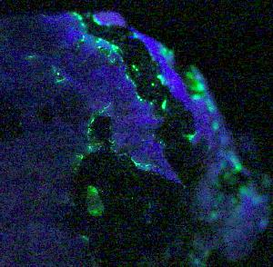
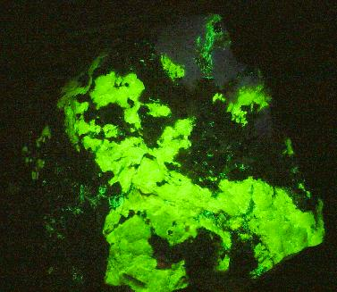
Fluorescence
Upper - rare fluorescent mineral hardystonite
Lower - rare fluorescent mineral esperite
Both from Franklin, New Jersey
Notes:
Source: http://irocks.com/franklin4.html
The types of luminescence seen in minerals are fluorescence and phosphorescence – two closely related phenomena.
Fluorescence - In most cases, the emitted light has a longer wavelength, and therefore lower energy, than the absorbed radiation. However, when the absorbed electromagnetic radiation is intense, it is possible for one electron to absorb two photons ; this can lead to emission of radiation having a shorter wavelength than the absorbed radiation. The emitted radiation may also be of the same wavelength as the absorbed radiation, termed "resonance fluorescence“
Phosphorescence - Unlike fluorescence, a phosphorescent material does not immediately re-emit the radiation it absorbs. The slower time scales of the re-emission are associated with forbidden energy state transitions in quantum mechanics. As these transitions occur very slowly in certain materials, absorbed radiation may be re-emitted at a lower intensity for up to several hours after the original excitation.

Slide 57
Acid Reaction
When acid is placed on the surface of certain minerals, carbon dioxide is released, producing a “fizz”
The strength of the response should be noted
Notes:
Image: http://www.eas.purdue.edu/mesozoic/lab_01/acid_reaction.jpg
Calcite effervesces strongly in dilute HCl
Malachite also reacts strongly
Dolomite reacts weakly in warm dilute HCl or if scratched to produce a little powder prior to applying the acid
Siderite reacts weakly

Slide 58
Taste
Must be used carefully
Poisonous minerals
Diseases
Categories
Salty – Halite
Bitter – Sylvite
Notes:
Halite NaCl, is rock-salt and therefore tastes of salt.
Sylvite KCl tastes bitter (salt substitute)
There are other minerals with distinctive tastes, most of them somewhat less pleasant than salt. Since some minerals are poisonous, and a laboratory setting is hardly sanitary, this test is not recommended.

Slide 59
Odor
Smell of a fresh specimen
Lab specimens are usually contaminated, so this test is not usually used for lab specimens, although streak plate odor may be diagnostic
Examples
Sulphurous (rotten egg) sulfur, pyrite, sphalerite
Earthy hematite, limonite

Slide 60
Feel
Tactile response to mineral surface
Greasy (unctuous) Talc, serpentine, graphite
Rough Crystalline minerals
Smooth – graphite
Soapy - graphite
Notes:
Crystalline minerals will feel rough.
Talc and serpentine often feel unctuous (greasy) or soapy.
Graphite and satin spar gypsum may feel smooth, unctuous or soapy. Graphite is a good conductor of heat and will therefor feel cold. Graphite is also a good conductor of electricity (it is used a brushes on electric motors), but this property would not be tested in the field.

Slide 61
Magnetism
A few minerals are strongly attracted to a magnet
Examples
Magnetite
Pyrrhotite
A hand magnet or the needle of a Brunton compass may be used to test for magnetism

Slide 62
Lodestone
Lodestone is a naturally magnetic variety of magnetite
The iron filings cling to the rock
Notes:
Source: http://www.curiogrove.com/minerals/min037.htm

Slide 63
Radioactivity
Some minerals contain radioactive elements
Placing the sample next to the radiation meter will produce an audible signal, as well as a deflection of the meter, if the sample is emitting radioactivity

