Slide 1
Metamorphic Rocks, Part 4 CONTACT AND DYNAMIC METAMORPHIC ROCKS
Hornfels, Skarns, Talc-Tremolite Schist, and Epidosite

Slide 2
Contact and Dynamic Metamorphism
The rocks in this lab are formed either by contact metamorphism or by dynamic metamorphism associated with movement along a fault
Contact metamorphism is sometimes called thermal metamorphism
Temperature is increased due to the heat lost by an intrusive body

Slide 3
Contact Metamorphic Facies
Contact metamorphic facies are divided into the Albite-Epidote hornfels, hornblende hornfels, pyroxene hornfels, and sanidinite facies
The albite-epidote facies is approximately equivalent to the greenschist facies, the hornblende hornfels to the amphibolite, and the pyroxene and sanidinite facies to the granulite facies

Slide 4
Contact Facies continued
Grain size, particularly of the albite-epidote rocks, is tiny
Epidote may be recognized by its color
Sometimes the rocks in the higher facies will have recognizable grains

Slide 5
Hornfels
A fine grained, massive rock (Massive means the minerals have no preferred orientation)
Generally produced by contact metamorphism, with no associated directed pressure
Hornfels is completely recrystallized during contact metamorphism

Slide 6
Albite-Epidote Facies
The major minerals in the albite-epidote hornfels facies are albite, epidote, chlorite, and actinolite
It is typical of the outer part of contact metamorphic aureoles
It is not greatly distinctive from greenschist facies rocks, and is not always accepted as a separate metamorphic facies for this reason

Slide 7
Albite-Epidote Facies continued
It should not be confused with the albite-epidote amphibolite facies, which is a transitional facies between the greenschist and amphibolite facies, and is generally associated with the higher pressures of regional metamorphism

Slide 8
Epidosite
The epidosite is indicative of the contact metamorphic facies albite-epidote hornfels facies
Epidote is often formed by metasomatism
The fine-grained textures of hornfels' makes detection of replacement difficult to impossible so other evidence would be needed to decide if this rock were of metasomatic origin

Slide 9
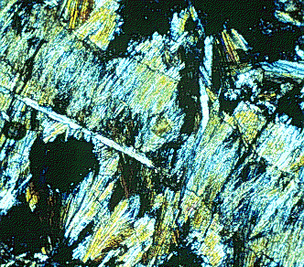
Epidote-Clinozoisite photomicrographs
Upper, CN; Lower, PP
Colorless (clinozoisite) to yellowish green (epidote) pleochroism (lower photo)
Birefringence weak in clinozoisite, to strong in epidote
Clinozoisite typically has anomalous blue interference color (upper photo)
Extinction is parallel in elongate grains
Notes:
http://www.humboldt.edu/~jdl1/web.page.images/epidote.clinozoisite1.html
Upper Photo #m_21.gif
Lower Photo #m_22.gif

Slide 10
Hornblende Hornfels
The hornblende hornfels facies is of slightly higher grade
Mafic rocks usually produce the plagioclase and hornblende assemblage
There should be no epidote or almandite
Pelitic rocks will be metamorphosed to micas, andalusite, cordierite, or sillimanite

Slide 11
Hornblende Hornfels continued
Almandite or staurolite are uncommon, kyanite is absent
Typical pressures are less than 4 kilobars, temperatures in the range 400 - 650EC

Slide 12
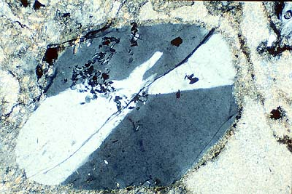
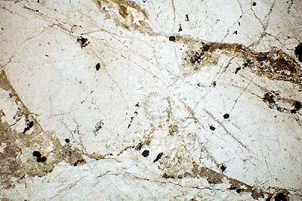
Cordierite
CN Left; PP Below
Low interference colors
(Upper) Cyclic twinning
(Lower) Sector Twinning
Photo: T. Barrett
(Right) Note lack of color and clouding which indicates that it has been altered
Notes:
http://www.science.ubc.ca/~eoswr/cgi-bin/db_gallery/searchframe.html
Upper Photo # tjb6m.jpg
Lower Photo # tjb12m.jpg

Slide 13
Hornblende Hornfels Photomicrograph
CN
Mixture of hornblende and plagioclase
Notes:
http://www.humboldt.edu/~jdl1/web.page.images/hornfels1.html
Photo #cg113.gif

Slide 14
Pyroxene Hornfels
The pyroxene hornfels facies is of distinctly higher grade
Mafic rocks will be metamorphosed to diopside, orthopyroxene (hypersthene or enstatite), and plagioclase
Amphiboles are normally absent

Slide 15
Pyroxene Hornfels Photomicrograph
CN
Plagioclase, cordierite (a few of the first order yellow grains), and biotite
Notes:
http://www.humboldt.edu/~jdl1/web.page.images/meta/contact/px.hornfels.gif
Photo #px.hornfels.gif

Slide 16
Pyroxene Hornfels
Pelitic assemblages usually are represented by the assemblage of sillimanite or andalusite, cordierite, and K-spar
Muscovite is absent, but biotite may be present in small amounts
Temperatures are in excess of 550EC
In grade, these rocks belong to the hypersthene or sillimanite hornfels

Slide 17
Andalusite Photomicrograph
Usually colorless, may be red in PP
First order gray interference colors
Typically euhedral (idioblastic) crystals
Two cleavages, with parallel or symmetrical extinction
Carbonaceous inclusions may be arranged symmetrically to form a variety called chiastolite
Common mineral in contact metamorphosed shales
Porphyroblast of andalusite, with faint dark cross of carbonaceous specks, in a fine-grained hornfels
Notes:
http://www.humboldt.edu/~jdl1/web.page.images/andalusite1.html
Photo #m_49.gif

Slide 18
Examples of Hornfels Rocks
One specimen you will examine is a cordierite hornfels, with porphyroblasts of cordierite, a magnesium aluminum silicate
Tremolite hornfels represents the hornblende hornfels facies, while enstatite almandine hornfels represents an even higher grade of metamorphism, the pyroxene hornfels facies

Slide 19
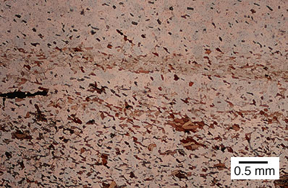
Biotite Hornfels Photomicrographs
Upper, CN; Lower, PP
The layers of biotite in this sample probably represent original sedimentary bedding
Sample #H-186
Notes:
(Upper) http://www.geolab.unc.edu/Petunia/IgMetAtlas/meta-micro/hornfels.X.html
Upper Photo #hornfels_X.jpg
(Lower) http://www.geolab.unc.edu/Petunia/IgMetAtlas/meta-micro/hornfels.UX.html
Lower Photo #hornfels_U.jpg

Slide 20
Spotted Hornfels Photomicrograph
CN
The mineral responsible for the spots is probably cordierite or andalusite
Sample #G-42
Notes:
http://www.geolab.unc.edu/Petunia/IgMetAtlas/meta-micro/spottedhornfels.X.html
Photo # spottedhornfels_X.jpg

Slide 21
Sanidinite Facies
The sanidinite facies are characterized by high-temperature feldspars, tridymite, and high-temperature lime-silicates such as spurrite and larnite
Other minerals include mullite and monticellite
Sanidinite facies rocks are often found as inclusions in lavas, where they were surrounded by molten rock
They often show evidence of melting

Slide 22
Sanidine Photo
Location: Besse en Chandesse, Puy de Dome, France
High-temperature K-spar

Slide 23
Skarn
Skarns are lime silicate rocks, which form by thermal alteration of limestone, either calcitic or dolomitic
One of the specimens you will examine is a garnet-wollastonite skarn
The garnet is andradite, a calcium-iron garnet
Most Ca-rich garnets form in calcareous rocks of either contact or regional metamorphic origin

Slide 24
Andradite Photo
Calcium-iron garnet
Location: San Benito, California
Notes:
http://cri.ensmp.fr/gm/541.html
Photo #16214.jpg

Slide 25
Skarn Mineralogy
Wollastonite is a pyroxenoid, a mineral type that is a single chain silicate, like the pyroxenes, but with a distinctly different crystal structure
The other example of skarn is cordierite-anthophyllite skarn
Cordierite is favored by low-pressure, high-temperature situations

Slide 26
Skarn Mineralogy continued
Anthophyllite is a magnesium-iron orthoamphibole
It is usually fibrous, but may be poikiloblastic
Anthophyllite is often found in Mg-rich metasomatic rocks, associated with cordierite

Slide 27
Skarn Rock Photo
Skarn rock associated with the Texada Island Mines iron/copper deposit
Dull-green mineral occurring as bands of large parallel crystals is actinolite
Also present are black magnetite and yellowish chalcopyrite, the two principle ore minerals in the deposit
Location: Texada Island Mine, coastal BC
The irregular texture seen here is typical of many skarns
Photo: Carlo Giovanella
Notes:
http://www.science.ubc.ca/~eoswr/cgi-bin/db_gallery/searchframe.html
Photo # cag173m.jpg

Slide 28
Skarn Rock Photo
Tremolite sprays in skarn Horsethief Creek contact metamorphic aureole
Photo: G.M. Dipple
Location: South eastern British Columbia
Notes:
http://www.science.ubc.ca/~eoswr/cgi-bin/db_gallery/searchframe.html
Photo # gd3m.jpg

Slide 29
Talc-Tremolite Schist
This schist contains two minerals, tremolite and talc, which are usually found in contact metamorphic rocks
Tremolite is a calcium-magnesium amphibole, and is usually fibrous or bladed
Tremolite is generally restricted to low-grade metamorphic rocks
The calcium in tremolite becomes calcite upon alteration

Slide 30
Tremolite Photomicrograph
CN
Cleavage clearly visible in grain towards upper left
Colorless to pale green in plane polarized light
Interference colors up to middle second order
Inclined extinction
Prismatic to fibrous form
Notes:
http://www.humboldt.edu/~jdl1/web.page.images/tremolite.actinolite1.html#anchor55683
Photo #m_40.gif

Slide 31
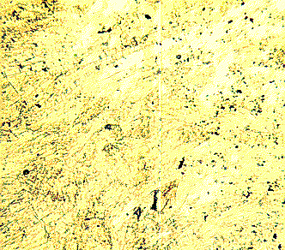
Tremolite Schist Photomicrographs
Upper, CN; Lower, PP
Tremolite schist, composed almost entirely of tremolite
Interlocking fibers of tremolite form the jade mineral, nephrite
Notes:
http://www.humboldt.edu/~jdl1/web.page.images/tremolite.actinolite1.html#anchor55683
Upper photo # b_99.gif
Lower photo #tremolite.gif

Slide 32
Talc-Tremolite Schist Photomicrograph
CN
Talc forms the fine-grained matrix between the prismatic crystals of tremolite in this rock
Note the ~120 degree cleavages in some of the tremolite sections
Notes:
http://www.geolab.unc.edu/Petunia/IgMetAtlas/meta-micro/talctremschist.X.html
Photo #talc-trem%20schist.jpg

Slide 33
Talc
Tremolite is often altered to talc, a hydrous magnesium sheet silicate
Talc is a common metamorphic product of impure dolomitic limestones
It commonly forms in shear zones and thus may form a schist

Slide 34
Dynamic Metamorphic Rocks
Dynamic metamorphic rocks do not fit well into the facies classification scheme
These rocks are intensely fractured and brecciated
They are often brittle
Predominant minerals are quartz and feldspar

Slide 35
Cataclasites
The cataclasite rocks are generally aphanetic, with no evidence of flow lines
If the rock is recrystallized it may become a blastomylonite

Slide 36
Cataclasite Photomicrograph
Strongly hematite altered shear zone
Rock appears mylonitic in outcrop, but thin section analysis reveals deformation is brittle
Therefore, rock described as a foliated cataclasite. (scale in cm)
Photo: C. Huggins
Notes:
http://www.science.ubc.ca/~eoswr/cgi-bin/db_gallery/searchframe.html
Photo #r1-32m.jpg

Slide 37
Blastomylonite in granitic gneiss
CN
This large grain is a K-feldspar porphyroclast
Unlike porphyroblasts, porphyroclasts are not grown in-situ, but rather are fragments of pre-existing minerals which were broken up during the process of metamorphism
Location: Montana
Sample #MT-34
Notes:
http://www.geolab.unc.edu/Petunia/IgMetAtlas/meta-micro/porophyroclastic.X.html
Photo #porphyroclastic_X.jpg

Slide 38
Mylonitic Rocks
Mylonitic rocks are crushed but generally show evidence of flow
The term ultramylonite is sometimes used for chert like rocks with no porphyroblasts left
They are often rich in feldspar and quartz, although these minerals cannot usually be identified
Undestroyed material may remain, and augen gneiss are sometimes produced by mylonitization

Slide 39
Mylonite Photomicrograph
CN
Location: Ragged Ridge, North Carolina
Extremely fine grain size and strong foliation in this mylonite
These features were probably caused by intense shearing
Notes:
http://www.geolab.unc.edu/Petunia/IgMetAtlas/meta-micro/mylonite.X.html
Photo # mylonite.jpg

