Slide 1
Optical Mineralogy
Lab 11 – Fall, 2018
Feldspars:
Exsolution, Zoning, and Twinning

Slide 2
Feldspars
Feldspar minerals are the most common minerals in the earth's crust
They are aluminosilicates of potassium, calcium, and sodium
The feldspars are divided into two groups, the alkali feldspars and the plagioclase feldspars

Slide 3
Plagioclase Feldspar
The plagioclase series is a solid solution series between sodium and calcium
Albite NaAlSi₃O₈
Anorthite CaAlSi₃O₈

Slide 4
Alkali Feldspar
The alkali feldspars are mainly potassium feldspar and albite
K-spar KAlSi₃O₈
There are three distinct minerals
Microcline (Low temperature)
Orthoclase
Sanidine (High temperature)

Slide 5
Ex-Solution
Albite and K-spar exhibit very limited solid solution at room temperature
If Na and K are both present in magma, the initial mineral will be a mixture of sodium and potassium but the resulting mineral will exsolve as it cools

Slide 6
Perthites
Two phases will be formed
Such mixtures are called perthites (albite or other sodic plagioclase in orthoclase) or antiperthites (microcline in plagioclase)
Notes:
Source: LECTURE-29 – Todd Dunn, Introduction to Feldspars at http://www.unb.ca/courses/geol2142/LEC-29.html

Slide 7
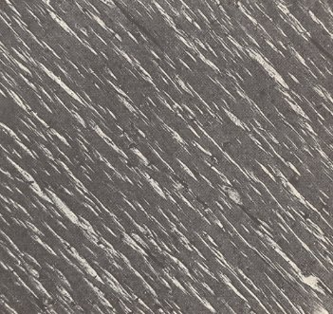
Perthite Photo
Perthite, as a result of exsolution
Microperthitic demixing of high temperature mixed crystals with chemical composition (K, Na)AlSi₃O₈ into Albite, NaAlSi₃O₈ (light) and Orthoclase, KAlSi₃O₈ (dark)
Notes:
Source: The Structure of Crystals Revisited at http://home.hetnet.nl/~heackel/crystals_rev.html

Slide 8
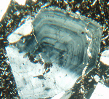
Zoning
Some plagioclase feldspars will have one composition in the interior of the crystal, and a gradually or sharply changing composition toward the outer edge of the crystal
This is called zoning
There are several types of zoning
Notes:
Source: Terms for Optical Phenomena and Properties at http://www.soils.org/divs/s9/micromorph/gloss2.html

Slide 9
Normal or Continuous Zoning
Normal zoning connotes the gradual transition during the growth of a crystal (from core to rim) to a relatively low-temperature composition in a crystalline solution series
It is the anticipated result of fractional crystallization where equilibrium has failed to keep up with falling liquidus composition

Slide 10
Discontinuous Zoning
Discontinuous zoning (example: calcic plagioclase with a narrow rim of sodic plagioclase) might occur when convection currents within magma carry a calcic crystal into a much more sodium-rich environment, from a sudden change in physical conditions, or from erosion followed by deposition

Slide 11
Reverse Zoning
Reverse zoning connotes the transition, generally abrupt, to a higher temperature outer zone in a crystal
Some hiatal event such as an addition of fresh magma to a magma chamber undergoing fractional crystallization or sudden loss of volatiles from a sub-volcanic magma chamber is responsible for reverse zoning

Slide 12
Oscillatory Zoning
Plagioclase (An₃₅₋₅₀) occurs as rectangular grains with euhedral oscillatory-zoned cores and irregular, serrate borders - Thin Section SN-3, May Lake Tonalite
Oscillatory zoning is a large number of thin shells of different compositions
Notes:
Source: Ray Joesten and Lori Dickson, PETROGRAPHY of GRANITIC ROCKS at http://www.sp.uconn.edu/~geo253vc/granodiorite.html

Slide 13
Twinning
Feldspars are either monoclinic (sanidine, orthoclase) or triclinic
Twinning, a very common phenomenon in the feldspars, varies according to the composition and the crystal system
There are at least seven different twin laws for the feldspars
Of these, only three are common

Slide 14
Carlsbad Twinning
Seen in either monoclinic or triclinic feldspars
Carlsbad twins are growth twins (that is, they form while the crystal is growing)
Carlsbad twinning is a type of penetration twinning
Carlsbad twinning is common in igneous rocks, but very rare in metamorphic rocks
They are seen as a pair of individual crystals, separated by a single line, in thin section
Notes:
Source: http://www.tulane.edu/~sanelson/eens211/twinning.htm

Slide 15
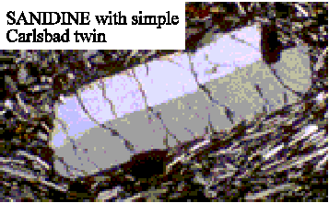
Carlsbad Twin Photo
Carlsbad twins are seen as a pair of individual crystals, separated by a single line, in thin section
Notes:
Source: Lecture-30 – Todd Dunn, Optics of Plagioclase and Alkali Feldspar at http://www.unb.ca/courses/geol2142/LEC-30.html

Slide 16
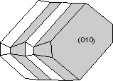
Albite Twinning
Seen only in triclinic feldspars
Albite twins may be growth, deformation, or transformation (formed when the crystal is transformed from mono- to triclinic) twins
Albite twinning is polysynthetic contact twinning
Notes:
Source: http://www.tulane.edu/~sanelson/eens211/twinning.htm

Slide 17
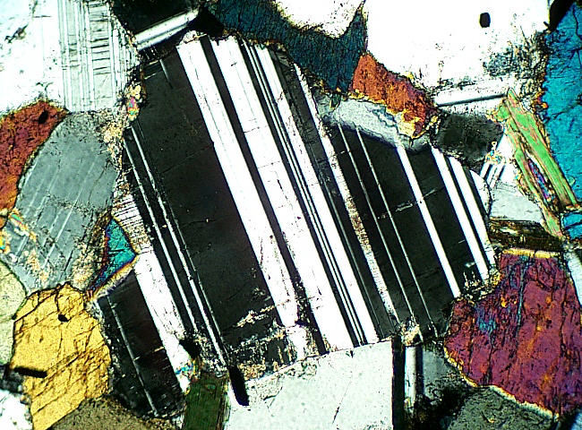
Albite Twin Photo
It is seen as numerous individual twins, parallel to each other, in thin section
The twins may be wedge-shaped (thicker at one end) if the twinning results from deformation
Plagioclase, unzoned, in a hornblende diorite
Note the strong, parallel sets of albite twins, and the less visible set of pericline twins inclined almost at right angles to the albite twins
Crossed nicols, 40x
Notes:
Source: Igneous rocks in thin section at http://www.union.edu/PUBLIC/GEODEPT/COURSES/petrology/ig_minerals.htm

Slide 18
Pericline Twining
Seen only in triclinic feldspars
Pericline twinning is quite similar to albite twinning
It may result from growth, deformation, or transformation
It is a polysynthetic contact type of twinning and shows a similar appearance to albite twinning, although with a different crystallographic orientation

Slide 19
Twin Combinations
It is also possible for crystals to exhibit compound twinning in which two twin laws are expressed simultaneously

Slide 20
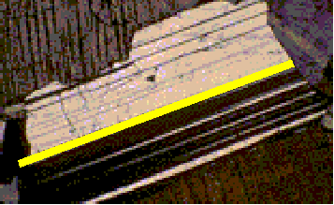
Carlsbad-Albite
The two halves of the Carlsbad twin may show albite twinning
The albite twins are oriented parallel to the Carlsbad twins
Notes:
Source: Lecture-30 – Todd Dunn, Optics of Plagioclase and Alkali Feldspar at http://www.unb.ca/courses/geol2142/LEC-30.html

Slide 21
Albite-Pericline
During transformation, both albite and pericline twins may form
The combination results in a "cross hatch" effect

Slide 22
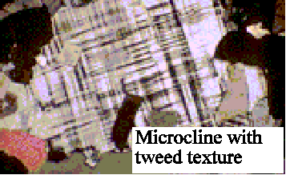
Albite-Pericline Photo
Cross hatch twinning is particularly common in microcline because microcline often forms by transformation from orthoclase
Cross hatch twinning is also called "gridiron" or “tartan” twinning
Notes:
Source: Lecture-30 – Todd Dunn, Optics of Plagioclase and Alkali Feldspar at http://www.unb.ca/courses/geol2142/LEC-30.html

Slide 23
Observation of Twinning
Twinning can be observed only under crossed-nicols (CN)
Usually low or medium power is used
The iris should be open

