Slide 1
Petrology Lecture 11
Metamorphic Facies
GLY 4310 - Spring, 2019
Notes:
Pentii Eskola first formulated the idea of metamorphic facies.
At the beginning of the twentieth century, categorization of metamorphic conditions could be done in only two ways:
1. Through the use of isograds. At that time, isograds were defined only for pelitic rocks.
2. Through "depth zones" as characterized by Grubenmann. The depth zones are the epizone, mesozone, and catazone seen earlier in conjunction with plutonic rocks. They are broad and not well-defined, and are unsuitable for metamorphic rock classification.
Eskola's work was based in part on work by Viktor Goldschmidt. Goldschmidt studied a series of contact metamorphosed hornfelses whose protoliths included pelitic, calcareous, and pssamitic rocks. This provided a considerable variation in parent rock composition, but Goldschmidt found simple mineral assemblages of six or fewer major minerals in the inner zone of aureoles around granitic intrusions around the Oslo area of Southern Norway. He noted that the equilibrium mineral assemblage was related to the bulk composition, at a particular metamorphic grade. Aluminous rocks contained minerals like cordierite, plagioclase, garnet, and/or Al₂SiO₅ polymorphs. Calcareous rocks were usually Al poor, and contained minerals like diopside, wollastonite, and/or amphiboles. He noted that pairs of minerals were consistently seen together, such as anorthite-hypersthene or diopside-andalusite.

Slide 2
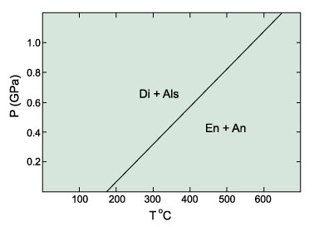
Alternative Assemblages, Oslo
MgSiO₃ + CaAl₂Si₂O₈ = CaMgSi₂O₆ + Al₂SiO₅
En + An = Di + And
If two alternative assemblages are compositionally-equivalent, we must be able to relate them by a reaction
Notes:
Goldschmidt found in the Oslo region that the left-hand pair was always stable. He felt that if equilibrium were not obtained or conditions were different, either pair, or perhaps all four minerals, might be present.
Working in the Orijärvi region of his native Finland, Eskola studied hornfelses, and confirmed Goldschmidt's idea. Eskola found a consistent relationship between mineral assemblage and chemical composition for a wide range of rocks. He found rocks at Oslo which contained K-feldspar and cordierite contained muscovite and biotite in Orijärvi.

Slide 3
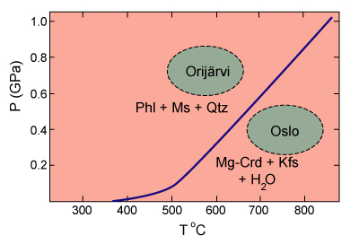
Alternative Assemblages, Orijärvi
2 KMg₃AlSi₃O₁₀(OH)₂ + 6 KAl₂AlSi₃O₁₀(OH)₂ + 15 SiO₂
Bi Mu Q
= 3 Mg₂Al₄Si₅O₁₈ + 8 KAlSi₃O₈ + 8 H₂O
Crd Ksp
Notes:
Since the Finnish assemblage is more hydrous and has less molar volume, Eskola reasoned the Finnish rocks formed at lower temperatures but higher pressure. He utilized the relationship between mineral assemblage and rock composition to formulate the facies concept.
Note the term facies is also used in sedimentary petrology, but in a different sense.

Slide 4
Metamorphic Facies Definition
Eskola (1915) developed the concept of metamorphic facies:
“In any rock or metamorphic formation which has arrived at a chemical equilibrium through metamorphism at constant temperature and pressure conditions, the mineral composition is controlled only by the chemical composition. We are led to a general conception which the writer proposes to call metamorphic facies.”
Notes:
Eskola's facies were based primarily on metamorphosed mafic rocks. Basalts are very common in orogenic belts. Metamorphic changes in basalts can be used to define broader T-P conditions than those in pelitic rocks. Facies classification thus provides a way to compare and classify metamorphic rocks on a world-wide basis.

Slide 5
Descriptive Definition of Metamorphic Facies
A metamorphic facies is a set of repeatedly associated mineral assemblages
Notes:
Finding any specified assemblage in the field tentatively assigns a metamorphic facies label. Finding a group of compatible assemblages would confirm the identification.

Slide 6
Interpretive Use of Metamorphic Facies
Eskola was aware of the P-T implications and correctly deduced the relative temperatures and pressures of facies he proposed
Advances in experimental techniques and the accumulation of experimental and thermodynamic data have allowed us to assign relatively accurate temperature and pressure limits to individual facies
Notes:
Metamorphic facies may also be used in an interpretive manner. A range of temperature and pressure is associated with each facies. Knowing the facies defines, within limits, the temperature and pressure at which the rocks formed. Despite the very limited knowledge of thermodynamic applications to geology early in the 20th century, Eskola was aware of the implications of the temperature-pressure relationships to rocks. His deduction of the relative T-P relationship [between the Finnish and Norwegian hornfelses] shows this.
Work done following Eskola's breakthrough definition of metamorphic facies has allowed us to much more accurately define the temperature and pressure ranges, and to move from relative relationships to more nearly absolute relationships.

Slide 7
Original Facies
Eskola (1920) proposed 5 original facies:
Greenschist
Amphibolite
Hornfels
Sanidinite
Eclogite
Each is easily defined on the basis of mineral assemblages that develop in mafic rocks
Notes:
Eskola's original metamorphic facies (1920) included greenschist, amphibolite, hornfels, sanidinite, and eclogite.
Since this work was based on mafic rocks, the facies he defined were heavily mafic, and the names tend to reflect this.

Slide 8
1939 Facies
In his final account, Eskola (1939) added:
Granulite
Epidote-amphibolite
Glaucophane-schist (now called Blueschist)
He changed the name of the hornfels facies to the pyroxene hornfels facies

Slide 9
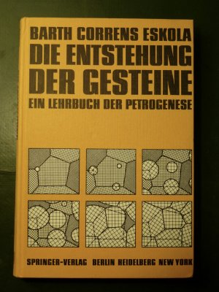
Eskola’s 1939 Facies Diagram
Fig. 25-1 The metamorphic facies proposed by Eskola and their relative temperature-pressure relationships. After Eskola (1939) Die Entstehung der Gesteine. Julius Springer. Berlin.
Notes:
His concept of the relationship between facies is shown in Figure 25-1.
Approximate translation - “The origin (creation) of rocks. A textbook of the petrogenesis”
Most recent work has seen proposals for additional facies. The work of Coombs on burial metamorphism in New Zealand, previously discussed, resulted in the suggestion to add zeolite and prehnite-pumpellyite facies. Fyfe et al. proposed the addition of albite-epidote hornfels and hornblende hornfels. Additional facies and sub-facies have been proposed. For simplicities sake, these have not been accepted for general use, although they may prove quite useful for individual investigations.
Part of the controversy over facies names results from the duel methods of defining facies. Eskola used the descriptive method based on mineral assemblages. Today's instrumentation makes possible the assignment of T-P regimes to facies with considerable precession. The biggest problem is in the area of low-pressure metamorphism. There is little difference in mafic rock facies that develop at low, medium, or even high pressure. Thus, for mafic rocks, the albite-epidote hornfels has about the same mineralogy as the greenschist facies, and the hornblende hornfels is very close to the amphibolite facies. The biggest argument for the inclusion of the low pressure facies comes from the pelitic rocks.
Garnets are common in regional metamorphic rocks (medium to high pressure) but rare in low pressure hornfels. Instead, cordierite and andalusite are common.

Slide 10
Modern Facies Diagram
Fig. 25-2. Temperature-pressure diagram showing the generally accepted limits of the various facies used in this text. Boundaries are approximate and gradational. The “typical” or average continental geotherm is from Brown and Mussett (1993). Winter (2001) An Introduction to Igneous and Metamorphic Petrology. Prentice Hall.
Notes:
The modern facies, with the controversial low-pressure facies included, are shown in Figure 25-2. All boundaries are gradational, and depend on several factors, such as rock composition and the composition of the intergranular fluid phase, which can vary from location to location. Thus, facies diagrams should be used as guidelines, not interpreted rigorously like equilibrium phase diagrams. Facies boundaries are defined by mineral reaction isograds (remember, these can be interpreted as chemical reactions). In addition, the figure shows an average continental geotherm, an elevated geotherm (30̊C/km), the Al₂SiO₅ polymorph data, and the water-saturated granitic rock melting curve.
Definitive assemblages that can be used to define facies, with mafic protoliths, are shown in Figure 25-1. Remember that a "+" sign means a mineral must be present, but a "±" sign is read as with or without, indicating a mineral's presence is optional.

Slide 11
Metamorphic Assemblages
Assemblages for mafic protoliths
Notes:
Metamorphic facies can be grouped. Yardley suggested four groups:

Slide 12
High Pressure Facies
Blueschist and eclogite facies
Low molar volume phases under conditions of high pressure
The lower-temperature blueschist facies occurs in areas of low T/P gradients, characteristically developed in subduction zones
Because eclogites are stable under normal geothermal conditions, they may develop wherever mafic magmas solidify in the deep crust or mantle (crustal chambers or dikes, sub-crustal magmatic underplates, subducted crust that is redistributed into the mantle)
Notes:
1. High pressure facies - Blueschist and eclogite. Minerals are characterized by low molar volume. Blueschist develops in areas of low T/P gradients associated with subduction zones. The term glaucophane schist facies has now largely been replaced by blueschist, despite being proposed first. The name blueschist comes from the sodic amphiboles associated with mafic blueschists. Eclogites develop in subduction zones under normal to high geothermal gradients, and also whenever mafic rocks are present in deep crust or mantle.

Slide 13
Medium Pressure Facies
Most metamorphic rocks now exposed at the surface of the Earth belong to the greenschist, amphibolite, or granulite facies
The greenschist and amphibolite facies conform to the “typical” geothermal gradient
Notes:
2. Medium pressure facies - Greenschist, amphibolite, and granulite. Greenschist and amphibolite facies are both formed under normal geothermal gradients, and are common in regional metamorphism. All three facies may be formed with an elevated geotherm. Granulite facies rocks are usually found in deeply eroded continental cratons, usually of Precambrian age.

Slide 14
Low Pressure Facies
The albite-epidote hornfels, hornblende hornfels, and pyroxene hornfels facies, contact metamorphic terranes and regional terranes with very high geothermal gradients
The sanidinite facies is rare and limited to xenoliths in mafic magmas and the innermost portions of some contact aureoles adjacent to hot mafic intrusives
Notes:
3. Low pressure facies - Albite-epidote hornfels, hornblende hornfels, pyroxene hornfels, and sanidinite. The first three are commonly developed in contact metamorphic facies, but can occur in regional rocks if the geotherm is very high. Sanidinite facies rocks are rare. They are associated with xenoliths in mafic magmas, or to the innermost parts of aureoles associated with very hot mafic or anorthosite intrusives.

Slide 15
Low Grade Facies
Rocks often fail to recrystallize thoroughly at very low grades, and equilibrium is not always attained
The zeolite and prehnite-pumpellyite facies are thus not always represented, and the greenschist facies is the lowest grade developed in many regional terranes
Notes:
4. Low grade facies - Zeolite and prehnite-pumpellyite. At low grades, equilibrium mineral assemblages often fail to develop, and recrystallization is often not complete. In many regional terranes, these facies fail to develop at all. They are most commonly seen in areas where the protolith reacts quickly, there is a high geothermal gradient, and fluids are abundant. Because of poor development, they are commonly hard to distinguish, Many petrologists refer to them collectively as sub-greenschist facies, avoiding the problem entirely.
It is not unusual to see petrologists mix different systems of classification. The isograd and facies systems may be mixed in an expression such as, "the staurolite zone of the amphibolite facies". Maps may include lines defining zones, and other defining facies boundaries.
Facies Series
Miyashiro proposed that traverses up the metamorphic grade should follow one of the metamorphic trajectories discussed earlier. If the traverse is extensive enough, it will likely cross through a series of facies. Initially, Miyashiro proposed five such series, naming most for the type locality:

Slide 16
Miyashiro’s Facies Series
(1961) initially proposed five facies series, most of them named for a specific representative “type locality” The series were:
1. Contact Facies Series (very low-P)
2. Buchan or Abukuma Facies Series (low-P regional)
3. Barrovian Facies Series (medium-P regional)
4. Sanbagawa Facies Series (high-P, moderate-T)
5. Franciscan Facies Series (high-P, low T)

Slide 17
Baric Series
Later, he reduced the number to three, which he called “Baric Series”
Low P/T
Medium P/T
High P/T

Slide 18
Miyashiro’s Baric Series
Fig. 25-3. Temperature-pressure diagram showing the three major types of metamorphic facies series proposed by Miyashiro (1973, 1994).

Slide 19
Low P/T Baric Series
The low P/T series is characteristic of high-heat-flow orogenic belts (Buchan or Ryoke-Abukuma type), rift areas, or contact metamorphism
Notes:
Characteristic series are shown on the next slide.

Slide 20
Low P/T Baric Series
The sequence of facies may be:
(zeolite facies) - (prehnite-pumpellyite facies) - greenschist facies -amphibolite facies - (granulite facies)
If protoliths are aluminous, rocks will contain cordierite and/or andalusite
Alternative sequence
(zeolite facies) - albite-epidote hornfels facies - hornblende hornfels facies - pyroxene hornfels facies
Sanidinite facies rocks are rare, requiring the transport of great heat to shallow levels

Slide 21
Baric Series
Notes:
The medium P/T series is characteristic of common orogenic belt of the Barrovian type.

Slide 22
Medium P/T Baric Series
The medium P/T series is characteristic of common orogenic belts (Barrovian type)
The sequence is
(zeolite facies) - (prehnite-pumpellyite facies) - greenschist facies -amphibolite facies - (granulite facies)

Slide 23
Medium P/T Baric Series
Crustal melting under water-saturated conditions occurs in the upper amphibolite facies (the solidus is indicated in Fig. 25-2)
The granulite facies, therefore, occurs only in water-deficient rocks, either dehydrated lower crust, or areas with high X_{CO2} in the fluid
Notes:
Since the water-saturated granite solidus is in the upper amphibolite facies, granulite facies cannot occur in water-saturated rocks.

Slide 24
Granite Solidus
Granulites are impossible in water-saturated rocks
Notes:
Granulites occur in dehydrated rocks (lower crust), or in rocks with high X_{CO2}.

Slide 25
Baric Series
Notes:
The high P/T series is characteristic of below normal geotherms, such as in subduction zones.

Slide 26
High P/T Baric Series
The high P/T series typically occurs in subduction zones where “normal” isotherms are depressed by the subduction of cool lithosphere faster than it can equilibrate thermally
Facies sequence is:
(zeolite facies) - (prehnite-pumpellyite facies) - blueschist facies - eclogite facies
Notes:
Metamorphism of Mafic Rocks
Eskola concentrated on metamorphosed mafic rocks in formulating his metamorphic facies. These include igneous rocks from basalt to andesite, gabbro, diorite, and what are commonly called immature graywackes. An immature graywacke is one that has undergone at most limited weathering. The mafic minerals have not been completely weathered out. Metamorphosed volcanics are by far the most voluminous. Collectively, the metamorphosed mafic rocks are called metabasites.
High-temperature mafic igneous rocks contain very little water. Ordinary prograde metamorphic reactions are not possible in these rocks, since they cannot be dehydrated. Indeed, without water, mafic rocks may remain unaltered while nearby sedimentary rocks are completely changed. Thus hydration is critical if these rocks are to react. If water is available, we need to consider permeability. Coarse grained rocks are usually the least permeable, and therefore the slowest to react. Tuffs and graywackes, which are permeable, will react faster. Of course, the latter rocks also have very small grain size, which facilitates reactions (higher surface area/volume ratio).

Slide 27
Hydration Reactions
Hydration reactions release large quantities of energy - in a paper by Bucher and Frey, they estimated that the following reaction would release enough energy to elevate the temperature of well-insulated rocks by 100̊C
Clinopyroxene + Plagioclase = Prehnite + Chlorite + Zeolite
Notes:
The reactants are metastable, being far from their stability fields, and the reactions will therefore go to completion even at low grades. If the temperatures are very low, kinetic barriers interfere, and reactions will stop well short of completion. Relict igneous textures are quite common under these conditions, and some phases may persist metastably.
We have learned that many mafic minerals are chemically complex, often with at least partial solid solution, or with one or more chemical substitutions possible in their formulas. Thus reactions discussed in general often vary from locality to locality, because of differences in bulk composition, relative abundances of water and carbon dioxide, and total fluid availability.

Slide 28
Petrogenetic Grids
Fig. 26.19. Simplified petrogenetic grid for metamorphosed mafic rocks showing the location of several determined univariant reactions in the CaO-MgO-Al₂O₃-SiO₂-H₂O-(Na₂O) system (“C(N)MASH”). Winter (2010) An Introduction to Igneous and Metamorphic Petrology. Prentice Hall.
Notes:
Figure 26-19 shows many of the reactions that govern metamorphism of mafic rocks.
The extensive solid solution can actually be a benefit. The diversity of mafic compositions open means fewer phases are necessary to accommodate a range of chemistries. Fewer phases, in turn, limits the number of possible reactions. Fewer reactions mean fewer isograds. Eskola chose the mafics for a reason! Fewer isograds mean broader subdivisions, and easier correlation between rocks in different localities.
The most common minerals, cpx and Ca-plag, are responsible for many of the chemical reactions observed. Ca-plag begins to break down as temperatures are lowered.

Slide 29
Alteration of Plagioclase
As temperature is lowered, the more Ca-rich plagioclases become progressively unstable
There is thus a general correlation between temperature and the maximum An-content of the stable plagioclase
At low metamorphic grades only albite (An₀₋₃) is stable
In the upper-greenschist facies oligoclase becomes stable. The An-content of plagioclase thus jumps from An₁₋₇ to An₁₇₋₂₀ (across the peristerite solvus) as grade increases
Andesine and more calcic plagioclases are stable in the upper amphibolite and granulite facies
The excess Ca and Al released may → calcite, an epidote mineral, sphene, or amphibole, etc., depending on P-T-X
Notes:
If equilibrium is maintained, there is a correlation between the An content of plagioclase and the temperature.
The lowest metamorphic grades only allow albite (An₀₋₃) to be present.
Between about An₇₋₁₇ a “peristerite” solvus appears. Thus few plagioclases have a composition within this range. Composition jumps from An₁₋₇ to An₁₇₋₂₀ (oligoclase) in upper greenschist rocks.
In the upper amphibolite to granulite facies, andesine and labradorite, or even higher plagioclase phases become stable. Microprobe analysis has made plagioclase composition determination much easier. It is possible to estimate the plagioclase composition microscopically, but the microprobe is more accurate and allows the “rim-to-rim” variation in composition to be seen. If equilibrium is truly present, the rim-to-rim variation will be zero.

Slide 30
Clinopyroxene Breakdown
Break down products include a number of mafic minerals, depending on grade
These minerals include chlorite, actinolite, hornblende, epidote, a metamorphic pyroxene, etc., and the one(s) that form are commonly diagnostic of the grade and facies
Notes:
What happens to the Ca and Al released as Ca-Plag breaks down? A variety of minerals may appear, depending on conditions. These include calcite, epidote, titanite, or an amphibole. The breakdown of cpx forms minerals like chlorite, actinolite, hornblende, epidote, or a metamorphic pyroxene (omphacite, for example). The minerals that form are a good clue to metamorphic grade.
Low Grade Mafic Assemblages -Zeolite and Prehnite-Pumpellyite Facies
Rocks in this category are usually only partly altered, and the products are extremely fine-grained, messy-looking minerals. Most workers chose to ignore them, simply calling them altered. Eskola simply wrote “formation of zeolites” in his chart. This indicated he did not believe the zeolites represented an equilibrium assemblages. Then Coombs and his collaborators examined them, and opened yet another window on previously unknown territory. They showed that zeolites and prehnite-pumpellyite facies do show systematic patterns, allowing them to be studied like any other rocks. Their chosen study area, New Zealand, has been discussed. The graywackes and tuffs were especially reactive, so the reactions went further there then in most other locations. They also found that metamorphism was related to the degree of circulating fluids, and is thus partially hydrothermal.

Slide 31
Heulandite
Growing in cavity
Notes:
Volcanic glass is altered to the zeolite heulandite, or sometimes analcime. In addition, a variety of phyllosilicates are produced, including smectite, kaolinite, montmorillonite, and celadonite. The latter mineral is a 1M polytype mica which is sea green in color, from which the name is derived (from Fr celadon, “sea green”). In addition, secondary quartz and a carbonate are common. Crystalline igneous minerals remain unaltered.
At greater depths, heulandite is replaced by laumontite, albite replaces analcime and calcitic plagioclase, and chlorite makes an appearance. Since both heulandite and analcime may form under purely diagenetic conditions, some petrologists consider the appearance of laumontite to be the true onset of metamorphism. Wairakite, another zeolite, makes an appearance at a slightly higher grade.
Prehnite and pumpellyite are stable in the upper zeolite facies. However, the laumontite eventually disappears, leaving prehnite, pumpellyite, and quartz. This marks the appearance of the prehnite-pumpellyite facies, which is stable above about 250̊C, and between 3-13 kilometers in depth. Other minerals present may include albite, chlorite, phengite (dioctahedral mica with Mg or Fe2+ replacing AL3+), titanite, lawsonite, stilpnomelane, and epidote. Many of these minerals occur in veins, amygdules, cavity fillings (especially the zeolites), and in fine grained matrix.
At the high end of the facies, prehnite may break down to yield actinolite. This has led some petrologists to create a separate pumpellyite-actinolite facies, but this is not generally accepted.

Slide 32
ACF Diagrams
ACF diagrams were first employed by Eskola in 1915. The nominal components are:
A = Al₂O₃
C = CaO, and
F = FeO + MgO
Corrected values
a = [Al₂O₃ + Fe₂O₃] - [Na₂O + K₂O]
c = [CaO] - 3.33[P₂O₅]
f = [FeO + MgO + MnO]
Where [ ] indicate molecular proportions of oxides
Notes:
However, the A value wanted is the value of excess Al₂O₃ left after allotting Na₂O and K₂O to form alkali feldspar.
The CaO value wanted is the excess CaO after allotting P₂O₅ to form apatite, assuming that any P₂O₅ in the rock will react with CaO to form apatite.
Assume then that all mineral assemblages plotted may also contain alkali feldspar and quartz (and apatite).

Slide 33
Zeolite Facies
Fig. 25-4a. ACF diagrams illustrating representative mineral assemblages for metabasites in the zeolite facies. The composition range of common mafic rocks is shaded
Hul = heulandite, Lmt = laumontie, Chl = chlorite Kln = kaolinite
Common assemblage:
chlorite + heulandite (or laumontite) + calcite +
quartz + albite
Notes:
It is possible to represent the zeolite and prehnite-pumpellyite facies on ACF ternary diagrams. Figure 25-4a and b shows such a representation. Figure 25-4a shows that a common mineral assemblage (shaded region) is
chlorite + heulandite (or laumontite) + calcite + quartz + albite
If the rocks are more aluminous, kaolinite will develop.

Slide 34
Prehnite-Pumpellyite Facies
Fig. 25-4b. ACF diagrams illustrating representative mineral assemblages for metabasites in the prehnite-pumpellyite facies. Actinolite is stable only in the upper prehnite-pumpellyite facies. The composition range of common mafic rocks is shaded
Cal = Calcite, Ttn = titanite, Act = actinolite Chl = chlorite, Prh = prehnite, Ep = epidote Zo = zoisite, Pmp = pumpellyite, Kln = kaolinite Prl = pyrophyllite
Notes:
In figure 25-4b, the tie-lines cross. Normally, crossed tie-lines represent a non-equilibrium assemblage. However, in this case, it is the result of plotting both the lower grade prehnite-pumpellyite and the higher grade pumpellyite-actinolite on the same diagram.

Slide 35
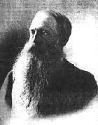
Pumpellyite
Pumpellyite, Los Arenales quarry, Mt. La Rocha de Piquer, Torás, Castellón, Valencian Community, Spain
Ca – Fe Sorosilicate
First described in 1925 for occurrences in the Calumet mine, Houghton Co., Keweenaw Peninisula, Michigan and named for American geologist, Raphael Pumpelly (1837–1923).
Raphael Pumpelly

Slide 36
Mineral Changes in Low Grade Rocks
Fig. 25-5. Typical mineral changes that take place in metabasic rocks during progressive metamorphism in the zeolite, prehnite-pumpellyite, and incipient greenschist facies.
Notes:
As rocks enter the greenschist facies, pumpellyite will disappear, and actinolite + epidote will replace it. In many locations, the sub-greenschist facies never develop. This can happen for three reasons.
1. Lack of fluids
2. Poor attainment of equilibrium at low grades
3. Presence of carbon dioxide
Medium P/T Mineral Assemblages - Greenschist, Amphibolite and Granulite Facies
Together, these facies constitute the most common facies series in regional metamorphic rock, and represent the great bulk of metamorphic rocks in general. Both the Barrovian and Buchan series are included in this facies series.
In the Scottish Highlands, the sub-greenschist facies are not present. The first evidence of metamorphism in mafic rocks occurs as greenschist facies rocks. The greenschist facies in these mafic rocks corresponds to the chlorite and biotite zones of associated pelitic rocks. The name greenschist comes from the prevalence of chlorite, actinolite, and epidote, which impart a green color to the rocks. Other minerals typically present include albite, quartz, and sometimes calcite, biotite, and stilpnomelane.

Slide 37
Greenschist Facies
Fig. 25-6. ACF diagram illustrating representative mineral assemblages for metabasites in the greenschist facies. The composition range of common mafic rocks is shaded.
The most characteristic mineral assemblage of the greenschist facies is:
chlorite + albite + epidote + actinolite ± quartz
Act = actinolite, Tlc = talc, Chl = chlorite,
Ep = epidote, Zo = zoisite, Cld = chloritiod,
Prl = pyrophyllite
Notes:
Typical metamorphic mineral assemblages of the metabasites in the greenschist facies are shown in Figure 25-6. The most common mineral assemblage of this facies is:
chlorite + albite + epidote + actinolite ± quartz
In the more Fe-Al rich Pelitic rocks of the Appalachians, chloritiod is present.

Slide 38
Greenschist to Amphibolite Facies Transition
Involves two major mineralogical changes
1. Albite → oligoclase (increased Ca-content across the peristerite gap)
2. Actinolite → hornblende (amphibole accepts increasing aluminum and alkalis at higher T)
Both transitions occur at approximately the same grade, but have different P/T slopes
Notes:
The transition from greenschist to amphibolite facies involves two major mineralogical changes.
1. Increased Ca content of plagioclase, from albite to oligoclase, across the peristerite gap
2. Transition form actinolite to hornblende. At higher temperatures, the amphibole structure is able to accommodate more aluminum and alkali ions.
The reactions that generate these changes are complex. The reaction that produces Ca-plagioclase consumes epidote. As pressure increases, the temperature for the calcic plagioclase reactions increases more than for the actinolite-hornblende reactions. In higher pressure sequences (Barrovian) hornblende appears before oligoclase, which led to the proposal for a transitional albite-epidote-amphibolite facies. In lower P/T terranes (Buchan), and in contact aureoles, the plagioclase appears first. In this case, actinolite coexists with andesine or even labradorite. In coexisting pelitic rocks, the transition to the amphibolite facies is usually in the garnet zone. (See Figure 26-19 modified)

Slide 39
Petrogenetic Grids
Fig. 26-19. Simplified petrogenetic grid for metamorphosed mafic rocks showing the location of several determined univariant reactions in the CaO-MgO-Al₂O₃-SiO₂-H₂O-(Na₂O) system (“C(N)MASH”).
Notes:
Metabasites in the amphibolite facies are characterized by the assemblage:
Hornblende + plagioclase (An_{>17}) + quartz + epidote + garnet ± clinopyroxene ± biotite
In the upper amphibolite facies, epidote disappears. The amphibolite facies corresponds to the upper garnet, staurolite, kyanite and lower sillimanite zones of associated pelitic rocks.

Slide 40
Amphibolite Facies
Fig. 25-7. ACF diagram illustrating representative mineral assemblages for metabasites in the amphibolite facies. The composition range of common mafic rocks is shaded.
Typically two-phase Hbl-Plag
Most amphibolites are thus predominantly black rocks with up to about 30% white plagioclase
Hbl = hornblende, Cum = cummingtonite, Ath = anthophyllite, Grs = grossularite, Grt = garnet, Bt = biotite
Notes:
Figure 25-7 shows a phase diagram for the amphibolite facies. The extensive solid solution of hornblende means that most rocks will plot in the two-phase hornblende-plagioclase region. Most amphibolites are thus predominantly black rocks with up to about 30% white plagioclase. (Application of the lever rule suggests that the rock is composed mainly of hornblende. Since the diagram is projected from albite, which is only a component of plagioclase, there is typically more plagioclase than is apparent from the diagram.
Changes in thin section include the changing color of hornblende, which goes from green to brown. This is due to increasing Ti content in the hornblende. In Al-Fe-rich and Ca-poor mafic rocks, pyralspite garnet appears. Pyralspite garnet is a term used to represent garnets with the composition M₃Al₂(SiO₄)₃, where M = Mg, Fe²⁺, or Mn²⁺, which includes pyrope, almandine, and spessartine, as well as intermediate forms. In Al-poor, Ca-rich ones, clinopyroxene appears. This adds either red or green, respectively, specks to the rock. Cummingtonite is present in Ca-Al poor rocks.
An unusual amphibolite facies metamorphic rock is the cordierite-anthophyllite rocks. They have high-Mg, low-Ca, unlike any known igneous or sedimentary rock. This is attributed to ocean-floor metamorphism, where circulating fluids near MOR aid the metamorphic process. Cordierite is not shown in Figure 25-7, but it is present in many amphibolite facies rocks, usually under low P but high T conditions.

Slide 41
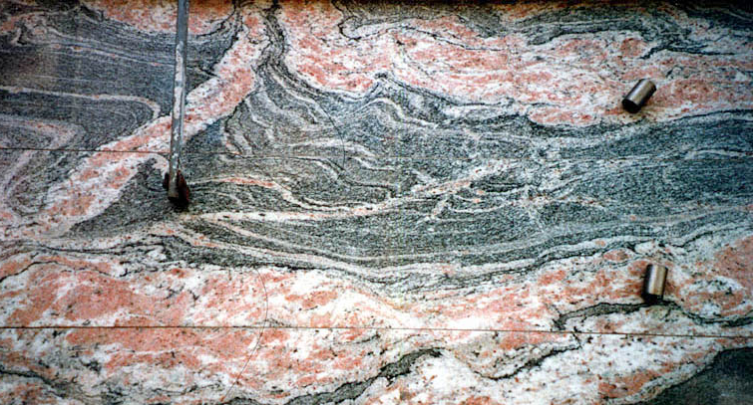
Greenschist, Amphibolite, Granulite Facies
Amphibolite → granulite facies ~ 650-700ºC
If aqueous fluid, associated pelitic and quartzo-feldspathic rocks (including granitoids) begin to melt in this range at low to medium pressures → migmatites and melts may become mobilized
As a result not all pelites and quartzo-feldspathic rocks reach the granulite facies
Notes:
The transition to the granulite facies begins between 650-800̊C. If aqueous fluids are present, pelitic and quartzo-feldspathic rocks will be above the solidus at low to medium pressure. Melting will begin. Migmatites may form. Thus, many pelites and quartzo-feldspathic rocks may not reach the granulite facies. (Roll mouse wheel to bring in picture)
In addition the fluids may mobilize. The loss of fluids depletes the rocks of water, and the resulting rocks will be sub-solidus. Thus a granulite facies may develop. In mafic rocks, melting occurs at higher temperatures, and granulite facies are more common. Hornblende begins to disappear with cpx and opx replacing it. This reaction occurs over a range of at least 50̊C.

Slide 42
Granulite Facies
Fig. 25-8. ACF diagram illustrating representative mineral assemblages for metabasites in the granulite facies. The composition range of common mafic rocks is shaded.
Common assemblage:
opx + cpx + plagioclase + quartz ± garnet
Wo = wollastonite, Aug = augite,
Grt = garnet, Crd = cordierite
Sil = sillimanite
Notes:
Granulite facies assemblages are mainly composed of anhydrous minerals. For metabasites, the type assemblage is:
opx + cpx + plagioclase + quartz ± garnet
Biotite or hornblende may be present, in minor amounts, as the only remaining hydrous phases, and only in the lower granulite facies. Basalts that have been hydrated to become greenstones, and then progressively metamorphosed to higher temperatures have returned to a mineralogy dominated by plagioclase and pyroxene. However, the texture of such metabasalts is gneissic, completely unlike the parent rock.
Figure 25-8 is a phase diagram for metabasites in the granulite facies. Pelitic rocks are also characterized by anhydrous phases at the granulite facies level. Muscovite disappears. Sillimanite, garnet, quartz, K-spar, and opx are common.
Note that the presence of a single pyroxene in an assemblage is not diagnostic of the granulite facies. In low-Al, high-Ca mafic rocks, clinopyroxene is common in amphibolite facies rocks. In high Mg-Fe metabasite, the clinoamphibole cummingtonite breaks down to orthopyroxene before the hornblende disappears, making an opx-bearing amphibolite.

Slide 43
Granulite Formation
Very hot temperatures - granulites represent temperatures in excess of 700°C, and sometimes as hot as 1000°C. Since temperatures at the depth of a granulite facies rock, with an average geotherm, should be about 500°C, they probably represent areas of crustal thickening with very high geotherms.
Granulite facies rocks are anhydrous. This allows them to reach temperatures of 1000°C without melting.
Notes:
Granulites require two conditions to form:
1. Very hot temperatures - granulites represent temperatures in excess of 700̊C, and sometimes as hot as 1000̊C. Since temperatures at the depth of a granulite facies rock, with an average geotherm, should be about 500̊C, they probably represent areas of crustal thickening with very high geotherms.
2. Granulite facies rocks are anhydrous. This allows them to reach temperatures of 1000̊C without melting.
Granulite facies rocks are stable over a range of pressures. Metabasites in low pressure environments lack any garnets.

Slide 44
Transition to Eclogite
This reaction removes plagioclase, forming garnet, and signalling the transition to eclogite
Opx + Plag = Garnet + Cpx + Qtz
4(Mg,Fe)SiO₃ + CaAl₂Si₂O₈ = (Mg,Fe)₃Al₂Si₃O₁₂ + Ca(Mg,Fe)Si₂O₆ + SiO₂
Notes:
At high pressures, garnets may be produced by the reaction:
Opx + Plag = Garnet + Cpx + Qtz
4(Mg,Fe)SiO₃ + CaAl₂Si₂O₈ = (Mg,Fe)₃Al₂Si₃O₁₂ + Ca(Mg,Fe)Si₂O₆ + SiO₂
This is a completely solid state reaction. The ΔV is large, and it is therefore quite pressure sensitive. This reaction occurs at about 1.3GPa at 800̊C, higher than the pressures shown on the petrogenetic grid diagram (Fig. 26-19). It is responsible for the disappearance of plagioclase, which marks the transition from granulite to eclogite.

Slide 45
Mineral Transformations in the Medium P/T Series
Fig. 25-9. Typical mineral changes that take place in metabasic rocks during progressive metamorphism in the medium P/T facies series
The approximate location of the pelitic zones of Barrovian metamorphism are included for comparison.
Notes:
Figure 25-9 summarizes the mineralogical changes occurring throughout the Medium P/T Series. The approximate equivalent Barrovian Zones are also shown. Keep in mind that mineral transformations are subject to variations because of compositional variations and the composition and amount of fluid present.
What is the origin of granulite facies rocks? They are relatively rare. Recent work has shed some light on their origin, and cast some doubt on old ideas. Traditionally, granulite facies terranes have been ascribed to deep burial of the roots of continental crust. The deep burial induces dehydration. Most exposed granulite facies rocks are found in deeply eroded, Precambrian rocks associated with continental shields.
In Southern Norway, CO₂ rich inclusions are present in granulite facies rocks. Associated amphibolite facies rocks are richer in water. It is possible that infiltration of carbon dioxide into the fluid phase replaces water, inhibiting melting that would normally occur in the amphibolite facies. This would preclude the necessity of removing the fluid phase entirely.
There are other differences between amphibolite facies and granulite facies rocks. Granulite facies rocks are depleted in LIL elements, as well as other incompatible elements. What causes this? One argument is that they are removed by a departing fluid phase, as the result of dehydration reactions. Another possibility is that these ions are removed by partial melting. We have already seen ample evidence that LIL and other incompatible elements are preferentially incorporated into early melts. Another suggestion that the bulk composition of the protolith is different for the granulite facies rocks than for the amphibolite facies rocks.

Slide 46
Mafic Assemblages of the Low P/T Series: Albite-Epidote Hornfels, Hornblende Hornfels, Pyroxene Hornfels, and Sanidinite Facies
Mineralogy of low-pressure metabasites not appreciably different from the med.-P facies series
Albite-epidote hornfels facies correlates with the greenschist facies into which it grades with increasing pressure
Hornblende hornfels facies correlates with the amphibolite facies, and the pyroxene hornfels and sanidinite facies correlate with the granulite facies
Notes:
We have previously seen that in mafic rocks there are few differences between the low pressure and the associated higher pressure phases.

Slide 47
Low P vs. Medium P Facies
At low pressure, the albite ➞ oligioclase precedes the actinolite ➞ hornblende transition.
The loss of albite marks the end of the albite-epidote facies and the beginning of the hornblende hornfels facies, even though hornblende may not yet be present in the very lowest grade.
Some petrologists resolve this incongruity by introducing a transitional zone, called the actinolite - calcic plagioclase zone.
However, this suggests that oligoclase is a calcic plagioclase.

Slide 48
Low P vs. Medium P Facies 2
Pyralspite garnet is rare to absent - it is a dense phase, usually seen only in higher pressure phases.
Ca-poor amphiboles are more common in low pressure phases.
Cummingtonite is an example

Slide 49
Low P vs. Medium P Facies 3
The innermost part of an aureole surrounding a granitic intrusion rarely reaches the pyroxene hornfels facies
With hot, dry intrusions higher facies develop
The following reaction, which characterizes the pyroxene hornfels facies, occurs:
Amphibole ➞ Opx + Cpx + Plag + Qtz
Sanidinite facies is not represented in mafic rocks
Notes:
Mafic Assemblages of the High P/T Series: Blueschist and Eclogite Facies
Under high pressure conditions, the mafic minerals exhibit far greater changes than felsic minerals. Subduction zone metamorphism is characterized by high P/T geothermal gradients. Since mafic minerals are common in this environment, conspicuous changes are seen. Blueschist is one example. It is an easily recognizable indicator of ancient subduction zones. Precambrian blueschists are rare. How can we interpret this?

Slide 50
Ancient blueschist?
There was no subduction before the Cambrian.
Very unlikely, since the early earth was hotter than today internally - the heat engine that drives plate tectonics should have been even more active then
Geothermal gradients were higher, and the P/T ratio would have been lower - Blueschist minerals would not be possible
Early metamorphism has been overprinted by later events, and is no longer recognizable
Notes:
Basalts which are converted to eclogites are extremely dense, denser than the surrounding mantle. They should sink. This would make the exposure of eclogites at the surface more difficult.
Some High P/T series begin with zeolite facies rocks, while others begin with blueschist. The zeolite facies, if present, is similar to that seen in the Medium P/T series. In between the zeolite and blueschist facies a transition zone usually occurs, characterized by the mineral lawsonite.

Slide 51
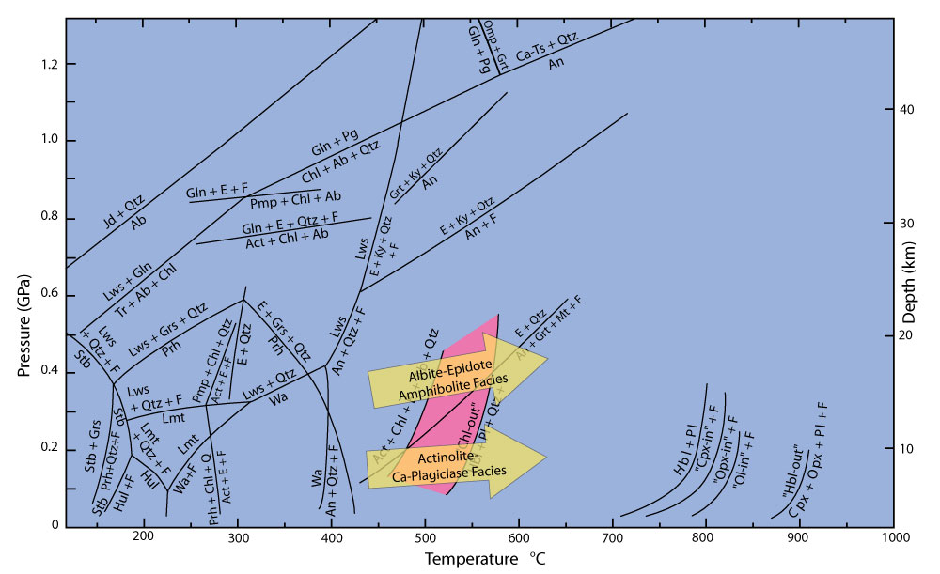
Fig. 26.19. Simplified petrogenetic grid for metamorphosed mafic rocks showing the location of several determined univariant reactions in the CaO-MgO-Al₂O₃-SiO₂-H₂O-(Na₂O) system (“C(N)MASH”). Winter (2010) An Introduction to Igneous and Metamorphic Petrology. Prentice Hall.
Notes:
Figure 26-19 shows the lawsonite reactions are pressure sensitive, occurring below 400̊C and between 0.3 to 0.6 GPa. This zone is sometimes called the lawsonite-albite-chlorite facies. Other occurrences show prehnite-pumpellyite, and sometimes greenschist, before reaching the blueschist facies.
Metabasites in the blueschist facies are characterized by the presence of a sodic, blue amphibole. Normally this is glaucophane, although some solid solution to riebeckite is possible. The characteristic assemblage is glaucophane + lawsonite. Reactions that produce glaucophane include:

Slide 52
Glaucophane Production
Tremolite+Chlorite+Albite = Glaucophane+Epidote + Quartz + H₂O
Pumpellyite + Chlorite + Albite = Glaucophane + Epidote + H₂O

Slide 53
Loss of Albite
At higher pressures, albite breaks down.
NaAlSi₃O₈ = NaAlSi₂O₆ + SiO₂
Albite = Jadeite + Quartz
Jadeite is a sodium pyroxene
Notes:
The assemblage Jadeite + Quartz is characteristic of the high pressure end of the blueschist facies. Low pressure metabasites are distinguished by glaucophane + epidote, with no jadeite or quartz. This is seen in the Sanbagawa belt in Japan.
Jadeite without quartz is stable at lower pressures, along with albite. Jadeite + albite is typical of an ultramafic, rather than a mafic, protolith. The Franciscan assemblage in California shows this assemblage.
Other common minerals seen in blueschist facies rocks include aragonite, which replaces calcite, chlorite, titanite, stilpnomelane, quartz, sericite, and pumpellyite. Paragonite, the sodium analogue of muscovite, is also common. In blueschists of pelitic origin, carpholite and chloritoid are seen. In metabasites, less common minerals include the hydrous iron silicate trio, deerite, howieite, and zussmanite.

Slide 54
Blueschist Facies
Fig. 25-10. ACF diagram illustrating representative mineral assemblages for metabasites in the blueschist facies
The composition range of common mafic rocks is shaded
Arg = aragonite, Jd = jadeite, Gln = glaucophane
Grt = garnet, Lws = Lawsonite, Ep = Epidote,
Prg = pargasite
Notes:
Figure 25-10 shows a diagram representing the blueschist facies.
The transition to the eclogite series is easily seen.

Slide 55
Characteristic Minerals of the Eclogite Facies
Garnet
Almandine Fe₃Al₂Si₃O₁₂
Grossular Ca₃Al₂Si₃O₁₂
Pyrope Mg₃Al₂Si₃O₁₂
Omphacite is a high-pressure solid solution between augite and jadeite pyroxenes
Omphacite (Ca,Na)(Mg,Fe,Al)Si₂O₆
Notes:
Plagioclase is not stable at the pressures where eclogite is formed. Albite breaks down to yield sodic amphiboles or jadeite, which is then altered to omphacite.

Slide 56
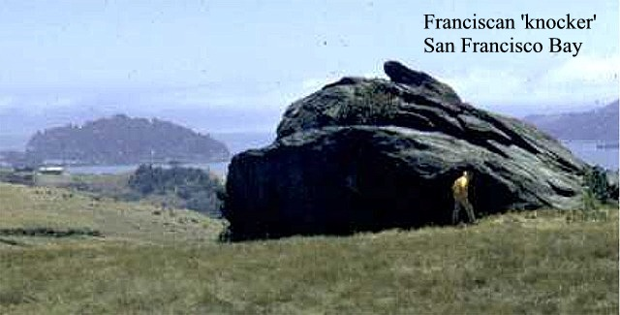
Formation of Jadeite
Glaucophane + Paragonite = Pyrope + Jadeite + Quartz + Water
Notes:
A typical reaction from the blueschist to eclogite facies is shown on the slide
This reaction requires pressures in excess of 1.2 GPa. At higher pressures, glaucophane may persist if the paragonite is exhausted.
In the field, eclogite "knockers" are easily seen as green inclusions in the blueschist. It is not unusual for eclogite and blueschist to be associated on fine scale (down to hand specimen level).
Photo: http://instruct.uwo.ca/earth-sci/200a-001/franciscphotos/francisc1.jpg

Slide 57
Eclogite Facies
Fig. 25-11. ACF diagram illustrating representative mineral assemblages for metabasites in the eclogite facies
The composition range of common mafic rocks is shaded
Wo = wollastonite, Omp = omphacite, Grs = grossularite
Prp-Alm = pyrope-almandine, Ky = kyanite
Notes:
Figure 25-11 shows the metabasites in the eclogite facies.
Transitions are also possible from the amphibolite or the granulite facies to eclogite. Here we are dealing with plagioclase with a considerable anorthite content, so the reactions are different. Plagioclase may react with amphibole, orthopyroxene, clinopyroxene, or olivine, forming products such as omphacitic clinopyroxene and either pyrope or grossular garnet. In addition, quartz and kyanite are sometimes formed. If no other reactions occur, anorthosite breaks down in the presence of water:

Slide 58
Breakdown of Anorthite
Hydrous
Anorthite + Water = Zoisite + Kyanite + Quartz
Anhydrous
Anorthite = Grossularite + Kyanite + Quartz
Notes:
It is the initial breakdown of plagioclase, via whatever reaction, that marks the transition from amphibolite or granulite to eclogite. Eclogites are found in three distinct petrologic settings. Coleman et al. first described these in 1965.

Slide 59
Coleman et al. Eclogite Description
Group A - Xenoliths in kimberlites or basalts
Group B - Bands to lens-shaped deposits in migmatitic gneisses
Group C - Bands or lens-shaped deposits in blueshist

Slide 60
Carswell Eclogite Classification
Low 450°- 550°C
Medium 550° - 900°C
High 900° - 1600°C
Notes:
Eclogites span a greater temperature range than any other facies, by far. The low temperature eclogites correlate with the Group C eclogites of Coleman. In the Western Alps, there are some eclogites associated with blueschist that correspond to higher temperatures. The blueschist-eclogite mixture is the product of tectonic disruption during subduction. These eclogites typically include other minerals such as epidote, zoisite, quartz, amphibolite, phengite, and paragonite. Garnets are restricted to less than 30% pyrope.
In Switzerland recognizable pillow basalts are metamorphosed so that the core is eclogite while the outer rim is blueschist. This proves that eclogites can be produced in near surface conditions, under extremely high pressures.
Eclogites associated with migmatitic gneisses (Group B) correspond roughly to the medium temperature group. They contain additional minerals such as quartz, kyanite, zoisite, paragonite, or Ca-amphibole. Pyrope content ranges from 30-55%. Most commonly, the surrounding rocks are amphibolite facies, but granulite, and occasionally blueschist, are possible. One hypothesis has these rocks created by thrust stacking of the crustal units so that the base of the crust is subjected to pressures > 2 GPa, and then returning to the surface. Since this corresponds to depths greater than 70 km, it represents a lot of vertical movement by crustal rocks.

Slide 61
Figure 18-8. Schematic models for the uplift and extensional collapse of orogenically thickened continental crust. Subduction leads to thickened crust by either continental collision (a1) or compression of the continental arc (a2), each with its characteristic orogenic magmatism.
Both mechanisms lead to a thickened crust, and probably thickened mechanical and thermal boundary layers (“MBL” and “TBL”) as in (b)
Notes:
The Group A (Xenoliths in kimberlites or basalts) eclogites of Coleman correspond to the high temperature Carswell classification. Typically they are subducted oceanic crust or delaminated mafic crustal underplates (Figure 18-8) that have been brought near the surface by rising magmas. Associated m
minerals are kyanite, coesite, and diamond, with pyrope content > 50%.
I-type granitoids – derived by partial melting of a mantle-derived igneous source (subcrustal underplate, or possibly subducted-slab crust or older higher level pluton)
S-type granitoids – derived by partial melting of peraluminous sedimentary source, previously weathered at the earth’s surface

Slide 62
Following the stable situation in (b), either compression ceases (c1) or the thick dense thermal boundary layer is removed by delamination or convective erosion (c2)
The result is extension and collapse of the crust, thinning of the lithosphere, and rise of hot asthenosphere (d)
The increased heat flux in (d), plus the decompression melting of the rising asthenosphere, results in bimodal post-orogenic magmatism with both mafic mantle and silicic crustal melts
Notes:
Pressure - Temperature - Time paths (P-T-t)
Previous discussions have largely ignored the factor of time. A metamorphic rock will typically be buried, metamorphosed, possibly with orogenic forces acting on it, then brought to the surface through uplift and erosion. The path that it follows is called a P-T-t path. Experimentally, there are several possible approaches to gaining information about P-T-t paths.
1. We can look for partial overprints of one mineral assemblage on another. Relict minerals may include part of the path, either prograde or retrograde. We have previously seen that equilibrium is apt to be maintained during prograde metamorphism. Relict minerals reflecting prograde metamorphism are therefore relatively common. The necessity for hydration reactions to occur during retrograde metamorphism makes the maintenance of equilibrium more difficult. Nevertheless, relict minerals reflecting retrograde paths have been observed.
2. We can apply the techniques of geothermometry and geobarometry to studies of core to rim changes in the geochemistries of individual, chemically zoned, mineral grains. Electron microprobes have greatly enhanced our ability to do this. Other techniques can be used as well. These include oxygen isotope geothermometry, data from fluid inclusions, and isotopic cooling ages, such as the ⁴⁰Ar/³⁹Ar method. All of these methods are examples of "reverse" methods. They begin with studies of the product, and attempt to determine the process that created the product. At best, they give us clues to part of the P-T-t path.
3. We can use heat-flow models to theoretically recreate complete P-T-t paths. These models are evaluated by comparison with the partial data obtained from the reverse methods.
Regional metamorphism was originally thought to be a relatively straight forward process. Rocks were buried, or were metamorphosed by burial and the heat from igneous intrusions. Plate tectonics quickly changed those ideas. We now know that crustal thickening is an important process at convergent plate boundaries. Radioactive heating is not uniform, being concentrated in felsic rocks. In addition, there is heat input at convergent boundaries during orogeny. Thus heat-flow models need to be developed for individual regimes, with differing conditions. A number of such models have been developed.
General results of the models is the requirement for higher than average heat flow in order to produce greenschist-amphibolite facies metamorphism. In addition, uplift and erosion affect the geotherm, and must be considered in complete models of metamorphism.

Slide 63
P-T-t Paths
Fig. 25-15. Schematic pressure-temperature-time paths based on heat-flow models
The Al₂SiO₅ phase diagram and two hypothetical dehydration curves are included
Facies boundaries, and facies series from Figs. 25-2 and 25-3.
Notes:
Figure 25-12 shows the modeled paths for three different types of metamorphism:
a. Orogenic belt experiencing crustal thickening
b. Shallow magmatism
c. Some types of granulite facies metamorphism
This is a schematic diagram. Numerous paths are possible. Parameters affecting the models include rates of thickening, rates of heat transfer, degree of magmatism, degree, and rate, or erosion, etc. Path "a" shows that pressure increases much more rapidly than temperature. Pressure is transmitted nearly instantaneously in rocks, but heat transfer is very slow, since silicates are good insulators. Thus thickened crustal rocks quickly approach the maximum pressure (P_{max}), while T initially goes up very little. These rocks then go through a lengthy period of increasing temperature, perhaps accompanied by a slight reduction in pressure due to erosion (negative slope beyond P_{max}). Temperature increase is due to enhanced radioactive element heating in the thicker crust, and possibly to subduction zone magmatism. One reason for the slow heat transfer is that most models allow conduction as the only heat transfer process. Fluid transfer of heat is not modeled. Finally, the cooling effects of uplift and erosion overcome the slow heating, and T_{max} is reached. The geotherm gradually returns to the normal continental geotherm. If the thickened crust is stable for a sufficient period, T_{max} will occur on a static but elevated geotherm.

Slide 64
Crustal Thickening P-T-t
Fig. 25-15a. Schematic pressure-temperature-time paths based on a crustal thickening heat-flow model
The Al₂SiO₅ phase diagram and two hypothetical dehydration curves are included
Facies boundaries, and facies series from Figs. 25-2 and 25-3
Notes:
The path “a” shown in F25-12 is characteristic of orogenic belt crustal thickening, over a considerable range of differences in input parameters. These paths are called "clockwise"paths, and are thought to be the norm for regional metamorphism.

Slide 65
Shallow Magmatism P-T-t
Fig. 25-15b. Schematic pressure-temperature-time paths based on a shallow magmatism heat-flow model
The Al₂SiO₅ phase diagram and two hypothetical dehydration curves are included
Facies boundaries, and facies series from Figs. 25-2 and 25-3
Notes:
Path "b" represents a situation in which at rock is heated and cooled under nearly isobaric conditions. The path for this rock is also clockwise, although very much flattened. Only T_{max} exists as a recognizable point on this curve, since there is so little pressure variation that a P_{max} is impossible to define. This is a possible "type" path for contact metamorphism. Many intermediate paths between this and path "a" can be imagined and constructed.

Slide 66
Zonation in Garnets
Fig. 25-16a. Chemical zoning profiles across a garnet from the Tauern Window
After Spear (1989)
Notes:
Figure 25-16a shows a conventional P-T path based on chemical zonation in garnet (Figure 25-13a) from a schist in the Tauern Window, located in the SW Alps.
Method makes the assumption that core to rim zonation is due to successive growth layers added during changing P-T conditions

Slide 67
Conventional P-T diagram
Fig. 25-16b. Conventional P-T diagram (pressure increases upward) showing three modeled “clockwise” P-T-t paths computed from the profiles using the method of Selverstone et al. (1984) J. Petrol., 25, 501-531 and Spear (1989)
After Spear (1989) Metamorphic Phase Equilibria and Pressure-Temperature-Time Paths. Mineral. Soc. Amer. Monograph 1
Notes:
Coexisting minerals include hornblende, kyanite, staurolite, biotite, chlorite, and quartz. Many regional metamorphic rocks, when they retain a record of metamorphic history, show paths similar to 25-16b, although only segments of the entire path are commonly preserved.

Slide 68
Counterclockwise P-T-t
Fig. 25-15c. Schematic pressure-temperature-time paths based on a heat-flow model for some types of granulite facies metamorphism
Facies boundaries, and facies series from Figs. 25-2 and 25-3
Notes:
Path "c"of Figure 25-12 is an example of a counterclockwise path. This is common in high-grade gneisses and granulite facies terranes. It is believed to result from the intrusion of large quantities of mafic magma into the lower to middle crust. The intrusion causes a rapid rise of both temperature and pressure below the intrusions. The high density of the mafic rock does not allow uplift. Thus rock below the intrusion cools isobarically without uplift and erosion.
Another type of granulite behavior is possible. This involves a nearly isothermal decompression, with a temperature somewhere between 550̊ - 950̊C. This may represent rapid uplift, or a collapse stage, following crustal thickening. It results in a clockwise path somewhat like "a".
Paths based on thermobarometry in granulite facies rocks are subject to difficulties. The rocks are held at high temperatures for long periods, and may re-equilibrate during cooling. We have seen before that retrograde reactions, lacking water, are often slow. When rocks are held at high temperatures for long periods retrograde reactions may be more important.
Selverstone and Chamberlain examined isobaric paths in granulite facies rocks, and suggest that they are an artifact of the core-rim thermobarometric technique, which does not agree with the record of preserved progression of overprinted mineral assemblages. They suggest caution in using these methods, especially for granulites.
Other methods, based on observed reaction rims in partial replacement textures, can be used to construct P-T-t paths based on petrogenetic grids. These methods do show both isobaric and isothermal decompression, so many petrologists think these paths are real.
Counterclockwise paths are found in settings other than the granulite facies. A study by Spear of Acadian orogeny rocks in the northeastern part of the U.S. found two different regimes. In the western part, a high-pressure (≼ 1 GPa) Barrovian trajectory shows a clockwise P-T-t path. In the eastern region, a lower-pressure (< 0.5 GPa) zone shows a Buchan trajectory, with a counterclockwise P-T-t path. The clockwise path is thought to result from crustal thickening followed by erosion and resultant cooling. The counterclockwise path is thought to result from crustal extension, which allowed many syntectonic plutons to intrude, possibly supplying enough heat to partially melt the lower crust.
The P-T-t paths shown in the diagrams are deceptive in one very important aspect. Time is not shown explicitly. The direction of movement is indicated, but the rate of progress can be quite different in different parts of the curve. For example, the progression to P_{max} in path "a" is rapid. The subsequent path to T_{max} due to erosion ("unroofing") is much slower. One study shows that one-third of the time is spent with 50̊C of T_{max}. Some petrologists therefore refer to these path simply as P-T curves.
The forward and reverse techniques agree fairly well with regard to path "a". Thus, we can try to make some inferences based on the path.

Slide 69
Inferences Based On P-T-t Paths
Contrary to the classical treatment of metamorphism, temperature and pressure do not both increase in unison as a single unified “metamorphic grade.”
Their relative magnitudes vary considerably during the process of metamorphism
Notes:
Inference 1: Pressure and temperature do not increase together. The relative changes in both quantities with time vary considerably along the path.
This differs from the conventional view of regional metamorphism.

Slide 70
P-T-t Paths
Fig. 25-15. Schematic pressure-temperature-time paths based on heat-flow models
The Al₂SiO₅ phase diagram and two hypothetical dehydration curves are included
Facies boundaries, and facies series from Figs. 25-2 and 25-3.
Notes:
2. P_{max} and T_{max} do not occur contemporaneously.

Slide 71
Inference 2
P_{max} and T_{max} do not occur at the same time
In the usual case of “clockwise” P-T-t paths, P_{max} occurs much earlier than T_{max}.
T_{max} should represent the maximum grade at which chemical equilibrium is “frozen in” and the metamorphic mineral assemblage is developed
This occurs at a pressure well below P_{max}, which is uncertain since a mineral geobarometer should record the pressure of T_{max}
“Metamorphic grade” should refer to the temperature and pressure at T_{max}, because the grade is determined via reference to the equilibrium mineral assemblage
Notes:
For clockwise paths, P_{max} precedes T_{max} by a significant time period.
T_{max} thus represents the maximum grade at which the chemical equilibrium appears to be frozen in, unless significant retrograde metamorphism occurs.
Metamorphic grade thus refers to the conditions at T_{max}.

Slide 72
Inference 3: P-T-t Paths
Fig. 25-15. Schematic pressure-temperature-time paths based on heat-flow models
The Al₂SiO₅ phase diagram and two hypothetical dehydration curves are included
Facies boundaries, and facies series from Figs. 25-2 and 25-3.
Notes:
3. The cooling uplift portion of path "a" can show significant variations. Path a₁ crosses the kyanite-sillimanite phase boundary while T is increasing, a prograde transition. When T_{max} is lower, as in path a₂, the kyanite-sillimanite boundary is crossed while T is decreasing, a retrograde transition. Since retrograde reactions are often kinetically inhibited, only minor replacement of the kyanite might occur.
If the P-T-t curve has a steeper slope than the dehydration curve, it is even possible that dehydration can occur during retrograde reactions. Since the dehydration curve has a low slope only at low pressures, this situation is confined to lower pressures.

Slide 73
Inference 4: Barrovian Trajectory P-T-t Path
Fig. 25-17. A typical Barrovian-type metamorphic field gradient and a series of metamorphic P-T-t paths for rocks found along that gradient in the field
Notes:
4. Another question that has long been debated is the relationship between spatial mineralogical changes and the temporal change in mineralogy.
Metamorphic field gradients (trajectories) are the change in P and T conditions along a traverse headed directly up metamorphic grade. Since increasing grade generally corresponds to greater depth, it has been compared to a geothermal gradient. However, geothermal gradients are vertical. The trajectory might be vertical but probably isn't in most cases. But do the temporal changes in mineralogy follow the spatial changes seen along the trajectory? Figure 25-17 helps to answer the question.
A typical Barrovian trajectory is shown. Clockwise P-T-t paths are shown for a number of rocks along the trajectory. Every rock goes through a point of considerably higher pressures and lower temperatures than the "final" conditions, those observed at T_{max}. Thus the spatial and temporal changes do not follow each other.

Slide 74
Inference 5
Implications for blueschists: most clockwise paths appear to generate blueschists in early stages, but these are not preserved, because T gradually increases to generate Med P/T at T(max) where metamorphic imprint developed
Perhaps preservation is the main reason that blueschists are relatively rare, not generation
Notes:
5. Examination of figure 25-12 for the Barrovian type "a" path shows the rocks go through the blueschist facies before finally equilibrating a lower pressure facies at a later time. This suggests that blueschist facies metamorphism is more common than generally thought, and that blueschist facies can occur during regional metamorphism. Oxburgh and Truotte proposed that progressive underthrusting occurs in the subduction zone. Slabs would successively underplate beneath the accretionary wedge. The subduction zone would move away from the arc over time. Thus rocks subjected to high P/low T conditions initially would move into medium or low P/T conditions later. Blueschist terranes with later greenschist/amphibolite overprints are known to occur in the Alps, Turkey, Greece, the Klamath mountains of NW California, the Sanbagawa belt, the Haast schists, New Caledonia, and other areas in northern Asia and China. Blueschist facies require rapid burial, followed by rapid uplift to preserve blueschist facies conditions and expose the blueschists before they have time to evolve into higher temperature regimes.
Most known blueschists do correlate well with subduction zones. Thus, even though blueschists may be generated during medium P/T conditions, they seem not to be preserved. There are two possible reasons:
1. The initial P increase shown for path "a" in Figure 25-12 is too steep, and blueschists may not really be produced.
2. Early, rapid uplift is common in subduction zones, but not in other areas. Thus blueschist preservation may be more important in determining where we see blueschists than actual blueschist generation.

Slide 75
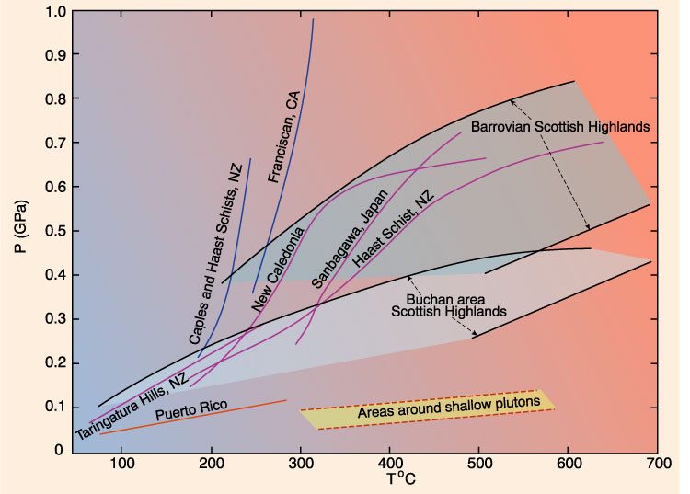
Facies Series
Fig. 21.1 A traverse up grade through a metamorphic terrane should follow one of several possible metamorphic trajectories (above) and, if extensive enough, cross through a sequence of facies

Slide 76
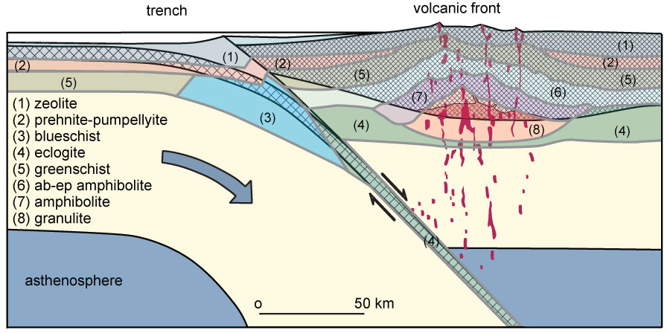
Metamorphic Facies
Figure 25.4. Schematic cross-section of an island arc illustrating isotherm depression along the outer belt and elevation along the inner axis of the volcanic arc. The high P/T facies series typically develops along the outer paired belt and the medium or low P/T series develop along the inner belt, depending on subduction rate, age of arc and subducted lithosphere, etc. From Ernst (1976).
Notes:
The diagram shows a cross-section of a Benioff zone, indicating where the various types of metamorphic rocks might be found.

