Slide 1
Petrology Lecture 9
Introduction to Metamorphism
GLY 4310 - Spring, 2019
Notes:
Chemical systems attempt to equilibrate with the conditions they are currently under. A system at high temperature is often at equilibrium. If conditions change, the system will attempt to change to match the new conditions. Solid rock generated at depth may be brought toward the surface by orogenic or diapiric uplift, accompanied by erosion.
Changes occur in the uplifted rock. If gabbro is exposed at the surface, mafic minerals weather to yield oxides, serpentine, etc. and the feldspars alter to become clays.
The conditions under which the gabbro was generated and the weathering conditions at the surface represent opposite extremes, separated by 1000̊C and similar large differences in pressure, oxygen fugacity, and presence of water. In between the extremes lies the realm of metamorphism.

Slide 2
Metamorphism Definition
“The mineralogical, chemical, and structural adjustment of solid rocks to physical and chemical conditions which differ from the conditions under which the rocks in question originated” (from the Glossary of geology, 2nd edition)
Notes:
The term metamorphism refers to, “The mineralogical, chemical, and structural adjustment of solid rocks to physical and chemical conditions which differ from the conditions under which the rocks in question originated. (Glossary of geology, 2nd edition) It comes from a Greek word, meta morph, meaning change of form.
In biology it is used to denote events like the change of a caterpillar to a butterfly. The changes in petrology occur between those of weathering, cementation, and diagenesis and melting. Diagenesis refers to all the processes that a sediment undergoes during lithification in near-surface environments.
But the processes occurring during metamorphism have many similarities to those that occur during diagenesis. Thus, metamorphic changes are usually defined in a negative sense - all those not included in zones of weathering or diagenesis. This does not always lead to a clear separation. Notable problems:
Zeolites - these open framework silicates often are generated in low-temperature diagenetic environments. They are also the product of environments in which recrystallization has clearly occurred.
Alkali feldspars - These minerals are essentially high-temperature, but can be produced by the action of some liquids in diagenetic environments.
Protolith - The term refers to the starting material from which a reaction or recrystallization begins from. Amorphous materials such as glass, or volcanic ash, organic matter, and evaporite minerals react much faster and at lower temperatures than most silicate or carbonate minerals.
Since some standards must be established, the IUGS formed a Subcommission on the Systematics of Metamorphic Rocks (SCMR). The SCMR, a branch of the IUGS Commission on the Systematics in Petrology (CSP), was initiated in 1985. The Subcommission originally comprised 33 members, 11 Study Groups, and a Working Group of around 100 earth scientists spread worldwide. The recommendations and glossary of the SCMR were published in August 2007 by Cambridge University Press (CUP) with the title is 'Metamorphic Rocks: A Classification and Glossary of Terms',
Where does metamorphism begin? In Hyndman’s original book, he stated the minimum temperature at 300̊C, occasionally lower. Winter suggests a temperature range of 100-150̊C for unstable protoliths. This is more in line with what is seen in rocks. A better limit might be above the boiling point of water under ambient conditions.

Slide 3
Metamorphism Definition, revised
“The mineralogical, chemical, and structural adjustment of solid rocks to physical and chemical conditions that have generally been imposed at depth, below the surface zones of weathering and cementation, and different from which the rocks in question originated.” (from the Glossary of geology, 5th edition)
Notes:
The portion in red was added

Slide 4
Onset of Metamorphism
Minerals used to characterize the onset of metamorphism include:
Analcime, carpholite, glaucophane, heulandite, laumontite, lawsonite, paragonite, prehnite, pumpellyite, and stilpnomelane
Notes:
Minerals used to characterize the onset of metamorphism include:
Analcime, carpholite, glaucophane, heulandite, laumontite, lawsonite, paragonite, prehnite, pumpellyite, and stilpnomelane.
The high temperature boundary also has problems. We have seen that granitic melts may begin to melt as low as 600̊C, but that melting is limited by low volatile content, and may extend over hundreds of degrees. The melt itself is igneous, but what is the residuum? When it is the majority, it seems appropriate to call it metamorphic. What about when the residuum is a few percent of the original rock? Natural boundaries are vague, and petrologists must be prepared to deal with these vague boundaries. Labels such as igneous or metamorphic petrologist often necessarily blend together.
Pressure limits are also somewhat vague. Under low pressure conditions, metamorphism may require quite high temperatures, seen only in regions of very high geothermal gradients. Such gradients may exist near the contacts with igneous intrusions, but seldom elsewhere. Truly high-pressure rocks from the earth’s lower mantle or inner core might be considered metamorphic, but they never reach the surface, and we therefore don’t deal with them. Kimberlite xenoliths indicate pressures of >4 GPa (>120Km), and are considered metamorphic. Mantle samples are also found in ophiolite sequences. With these exceptions, most rocks are crustal. The upper limit for pressure is thus about 3 GPa, usually lower.
With these ideas in mind, the SCMR has proposed the following definition of metamorphism:

Slide 5
SCMR Definition of Metamorphism
The Subcommission on the Systematics of Metamorphic Rocks has proposed the following definition:
Metamorphism is a subsolidus process leading to changes in mineralogy and/or texture (for example grain size) and often in chemical composition in a rock. These changes are due to physical and/or chemical conditions that differ from those normally occurring at the surface of planets and in zones of concentration and diagenesis below the surface. They may coexist with partial melting.
Notes:
Generally the study of coal, petroleum, and ore deposits are excluded from petrology. Anthracite, the highest grade of coal, is regarded as metamorphic. Many ore formation processes involve metamorphic reactions. The exclusion is based solely on the perceived need to have specialists in these subjects.
Agents of Metamorphism
Any change in the physical or chemical state of a rock can potentially lead to metamorphism. Several “agents”, or types of change are commonly recognized. These may act independently, but are often observed to act in combination. These are covered in the lab lecture for lecture 9. They will be examined further here.

Slide 6
Oceanic and Continental Geotherms
Figure 1.9. Estimated ranges of oceanic and continental steady-state geotherms to a depth of 100 km using upper and lower limits based on heat flows measured near the surface. After Sclater et al. (1980), Earth. Rev. Geophys. Space Sci., 18, 269-311.
Notes:
Temperature
Metamorphism Introduction, slide 5 here
Changes in temperature commonly contribute to metamorphic changes. Figure 1-9 shows the ordinary oceanic and continental geotherms. The boundary lines shown, between 10-40 kms, represent mid to lower continental crust. The continental geotherm is considerably higher, due to LIL elements, which concentrate in continental crust and generate significant heat.
Increased heat promotes recrystallization, especially:
1. When the rocks are fine-grained, because these have much higher area/volume ratios, and reactions occur on surfaces.
2. When the environment is static. Shear stresses typically reduce grain sizes.
The process of converting smaller grains to fewer, larger grains of the same type is annealing, often observed in metals and ceramics when these materials are held at high temperatures.
Increased heat may also take a mineral beyond its natural limit of stability. This results in a reaction or reactions that consume the mineral, forming a new stable phase. Kinetic barriers can and do impede this process, sometimes precluding it from occurring until very much higher temperatures are reached. Some substances, known as mineralizers (effectively catalysts) reduce the kinetic barriers. Fluoride ion is a very effective mineralizer, and water and carbon dioxide may play the same role, The types of reactions which may occur include:
1. Devolatilization reactions - This may include dehydration or decarbonation, as water or carbon dioxide molecules break bonds at increasing temperatures. Volatile-bearing minerals must be in the original assemblage for these reactions to occur. The higher the volatile content, the more likely these reactions are to occur. Minerals such as clays, zeolites, chlorites, and serpentines form at low temperature, and there very volatile rich character makes them targets for diagenetic and low-temperature metamorphic reactions.
2. Crystallization reactions - These include the formation of new minerals, as well as the recrystallization of existing minerals. The term neocrystallization is sometimes used to specify that new minerals are being formed.
3. Kinetic barrier - As temperatures are raised, kinetic barriers that may preclude some reactions form occurring may be overcome. These barriers prevent the attainment of equilibrium at lower temperatures, but elevated temperatures allow the rocks to equilibrate.
Pressure
Since most rocks are metamorphosed at regions within the earth where temperatures are higher, pressure has also necessarily increased. Such pressure is variously known as lithostatic, confining, or load pressure. Most rocks will find themselves under conditions represented by the geothermal gradients curves of figure 1-9. Perturbations of the geothermal gradient can and do occur:
Lower than average - Within a subducting plate
Higher than average - Above a hot spot, near an igneous intrusion, unusual radioactive concentrations, near zones of crustal thickening or extension
Most perturbations are transient phenomena, and the effects will diminish as the perturbations disappears.
Examination of old orogenic belts can yield useful information about the pressure temperature relationships that have occurred under different conditions.

Slide 7
Metamorphic Trajectories
Figure 21-1. Metamorphic field gradients (estimated P-T conditions along surface traverses directly up metamorphic grade) for several metamorphic areas. After Turner (1981). Metamorphic Petrology: Mineralogical, Field, and Tectonic Aspects. McGraw-Hill.
Notes:
Figure 21-1 shows a plot of data from studies that have been done. Typically these data are generated by traversing a metamorphic outcrop from the lowest toward the highest grade of metamorphism. Highest grade conditions are usually at the greatest depths. However, the traverses rarely represent a true vertical cross-section, and are thus not representative of the exact geothermal gradient. Post-metamorphic uplift and erosion are uneven, accounting for many of the problems observed. The metamorphic field gradients, aka metamorphic trajectories or arrays, give us the best estimate we have of the true geothermal gradient at the time of metamorphism. Actual trajectories may vary across an orogen, increasing toward the point where heat and plutonism were highest.
Minerals have stability limits for pressure as well as temperature. Increasing pressure may cause the disappearance of a mineral, replacing it with a new phase. The different trajectories seen in Figure 21-1 may thus show quite different replacement patterns. For example, the Franciscan path is nearly vertical, indicating rapid change in pressure with little increase in temperature. The various trajectories for Scottish rocks show a much higher rate of temperature change, often with modest pressure increases.
The term “metamorphic grade” is often used to express the degree of metamorphism. Generally more attention is paid to temperature than pressure in determining metamorphic grade. If we accept the role of pressure as being subsidiary to temperature, than pressure can be a modifier. When pressures are low, less dense phases will form, whereas high pressures favor denser minerals.

Slide 8
Pressure Types
Lithostatic pressure - uniform stress (hydrostatic)
Deviatoric stress = pressure unequal in different directions
Resolved into three mutually perpendicular stress (σ) components:
σ₁ is the maximum principal stress
σ₂ is an intermediate principal stress
σ₃ is the minimum principal stress
In hydrostatic situations all three are equal
Notes:
(Roll mouse) The type of pressure is also important. Lithostatic pressure is equal in all directions. Tectonic pressures are usually directed along an axis. When this occurs, ductile flow usually occurs in a way that reduces the effect of the imposed pressure. (Le Châtlier again) This happens whenever the imposed pressure differential exceeds the strength of the rock. This happens below a relatively shallow depth. Above this depth, the rocks behave in a brittle manner, fracturing and then moving along the fracture (= faulting).
Deviatoric Stress (roll mouse)
Deformation, common in metamorphic rocks, is seen only when pressure is unequal in different directions. Lithostatic pressure, which is uniform (equal in all directions), can produce only equal contraction, not deformation. Deviatoric stress (unequal in different directions) is produced by tectonic forces. Three dimensional vectors (such as force) can be resolved into three principal components. The stress tensor can be resolved into three principal components, as follows:
(roll mouse - 3 times)
σ₁ is the maximum principal stress
σ₂ is the intermediate principal stress
σ₃ is the minimum principal stress
(roll mouse) For uniform stress, σ₁ = σ₂ = σ₃. Stress will be maintained as long as differential pressure is applied, and keeps pace with the rocks ability to yield. Examples include orogenic belts, extending rifts, and shear zones. The yielding by the rock is deformation, aka strain. Stress is force/unit area, and the deformational response is strain.

Slide 9
Deviatoric Stress Effect
Notes:
Deviatoric stress affects the textures and structures, but not the equilibrium mineral assemblage
Strain energy may overcome kinetic barriers to reactions

Slide 10
Deviatoric Stress: Tension
Figure 21-2. The three main types of deviatoric stress with an example of possible resulting structures. a. Tension, in which one stress in negative. “Tension fractures” may open normal to the extension direction and become filled with mineral precipitates. Winter (2001) An Introduction to Igneous and Metamorphic Petrology. Prentice Hall.
Notes:
There are three types of stress:
Tension - Forces pull an object apart, and the resulting strain is extension. σ₁ and σ₂ positive, but σ₃ is negative (See Figure 21-2a). This often results in tension fractures. These fractures allow metamorphic fluids to circulate, and may be filled by minerals precipitated from solution.

Slide 11
Deviatoric Stress: Compression
Figure 21-2. The three main types of deviatoric stress with an example of possible resulting structures. b. Compression, causing flattening or folding. Winter (2001) An Introduction to Igneous and Metamorphic Petrology. Prentice Hall.
Notes:
Compression - Forces directed along a single axis toward a common center. σ₁ is dominant, with little contribution from σ₂ or σ₃. The response to compression may be folding, which shortens the object in the direction of applied stress (σ₂ ≠ σ₃), or flattening (σ₂ ≈ σ₃) (see Figure 21-2b). Platy or elongated minerals may be rotated during either folding or flattening.

Slide 12
Flattening
σ₁ > σ₂ = σ₃ → foliation and no lineation
σ₁ = σ₂ > σ₃ → lineation and no foliation
σ₁ > σ₂ > σ₃ → both foliation and lineation
Figure 21-3. Flattening of a ductile homogeneous sphere (a) containing randomly oriented flat disks or flakes. In (b), the matrix flows with progressive flattening, and the flakes are rotated toward parallelism normal to the predominant stress. Winter (2001) An Introduction to Igneous and Metamorphic Petrology. Prentice Hall.
Notes:
Figure 21-3b shows the flattening of a sphere into an ellipsoid (actually, the strain ellipsoid) Rigid minerals have rotated to be perpendicular to the applied stress.
We can easily observe the orientation of minerals after deformation, but have no means of judging the shape deformation, since we don’t know the original shape. Thus, observation of foliation is extremely important. Working with oriented samples, we can estimate the directions of the principle stress components. With large scale deformation, field evidence will usually have already given us this information. For small scale deformation, the petrologic examinations may provide crucial input. New minerals may also grow during deformation, and will tend to grow ⊥ σ₁ . Whether by rotation or flattening, this leads to metamorphic foliation, which may be schistosity, gneissosity, or rock cleavage.
Compression in two directions simultaneously is also possible. In this case, σ₁ ≈σ₂ > σ₃ and the resulting strain ellipsoid will be elongated, but roughly circular in cross-section perpendicular to the direction of elongation (think of a salami). Elongated and platy minerals will rotate so that their long axis is parallel to the axis of elongation. This produces lineation. Another possibility is that σ₁ > σ₂ > σ₃. In this case, the strain ellipsoid is elongated in two directions, one greater than the other, rather like a bar of soap. Both foliation (of platy minerals) and lineation (of elongated minerals) will occur. The platy minerals will be perpendicular to the σ₁ and σ₂ axis. The elongated minerals will be perpendicular to σ₁.
Another response to stress of the compressive type is shear. Shear results from movement along a plane or set of planes at an angle to σ₁. This may produce a strain ellipsoid identical to that produced by flattening. In structural geology, flattening is referred to as pure shear (Figure 21-3b),

Slide 13
Deviatoric Stress: Shear
Figure 21-2. The three main types of deviatoric stress with an example of possible resulting structures. b. Shear, causing slip along parallel planes and rotation. Winter (2001) An Introduction to Igneous and Metamorphic Petrology. Prentice Hall.
Notes:
whereas the movement along planes is called simple shear (Figure 21-2c). Pure shear results in foliation ⊥ to the short axis of deformation, while in simple shear the foliation is not orthogonal to the shortest axis of deformation.
Metamorphic Fluids
Many metamorphic reactions release fluids, and their may have been a fluid phase associated with the parent rock. Fluid refers to either liquid or gas. Indeed, at low pressures the fluid may be either liquid, gas, or both. For water, above the critical point, the liquid and gas phases merge into a single fluid phase.

Slide 14
Phase Diagram for Water
Fig. 6-7. After Bridgman (1911) Proc. Amer. Acad. Arts and Sci., 5, 441-513; (1936) J. Chem. Phys., 3, 597-605; (1937) J. Chem. Phys., 5, 964-966.
Notes:
(See Figure 6-7) Since many metamorphic reactions occur at conditions above the critical point (374̊C, 21.8 MPa in pure water), they may only be a single phase present, called a super-critical fluid. If electrolytes or other dissolved fluids (CO₂) are present in the water, the position of the critical point is elevated to higher temperatures and pressures.
Direct evidence for the existence and composition of the fluid phase is difficult to obtain. As the rocks are brought to the surface, fluids escape. Sometimes there may be fluid inclusions within mineral grains. Careful study of the fluids will give some indication of composition, but under much lower T and P conditions than the original fluids were at. If the fluid inclusions occur as planar arrays, chances are they are post-metamorphic fluids they have entered the rock along cracks, and then have been trapped. Theoretical evidence for fluid phases comes from the mineral assemblages themselves, since many would not be stable in the absence of any fluids.
At shallow depths, the fluid phase extends continuously to the surface. Lithostatic pressures will be = ρgh. The fluids, in contact with the surface, will also experience a pressure of ρgh. But the two are not equal. For lithostatic pressure ρ = ρ_{mineral}. For water, ρ = ρ_{water}. Since ρ_{water} < ρ_{mineral}, P_{fluid} < P_{lith}. The presence of impervious sedimentary caprock may increase P_{fluid}, but it is still less than P_{lith}.

Slide 15
Collapse
Figure 21-4. A situation in which lithostatic pressure (P_{lith}) exerted by the mineral grains is greater than the intergranular fluid pressure (P_{fluid}). At a depth around 10 km (or T around 300ºC) minerals begin to yield or dissolve at the contact points and shift toward or precipitate in the fluid-filled areas, allowing the rock to compress. The decreased volume of the pore spaces will raise P_{fluid} until it equals P_{lith}. Winter (2001) An Introduction to Igneous and Metamorphic Petrology. Prentice Hall.
Notes:
Below a certain depth, around 10 km, the pressure at the point of mineral contact, P_{lith}, will be very much greater then the pressure exerted by the intergranular fluids on the minerals (see Figure 21-4). One of two things happens:
1. The mineral grains deform, and compress the pore space until P_{fluid} = P_{lith}.
2. Pressure Solution occurs. Minerals at the stressed contacts between grains have a higher free energy than adjacent grains not in contact. They may dissolve and be reprecipitated in the pore space. This lowers the overall free energy of the system, and also allows the grains to move closer together, as well as filling the pore spaces. This continues until P_{fluid} = P_{lith}.
Most intergranular fluids are water. Carbon dioxide may also be present, and methane is sometimes present, depending on whether the system is oxidizing or reducing. Other possible species include S gases and N₂. Dissolved species include alkalis and halides. The presence of multi component fluid phases may be handled on the basis of pressure,

Slide 16
Multi-Component Fluid Phases
P_{fluid} = P_{H2O} + P_{CO2} + .....
X_{H2O} + X_{CO2} + ..... = 1.0
P_{H2O} = X_{H2O} • P_{fluid}
Notes:
P_{fluid} = P_{H2O} + P_{CO2} + .....
or from a mole fraction viewpoint, where the sum of the mole fractions total 1,
X_{H2O} + X_{CO2} + ..... = 1.0
The two are related:
P_{H2O} = X_{H2O} • P_{fluid}
There are a variety of potential fluid sources. These include:

Slide 17
Potential Fluid Sources
1. Meteoritic water
2. Juvenile Water
3. Water associated with subducted material
4. Sedimentary brines
5. Water from metamorphic dehydration reactions
6. Degassing of the mantle
Notes:
Metamorphic fluids are hot and under pressure. They are capable of considerable dissolution, followed by transport. A similar situation exists with waters released from plutonic intrusions into sedimentary country rock. These fluids may exchange substances with the material through which they pass. This process is known as metasomatism. Analysis of many metamorphic rocks shows that most metamorphic reactions are essentially isochemical (no addition or removal of atoms). However, limitations on measurements of fluid phase movements mean we ignore the introduction or removal of atoms by fluid phases. Since metasomatism involves considerable exchange, there is a gap between the terms isochemical and metasomatic, with no adequate terminology to describe intermediate stages. Metamorphic reactions often involve gradients in T and P. To that, we should add metasomatic (chemical) gradients.

Slide 18
IUGS-SCMR Classification of Metamorphic Rocks
Contact Metamorphism
Pyrometamorphism
Regional Metamorphism
Orogenic Metamorphism
Burial Metamorphism
Ocean Floor Metamorphism
Hydrothermal Metamorphism
Fault-Zone Metamorphism
Impact or Shock Metamorphism
Notes:
Types of Metamorphism
The IUGS-SCMR has recommended the following classification for metamorphic rocks. (above)
Contact Metamorphism
Agents: Heat from igneous intrusion, possible metasomatic intrusion
Location: Anywhere an intrusion occurs, over a wide range of depth (pressure) - effects are greatest in shallow intrusions because country rock is much colder than the intrusion

Slide 19
Contact Metamorphism
Heat from the lava flow above baked sediments
into a red shale in a narrow zone along the contact
Notes:
A contact aureole typically surrounds the intrusion. Epizonic plutons have relatively narrow aureoles, because heat is rapidly lost into the cold country rock. Mesozonic aureoles are wider, but the country rocks are likely to be metamorphic, and the effects are harder to observe. In catazonic plutons, the country rocks are already so hot that contact metamorphic effects are often insignificant.

Slide 20
Temperature Distributions Within a Dike
Figure 21-5. Temperature distribution within a 1-km thick vertical dike and in the country rocks (initially at 0ºC) as a function of time. Curves are labeled in years. The model assumes an initial intrusion temperature of 1200ºC and cooling by conduction only. After Jaeger, (1968) Cooling and solidification of igneous rocks. In H. H. Hess and A. Poldervaart (eds.), Basalts, vol. 2. John Wiley & Sons. New York, pp. 503-536.
Notes:
Figure 21-5 shows a model by J.C. Jaeger on the thermal effects of a dike emplaced at 1200̊C into country rocks at 0̊C. One kilometer from the intrusion, temperatures are raised 200̊C, but only after several thousand years. Once raised to this temperature, it maintains the temperature for a million years or more. The exact effects depend on the volume of the intrusion, the shape of the intrusion, the orientation of the intruding body, and the initial difference in temperature. Batholiths may have contact aureoles stretching for several kilometers, but for small dikes the effects reach only centimeters or even millimeters.
If the country rock is permeable and fluids are available, fluids will cool the intrusion quicker, and will heat the country rock faster and at a greater distance from the contact. Metasomatism plays the greatest role when the composition of the country rock is substantially different from that of the magma, especially when the country rock is carbonate-rich. The hot acidic waters react with carbonates to produce rocks known as skarns or tactites. The fluid source, as determined by oxygen isotope data, is usually meteoritic, but some may be juvenile.
In shallow, low-pressure environments, the effects of contact metamorphism are most evident. There is typically low to very low deviatoric stress, and the rocks are not foliated. A typical texture is that of hornfels or granofels. Relict structures are preserved.

Slide 21
Hornfels
Pinkish upper layer is Shap Granite, which intruded as hot magma into the surrounding rocks around 400 million years ago.
Heat from the magma intrusion has “baked” the darker rock (which was originally mudstone), causing it to re-crystallize in a new form – a hard, flinty-looking metamorphic rock called hornfels.
Notes:
Photo: http://www.geolsoc.org.uk/gsl/cache/offonce/education/rockcycle/pid/3507%3Bjsessionid=8D97E3F825F81A4ADCE223DEE5132BD0
Hornfels - A fine-grained granofels, characteristic of contact metamorphic aureoles.
Granofels - A texture characterized by a lack of preferred orientation, aka isotropic texture.
Many times plutonism accompanies orogeny. Contact metamorphic effects occur in conjunction with orogenic metamorphism. The contact metamorphism overprints the regional metamorphism, especially in shallow, low-grade environments. Spotted slates or phyllites are an example of this. The slate or phyllite is produced during orogenic metamorphism. Later, some grains of the rock begin to grow as the result of reheating by the contact event.
Pyrometamorphism is a very high temperature type of contact metamorphism. Xenoliths which fall into magma chambers may be rapidly heated, and show substantial alteration. Wall rocks in or near volcanic necks are another example. Partial melting of country rock is common.
Regional Metamorphism
Any metamorphic event that effects a large body of rock and has a lateral extent of tens of kilometers may be considered to be regional. We may separate these rocks into three subcategories,
Orogenic Metamorphism
Agents: Dynamo-thermal - Deviatoric stress produced by plate collision, along with elevated geothermal gradients.
Location: Island arcs, continental arcs, and continental collision zones all fall into this category.
Convergent plate margins exert substantial deviatoric stress on rocks at the boundary. Many of the studies of regional metamorphism focus on orogenic belts, so the terms orogenic and regional are sometimes regarded as synonymous. Affected rocks are normally foliated, ranging from slate through gneiss.

Slide 22
Continental Arc Orogen
Figure 21-6. Schematic model for the sequential (a → c) development of a “Cordilleran-type” or active continental margin orogen. The dashed and black layers on the right represent the basaltic and gabbroic layers of the oceanic crust. From Dewey and Bird (1970) J. Geophys. Res., 75, 2625-2647; and Miyashiro et al. (1979) Orogeny. John Wiley & Sons.
Notes:
An example of a continental-arc orogen is shown in Figure 21-6. The incipient induction is shown is figure 21-6a. Beneath the developing trench, tectonic pressures will be quite high, resulting in high-pressure metamorphism. Part b shows the development of an orogenic welt, caused by crumpling within the continental plate. The crust will thicken due to compression, tectonic underplating, and magmatic underplating. Tectonic underplating refers to a trench-ward migration of the underthrusting by the oceanic plate, leaving accumulating slabs of oceanic crust on the welt. Magmatic underplating occurs when mantle-derived melts stall and accumulate at the base of the crust. This adds heat to the welt from below by magmatic underplating, rising plutons, and induced mantle convection above the subducted slab. In addition, the thickened crust generates more radioactive heat. Temperature is greatest at the center of the welt, and increases downward toward the plutons. Metamorphism is extensive. Partial melting may occur. The resulting structures are described as gneiss domes or even metamorphic core complexes. The Adirondack Mountains in New York state are a classic example.
Uplift of the welt and the inevitable erosion exposes the metamorphic rocks. The rocks remain hot for a considerable period, and metamorphism continues. This tends to make the metamorphic pattern a simple concentric dome, although the structural pattern that accompanies the metamorphism may be complex. Many orogenic episodes produce repeated episodes of deformation and metamorphism, again leaving a polymetamorphic imprint.
Collision between two continents involves a plate with a passive margin. Passive continental margins are usually the site of massive sediment accumulation (continental shelf). The structural, magmatic, and metamorphic patterns are even more complex than for a continent-ocean collision.
Burial Metamorphism
Agents: Load pressure, temperature due to geothermal gradient
Location: Sedimentary basins
In sedimentary basins, sediments may accumulate to thicknesses of ten kilometers or more. The conditions near the bottom of the pile may be just enough to produce low-grade metamorphism. The Southland Syncline in New Zealand is one example. The sediments were mainly volcanoclastics, fine glassy material that is very prone to reaction. Diagenesis reactions will occur in the higher levels. At somewhat lower levels, very mild metamorphism in the form of new minerals like zeolites, prehnite, pumpellyite, and laumontite ere found. At the deepest levels, minerals typical of greenschist facies are found. Most of the metamorphism is restricted to veins, strongly suggesting that fluids were involved. Opal is also found. This suggests the fluids are silica saturated. The hydrothermal fluids may indicate some elevation of the geothermal gradient. Coombs, who proposed the term burial metamorphism, also proposed calling this type of metamorphism hydrothermal metamorphism. Since some degree of hydrothermal alteration is present in many rocks, this is a difficult type of metamorphism to define, and the term is only partially accepted.
A major difference between orogenic metamorphism and burial metamorphism is the lack of significant structural deformation in the latter. The sedimentary basins are large, nearly undisturbed accumulations of sediment. Modern examples include the Gulf of Mexico, fed principally by the Mississippi River, and the Bengal Fan, fed by the Ganges and Brahmaputra Rivers. Seismic studies indicate the Bengal Fan is 22 kilometers deep. This would correspond to a pressure of 0.6 GPa, and temperatures between 250-300̊C. This is well within minimum metamorphic conditions. Some foliation due to load pressure is possible. Rocks from the bottom of such a basin might be very difficult to distinguish from low grade orogenic rocks.
Ocean-floor metamorphism
Agents: Metasomatism, temperature
Location: Ocean crust near MOR spreading centers
In the past few decades, post WWII ocean exploration has recovered a considerable amount of metamorphosed gabbro and basalt from the ocean floor near spreading centers. Miyashiro et al. called the process that created these rocks ocean-floor metamorphism.
The minerals observed in these rocks indicate a wide variety of temperatures, all at low pressure. There is considerable chemical alteration, especially the replacement of Ca and Si by Mg and Na. This type of alteration is typical of basalt reacting with seawater. There are very substantial localized differences in the degree of metamorphism, almost certainly due to proximity to fractures that allow seawater to circulate. Direct evidence comes from submersible observation of black smokers, and from drill cores. Fractures zones range from major, spaced kilometers apart, through meter-sized openings down to centimeter sized fractures attributed to contraction upon cooling.
Alteration happens quickly, almost always near the ridge, where magmatism and heat are greatest. Indeed, the localization of this metamorphism to near ridge environments caused Spear to suggest the term Ocean-ridge metamorphism. It is clearly a type of hydrothermal alteration.
Actual alteration involves a process called albitization of the plagioclase found in basalt. Sodium from seawater replaces Ca. Alteration of feldspars and mafics also produces chlorite, calcite, epidote, prehnite, zeolites, and other low-temperature minerals. The resulting product is called a spillite. It often retains the textures of the basalt. These include both vesicles and pillow structures. Of particular note are the distinct chlorite-quartz rocks. They have a high-Mg, low-Ca signature. No other igneous or sedimentary rock has this signature. They may be the protolith of the cordierite-anthophyllite metamorphic rocks, found under higher grade conditions in some orogenic belts.
Fault-Zone Metamorphism
Agents: Shear stress
Location: Along the fault scarps associated with large scale faulting, and in distributed shear zones
This process goes under several names. SCMR sometimes calls the process dislocation metamorphism, and shear-zone metamorphism is often used. Spear has used the term high-stress metamorphism and dynamic metamorphism is used. The latter two terms include both fault-zone and impact metamorphism.
The metamorphism seen here is the result of strained crystal lattices. Strain weakens bonds, and greatly lowers energy barriers that often inhibit reactions. If temperatures are low, and strain high, the response is bending or breaking, sometimes crushing of grains. This process is called cataclasis, and occurs in the shallow portions of fault zones where minerals are brittle. Rocks in the brittle zone are fault breccia (broken, crushed filling in fault zones) or fault gouge (clayey alteration of breccia by groundwater permeating down the fault plane).

Slide 23
Mylonite
Mylonite along the Linville Falls Fault, Linville Falls, NC. Relatively undeformed conglomeratic quartzite lies above the layered mylonite zone. (Text from Pamela Gore)
Notes:
Photo: http://facstaff.gpc.edu/~pgore/geology/geo101/meta.htm
At greater depths, localized shearing may produce a fine-grained foliated rock called a mylonite.

Slide 24
Fault Zone Cross-Sections
(a) Shallow fault zone with fault breccia
(b) Slightly deeper fault zone (exposed by erosion) with some ductile flow and fault mylonite
Figure 21-7. Schematic cross section across fault zones. After Mason (1978) Petrology of the Metamorphic Rocks. George Allen & Unwin. London.
Notes:
(See figure 21-7) At larger depths, shear movements are more evenly distributed because rocks are ductile. This requires higher temperatures, and recrystallization begins to accompany the shear. It is also important to remember that different types of minerals become ductile at different conditions. Quartz may still be quite brittle while calcite might be ductile.
Impact Metamorphism
Agent: Transient, extremely high pressure wave, accompanied by rapid very large temperature increase
Location: At the point of impact of large meteorite impact
Rocks formed when a large bolide impacts the earth at speeds about 10 km/sec sustain a transient but very large pressure wave. In addition, temperature is quickly raised several thousand degrees. This results in some melting, and sometimes vaporization, of minerals. These rocks, called impactites, are found in the impact crater and associated ejecta blanket.
Impactites often possess one or more features. High pressure silica phases, either coesite or stishovite, may be present. Amorphous glass is usually present.

Slide 25
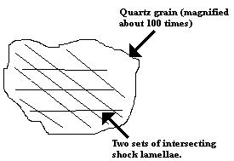
Shocked Quartz
Shocked quartz crystal from the K/T boundary layer of the Raton Basin, Colorado/New Mexico.
Photo by Glen Isett, US Geological Survey
Notes:
Geology cover and text: http://www.lawrence.edu/dept/environmental_studies/breccias.html
Figure: http://www.scn.org/~bh162/shocked_quartz.html March 1986
Shocked quartz crystals, containing characteristic shock lamellae, may be present.

Slide 26
Shatter Cones
Figure 22-4. Shatter cones in limestone from the Haughton Structure, Northwest Territories
Photograph courtesy Richard Grieve, © Natural Resources Canada
Notes:
Shatter cones, which are nested cone-shaped structures are also characteristic.

Slide 27
Prograde Metamorphism
Prograde: increase in metamorphic grade with time as a rock is subjected to gradually more severe conditions
Prograde metamorphism: changes in a rock that accompany increasing metamorphic grade
Retrograde: decreasing grade as rock cools and recovers from a metamorphic or igneous event
Retrograde metamorphism: any accompanying changes
Notes:
Progressive Metamorphism
(Roll mouse wheel )
Metamorphism may accompany any change in conditions. These could include an increase in temperature or pressure. The process is called prograde, (roll mouse wheel) and the resulting changes in the rock are prograde metamorphism. (Roll mouse wheel ) A decrease in temperature and pressure is called retrograde, (roll mouse wheel) and resulting changes are retrograde metamorphism.
In all except extreme cases, such as incipient metamorphism, or transient events like fault-zone or impact metamorphism, equilibrium is thought to be obtained, and to prevail during an on-going metamorphic episode.

Slide 28
The Progressive Nature of Metamorphism
A rock at a high metamorphic grade probably progressed through a sequence of mineral assemblages rather than hopping directly from an unmetamorphosed rock to the metamorphic rock that we find today
Notes:
Metamorphic rocks usually maintain equilibrium as grade increases
High-grade metamorphic rock probably progressed through a sequence of mineral assemblages as it adjusted to increasing temperature and pressure, rather than hopping directly from un-met to the metamorphic rock that we find today
If a metamorphosed sedimentary rock experienced a cycle of increasing metamorphic grade, followed by decreasing grade, at what point on this cyclic P-T-t path did its present mineral assemblage last equilibrate?
The zonal distribution of metamorphic rock types preserved in a geographic sequence of increased metamorphic grade suggests that each rock preserves the conditions of the maximum metamorphic grade (temperature) experienced by that rock during metamorphism

Slide 29
The Progressive Nature of Metamorphism
Retrograde metamorphism typically of minor significance
Prograde reactions are endothermic and easily driven by increasing T
Devolatilization reactions are easier than reintroducing the volatiles
Geothermometry indicates that the mineral compositions commonly preserve the maximum temperature
Notes:
Retrograde is usually detectable by observing textures, such as the incipient replacement of high-grade minerals by low-grade ones at their rims
Zonal metamorphic patterns, in which rocks preserve a geographic sequence of increasing grade, suggests that retrograde metamorphism is not terribly significant. Since cooling in large metamorphic complexes should be slow, time should not be a significant factor in precluding retrograde reactions. What might inhibit them? (Roll mouse wheel)
1. Prograde reactions are endothermic. The heat supplied causes them to progress rapidly. They often involve dehydration or decarbonation, or both. This helps to maintain equilibrium.
2. Retrograde reactions are exothermic. However, this assumes the fluids (water or carbon dioxide) are available for rehydration or recarbonation reactions. In most cases, the fluids are driven off during prograde reactions, and are not available.
Thus, the mineralogy and texture of metamorphic rocks usually reflects the maximum grade obtained. The composition may not, however. Geothermobarometry uses the temperature and sometimes the pressure dependence of metamorphic reactions between coexisting minerals to estimate the T and P conditions of metamorphism. Exchange reactions, such as Mg-Fe, do not require much energy. They maintain equilibrium with the retrograde conditions, at least until temperatures fall to the point where the reactions become extremely sluggish.
Protolith Types
The parent rock type has an extremely important effect on the types and degree of metamorphism. The most important factor is the composition of the parent rock. Six categories serve to separate the parent rocks.

Slide 30
Types of Protolith
Lump the common types of sedimentary and igneous rocks into six chemically based-groups
1. Ultramafic - very high Mg, Fe, Ni, Cr
2. Mafic - high Fe, Mg, and Ca
3. Shales (pelitic) - high Al, K, Si
4. Carbonates - high Ca, Mg, CO₂
5. Quartz - nearly pure SiO₂.
6. Quartzo-feldspathic - high Si, Na, K, Al
Notes:
Chemistry of the protolith is the most important clue toward deducing the parent rock (Roll mouse wheel for each number)
1. Ultramafic rocks. Mantle rocks, komatiites, or cumulates
2. Mafic rocks. Basalts or gabbros, some graywackes
3. Shales (or pelitic rocks). Fine grained clastic clays and silts deposited in stable platforms or offshore wedges.
4. Carbonates. Mostly sedimentary limestones and dolostones. Impure carbonates (marls) may contain sand or shale components
5. Quartz rocks. Cherts are oceanic, and sands are moderately high energy continental clastics. Nearly pure SiO₂.
6. Quartzo-feldspathic rocks. Arkose or granitoid and rhyolitic rocks. High Si, Na, K, Al
Categories are often gradational, and cannot include the full range of possible parental rocks
One common gradational rock type is a sand-shale mixture: psammite
Other rocks: evaporites, ironstones, manganese sediments, phosphates, laterites, alkaline igneous rocks, coal, and ore bodies

Slide 31
Regional Metamorphism, Scottish Highlands
Barrow’s Area
Figure 21-8. Regional metamorphic map of the Scottish Highlands, showing the zones of minerals that develop with increasing metamorphic grade
From Gillen (1982) Metamorphic Geology. An Introduction to Tectonic and Metamorphic Processes. George Allen & Unwin. London.
Notes:
Orogenic Regional Metamorphism, Scottish Highlands
George Barrow, British petrologist, made one of the first systematic studies of metamorphic rock types, their variation, and mineral assemblages in an episode of progressive metamorphism. His studies were centered in the SE Highlands of Scotland, starting in the late 19th century. These rocks were produced by the Caledonain orogeny, which peaked about 500 mybp. Deformation was intense. The rocks were folded and thrust into a series of nappes, with numerous large granitic intrusions. Later plate movements fragmented the orogenic belt, and pieces of it are found in Scandinavia, Greenland, and in the Appalachian belt of N. America. The Scottish rocks comprise a total thickness of 13 kilometers, composed of conglomerate, sandstone, shale, limestone, and mafic rocks.
Barrow found little change in the sandstones. The pelitic rocks (protolith: shale) he divided into a series of metamorphic zones based on the appearance of a new mineral in each zone. He also observed that grain size increased through the zones. The minerals used to denote the zones are called index minerals. The zones now recognized in the Scottish highlands are: (See Figure 21-8)

Slide 32
Barrovian Zones
Chlorite zone - Slates or phyllites
Minerals: Chlorite, muscovite, quartz, albite
Biotite zone - Phyllites, schists
Minerals: Biotite, chlorite, muscovite, quartz, albite
Garnet zone: Garniferous schists
Minerals: Red almandine garnet, biotite, chlorite, muscovite, quartz, albite or oligoclase
Staurolite zone: Schists
Minerals: Staurolite, biotite, muscovite, quartz, garnet and plagioclase
Kyanite zone - Schists
Minerals: Kyanite, biotite, muscovite, quartz, and plagioclase, ±garnet, ±staurolite.
Sillimanite zone - Schists and gneisses
Minerals: Sillimanite, biotite, muscovite, quartz, plagioclase, and garnet, ±staurolite, ±kyanite
Notes:
(Roll mouse wheel to show zones successively)
This sequence has been recognized in a number of orogenic belts. The zones are now well-established as Barrovian zones. C.E. Tilley added the term isograd for the boundary that separates zones. The classical definition of isograd is a line connecting points of the first appearance of a particular metamorphic index mineral in the field as one progresses up the metamorphic grade.
When an isograd is crossed, a new zone is entered. The zone has the same name as the isograd which marks its lower boundary. An isograd is intended to represent a line of constant metamorphic grade. It is, of course, difficult to find continuous outcrops in the field. Thus the boundaries may be somewhat fuzzy in areas of poor exposure. In addition, isograds are probably irregular curved surfaces in space, and the mapped isograds represent the intersection of the three-dimensional isograd with the earth's surface.
An index mineral may be present in zones higher than its own. Even when the mineral should have been replaced, it may persist. The Al₂SiO₅ polymorphs serve as examples.

Slide 33
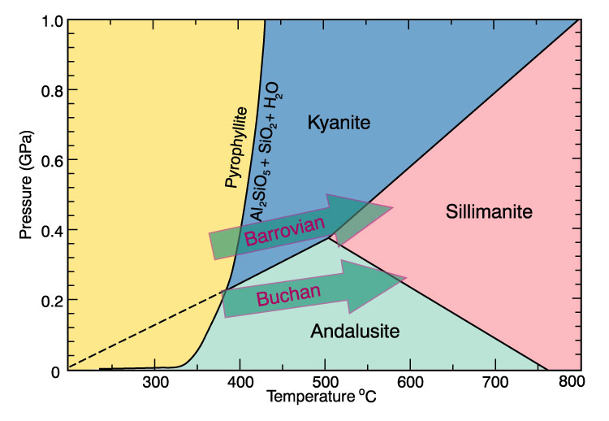
Al₂SiO₅ Phase Diagram
Notes:
(See Figure 21-9) The kyanite to sillimanite reaction involves small changes in free energy, so the kyanite may persist metastably. (It is possible that conditions are exactly on the phase boundary, but the appearance of two minerals in the same zone happens much more commonly than it should by chance position in a phase diagram.)
Barrovian zones were developed in an area of rather narrow compositional range. In regions with different compositions, the use of additional or replacement index minerals may be appropriate. In the Appalachians, the shales are more iron and aluminum rich than in the Scottish Highlands. It is possible to introduce a chloritiod isograd in such cases. In the Banff and Buchan districts of Scotland, the isograds are as follows:

Slide 34
Buchan or Abukuma Isograds
Chlorite
Biotite
Cordierite
Andalusite
Sillimanite
Notes:
The appearance of andalusite instead of kyanite is an indication that pressures were low, since andalusite is not stable above 0.37 GPa. Cordierite has a large molar volume, a good indication that it too is a low pressure mineral. Thus it appears the geothermal gradient was higher in the Buchan area, and pressures were lower at equivalent temperatures. This sequence is known as Buchan-type metamorphism. In Japan, the same variation is known as the Abukuma-type.
Regional Burial Metamorphism, Otago, New Zealand
From the Permian through the Jurassic, much of the island of New Zealand was the location of voluminous sedimentation. This included graywacke, tuff and some volcanics, deposited in a trough. This combination of rocks has a very fine grain size making them very prone to metamorphism. During the Cretaceous, these rocks were metamorphosed.

Slide 35
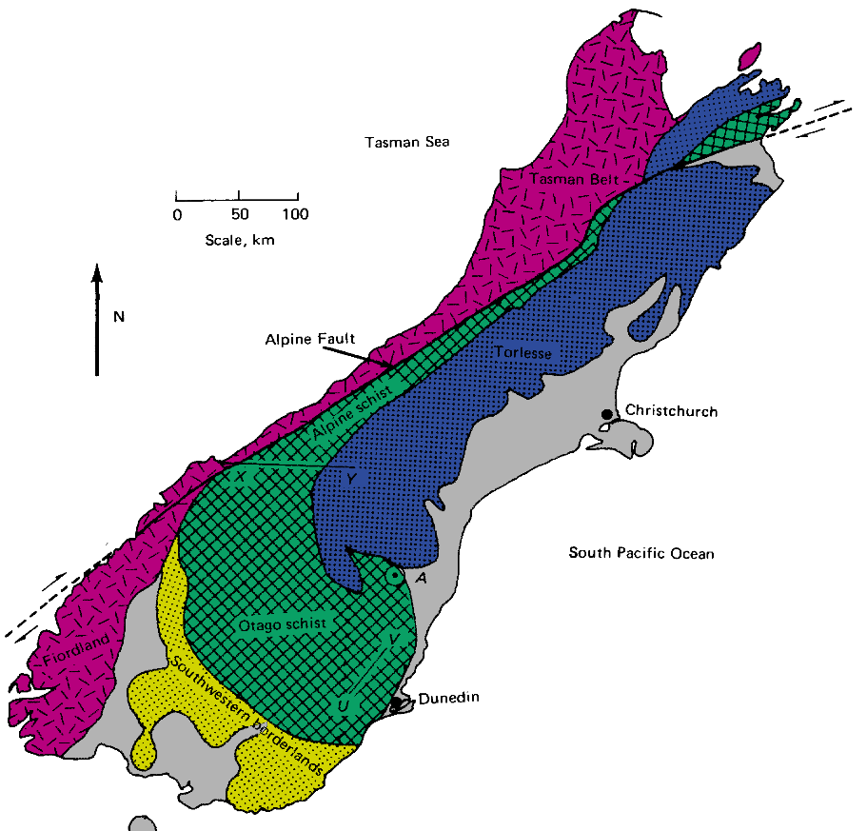
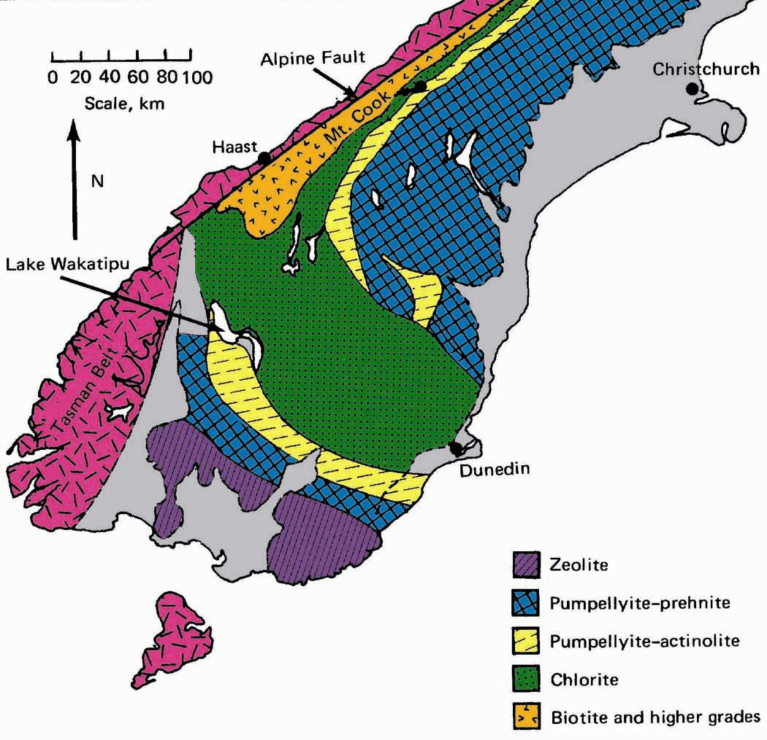
Regional Burial Metamorphism Otago, New Zealand
Section X-Y shows more detail
Figure 21-10. Geologic sketch map of the South Island of New Zealand showing the Mesozoic metamorphic rocks east of the older Tasman Belt and the Alpine Fault. The Torlese Group is metamorphosed predominantly in the prehnite-pumpellyite zone, and the Otago Schist in higher grade zones. X-Y is the Haast River Section of Figure 21-11. From Turner (1981) Metamorphic Petrology: Mineralogical, Field, and Tectonic Aspects. McGraw-Hill.
Notes:
(See Figure 21-10) Studies by D.S. Coombs and coworkers on the South Island of New Zealand have made this the "type locality" for burial metamorphism. In the northern part of the island, medium grade Barrovian zones are reached. But in the south, we see lower grade rocks that are another variation. There is little deformation here, and plutons are almost non-existent.

Slide 36
Haast Group
Figure 21-11. Metamorphic zones of the Haast Group (along section X-Y in Figure 21-10).
After Cooper and Lovering (1970) Contrib. Mineral. Petrol., 27, 11-24.
Notes:
The isograds the Coombs group mapped here are shown in Figure 21-11, which is of the Haast River section. The isograds are:
Zeolite
Prehnite-pumpellyite
Pumpellyite(-actinolite)
Chlorite (-clinozoisite)
Biotite
Almandine garnet
Oligoclase
The zeolite zone is characterized by the alteration of volcanic glass to the zeolites heulandite or analcite, accompanied by secondary quartz and some phyllosilicates. The original minerals are essentially unaltered, even high temperature volcanics which are far from their field of stability. As depth increases, heulandite is replaced by laumonite, and both prehnite and pumpellyite form. Plagioclase is albitized because the most calcic compositions are unstable. As grade increases, the rocks are more recrystallized, and good schistosity develops. The rocks then evolve into grades associated with regional orogenic metamorphism.
At very low grade, reaction rates are slow. Equilibrium is probably not obtainable in geologically reasonable times. The preservation of original igneous textures and minerals is common. Where hot fluids have penetrated, grades are higher. Zonation is apparent if the rocks are carefully observed, and the index minerals altered. The rocks in New Zealand represent the various lowest levels of metamorphism, actually a transition from diagenesis to metamorphism. We might expect to see similar zones in the outermost areas of most orogenic belts, but careful work has found them only in a few cases. It seems likely the unstable tuffs and graywackes react faster than most rock. Hot fluids have also increased reaction rates. Typical pelitic sediments seem incapable of reaction under similar conditions.
Ca-bearing minerals, like laumonite, prehnite, and pumpellyite are stable in water-rich, carbonate-free fluids. In the presence of carbon dioxide, calcium would form calcite instead. In the Salton Sea geothermal field of Southern California, hot fluids contain carbon dioxide. Zeolites are absent, but epidote and chlorite are common.
Paired Orogenic Metamorphic Belts of Japan
On the islands of Shikoku and Honshu in Japan, a pair of metamorphic belts are present along a NE-SW line parallel to the subduction zone. Both belts are the same age, but they have different metamorphic signatures.

Slide 37
Japanese Metamorphic Belts
Figure 21-12. The Sanbagawa and Ryoke metamorphic belts of Japan\
From Turner (1981) Metamorphic Petrology: Mineralogical, Field, and Tectonic Aspects. McGraw-Hill and Miyashiro (1994) Metamorphic Petrology. Oxford University Press.
Notes:
(See Figure 21-12) The Abukuma or Ryoke belt, which lies to the NW, farthest away from the subduction zone, is a Buchan type low P/T belt. Rocks are meta-pelitic sediments ranging up to sillimanite zone. Granitic plutons are common. These rocks represent high-temperature, low-pressure conditions.
The Sanbagawa belt, which lies closer to the subduction zone, is composed of late Paleozoic volcanic/sedimentary fill, with grade increasing toward the NW. It shows much higher pressures than the Ryoke belt. The highest grade reached is garnet, in pelitic rocks. Alkaline rocks are more common, however, and glaucophane develops in the alkaline rocks, giving way to hornblende at higher grade. Glaucophane is an important indicator mineral, denoting high-pressure low temperature conditions. The bluish color of the glaucophane is used in naming the rocks blueschists.
The two belts are entirely separated by a major fault zone called the Median Line. The Ryoke-Abukuma belt is derived from sediments typical of a mature volcanic arc. The Sanbagawa belt is formed from the oceanward accretionary wedge, with a mixture of arc-derived sediments and volcanics mixed together with oceanic crust and marine sediments. It is the marine sediments that contribute the high sodium content necessary to form glaucophane.

Slide 38
Subduction Zone Isotherms
Figure 16-15 Cross section of subduction zone showing isotherms (after Furukawa, 1993) and mantle flow lines (dashed and arrows, after Tatsumi and Eggins, 1995). Potential magma source regions are numbered.
Notes:
Figure 16-15 shows a cross-section of a subduction zone. The 600̊C isotherm is as deep as 100 km in the trench-subduction zone area, whereas it can be as shallow as 20 km below the volcanic arc. Thus the Ryoke-Sanbagawa belts probably represent a pair of coeval belts. A higher P/T belt will be near the trench (Ryoke), and a lower P/T (Sanbagawa) belt away from the trench. These should be common in many ocean-continent or ocean-ocean subduction zones. These were called Paired Metamorphic Belts by Miyashiro.

Slide 39
Circum-Pacific Metamorphism
Figure 21-13. Some of the paired metamorphic belts in the circum-Pacific region
From Miyashiro (1994) Metamorphic Petrology. Oxford University Press.
Notes:
Figure 21-13 shows a map of the circum-Pacific belt, showing six examples, and one more in the Caribbean. The paired belts are separated by 100-200 kms, an area called the arc-trench gap. The contact between the belts in the ocean-continent case is often a major fault. The offset along the faults is dip-slip, but considerable strike-slip component may be present.
Contact Metamorphism of Pelitic Rocks, Skiddaw Aureole, UK
In the English Lake District, Ordovician Skiddaw Slates are intruded by granite and granodiorite bodies. The intrusions are shallow. Contact metamorphism overprints earlier low-grade regional orogenic metamorphism. The orogenic metamorphism reached chlorite-zone. Outside of the contact aureole, the slates contain muscovite (or sericite-phengite, at the lowest grades), quartz, chlorite, chloritoid, and mixed opaques (graphite, sulfides, mixed Fe-oxides), ±biotite. They have been divided into three zones, mainly on the basis of texture.

Slide 40
Contact Metamorphism of Pelitic Rocks in the Skiddaw Aureole, UK
Unaltered slates
Outer zone of spotted slates
Middle zone of andalusite slates
Inner zone of hornfels
Skiddaw granite
Increasing Metamorphic Grade
Notes:
The width of the aureole, 2 km, suggests that the exposed igneous contact dips outward at a small angle.

Slide 41
Skiddaw Granite, Lake District, UK
Figure 21-14. Geologic Map and cross-section of the area around the Skiddaw granite, Lake District, UK
After Eastwood (1et al. 968). Geology of the Country around Cockermouth and Caldbeck
Explanation accompanying the 1-inch Geological Sheet 23, New Series. Institute of Geological Sciences. London.
Notes:
The outer zone is characterized by small spots (0.2 - 2.0 mm). The finer material has recrystallized, and is slightly coarser than matrix in the unaltered slate. The spots are black because the opaques seem to concentrate around the center of crystallization. Thin-section examination of the spots and matrix reveals essentially the same mineralogy, except for slightly more muscovite in the spots. The spots were probably a single grain which surrounded nearby minerals, and were likely either andalusite or cordierite. Retrograde metamorphism has reduced them to a fine aggregate, dominated by muscovite. Both cordierite and andalusite are found at higher grades, including the inner-most part of the outer zone, where they are corroded. This scenario makes the spots pseudomorphs.
The middle zone contains biotite, muscovite, cordierite, andalusite, quartz, and opaque minerals. Cordierite forms irregular, equi-dimensional crystals with numerous inclusions. Mica inclusions retain the orientation of the external slate matrix, indicating cordierite enveloped aligned micas. This is evidence for the overprint of thermal metamorphism on earlier regional metamorphism.

Slide 42
Skiddaw Aureole, UK Middle Zone
Slates more thoroughly recrystallized
Contain biotite + muscovite + cordierite + andalusite + quartz
1 mm
Figure 21-15. Cordierite-andalusite slate from the middle zone of the Skiddaw aureole
From Mason (1978) Petrology of the Metamorphic Rocks. George Allen & Unwin. London.
Notes:
Andalusite crystals contain fewer inclusions than cordierite, and may have cruciform inclusions of opaque minerals (chiastolite - Figure 21-15 shows incipient andalusite, figure 21-16 a chiastolite grain).

Slide 43
Skiddaw Aureole, UK Inner Zone
Thoroughly recrystallized
Foliation lost
1 mm
Figure 21-16. Andalusite-cordierite schist from the inner zone of the Skiddaw aureole
Note the chiastolite cross in andalusite (see also Figure 22-49). From Mason (1978) Petrology of the Metamorphic Rocks
George Allen & Unwin. London.
Notes:
Both andalusite and cordierite are low-pressure minerals, so must represent the contact metamorphism episode, which occurred at shallow depths.
The inner zone minerals are coarser and more recrystallized than the middle zone, but have the same mineral assembly. Cordierite has no mica inclusions, but contains trains of opaques which may record the original foliation direction. Some rocks are schistose, but the innermost zone loses all foliation, and the rocks are hornfelsic. The quartz-rich areas shown in figure 21-16 meet in triple junctions, at about 120̊, typical of nearly hydrostatic metamorphism.
The zones at Skiddaw are structural, rather than on a grade basis. The sequence of mineral development with grade is difficult to determine. Most minerals appear in the outer zone. Thus the textural approach appears more useful at Skiddaw. This may extend to other contact metamorphic aureoles as well.
In Scotland, Comrie schists were intruded by much hotter (diorite) rocks than at Skiddaw. The inner aureole is granofels, containing very high temperature mineral associations (opx + K-spar). These minerals form by dehydration of biotite and muscovite. Opx, in both contact and regional metamorphic rocks, appears only at the highest grades, usually accompanied by partial melting. Typical mineral assemblage:

Slide 44
Comrie Schists, Scotland
Typical Mineral Assemblage:
Hypersthene + cordierite + orthoclase + biotite + opaques
Silica rich rocks
Cummingtonite (Ca-free amphibole) + quartz + andesine + biotite + opaques
Silica undersaturated
Corundum, Fe-Mg spinel
Notes:
Contact metamorphosed by diorite intrusion, much hotter than the Skiddaw Intrusion
Since the silica undersaturated regions occur only in the inner aureole, Tilley attributed their presence to Si loss to the diorite. More likely, SiO₂ and water entered partial melts, and were removed.
Contact Metamorphism and Skarn Formation, Crestmore, California
The Crestmore Quarry in Los Angeles California is a world famous location for contact pyrometamorphism involving metasomatism. The quarry is operated by a cement company, which uses to products for the manufacture of cement. Most of the aureole is now gone. Burnham's 1959 study provides an excellent view of this classic location.

Slide 45
Contact Metamorphism, Crestmore, California
Figure 21-17. Idealized N-S cross section (not to scale) through the quartz monzonite and the aureole at Crestmore, CA
From Burnham (1959) Geol. Soc. Amer. Bull., 70, 879-920.
Notes:
A quartz monzonite porphyry was intruded into Mg-bearing carbonates. The country rock had experienced an earlier metamorphic event, and were brucite-bearing calcitic marbles. The temperatures involved at Crestmore were high enough to make this a case of pyrometamorphism. Considering the shallow depth (as evidenced by low pressure minerals) this is very unusual, seen in only a few places on earth.
Burnham's study mapped four zones, consisting of a total of 10 assemblages.

Slide 46
Crestmore Zones
Notes:
Mineral Formulas
Brucite Mg(OH)₂
Calcite CaCO₃
Clinohumite Mg₉(SiO₄)₄(F,OH)₂
Clinonite Ca(Mg,Al)_{3⇌2}Al₂Si₂O₁₀(OH)₂
Diopside CaMgSi₂O₆
Forsterite Mg₂SiO₄
Grossular (garnet) Ca₂Al₂Si₃O₁₂
Melilite (Ca,Na)₂(Mg,Al)(Si,Al)₂O₇
Merwinite Ca₃Mg(SiO₄)₂
Monticellite CaMgSiO₄
Spinel MgAl₂O₄
Spurrite Ca₅(SiO₄)₂(CO₃)
Tillyite Ca₅Si₂O₇(CO₃)₂
Vesuvianite (Idocrase) Ca₁₉(Al,Mg,)₁₃B₀₋₅Si₁₈O₆₈(OH,O,F)₁₀
Wollastonite CaSiO₃
This kind of representation represents information overload. It is difficult to remember all the assemblages, and the chemistry that is taking please is difficult to interpret. It is clear there are a progression of minerals, such as the replacement of clinohumite by clintonite between assemblages 2 and 3. The appearance of the index minerals is also clear. In order to help clarify what is actually happening, we can rewrite the information in the form of chemical equations

Slide 47
Example Transformations
Assemblage 1 to Assemblage 2
2 Clinohumite + SiO₂ → 9 Forsterite + 2 H₂O
Assemblage 7 to Assemblage 8
Monticellite + 2 Spurrite + 3 Merwinite + 4 Melilite + 15 SiO₂ + 12 H₂O → 6 Vesuvianite + 2 CO₂
Notes:
The chemical equations provide additional information, but also have draw-backs. They aren't easy to determine. They also are difficult to remember. But they do provide information not clear from the mineral assemblages alone, such as the liberation of carbon dioxide during the formation of vesuvianite. This has lead to a new trend, treating all isograds as chemical reactions, whenever possible.
Large quantities of numerical data are often handled best by displaying the data graphically. Examination of the mineral list reveals that most of the minerals can be represented by the system CaO-MgO-SiO₂-CO₂-H₂O. Omitting the volatiles, the system can be plotted on the ternary diagram CaO-MgO-SiO₂ (Figure 21-18).

Slide 48
CaO-MgO-SiO₂
Figure 21-18. CaO-MgO-SiO₂ diagram at a fixed pressure and temperature showing the compositional relationships among the minerals and zones at Crestmore. Numbers correspond to zones listed in the text. After Burnham (1959) Geol. Soc. Amer. Bull., 70, 879-920; and Best (1982) Igneous and Metamorphic Petrology. W. H. Freeman.
Zones are numbered (from outside inward)
Notes:
Such diagrams are called chemographic compatibility, or composition-paragenesis diagrams.
Figure 21-18 shows the diagram for Crestmore. All of the minerals in the assemblages are plotted on the diagram. Coexisting minerals are connected by lines, called "tie-lines". The numbers represent the mineral assemblages discussed previously. Any point which lies within a small triangle created by the tie-lines will consist of the minerals at the corners of the triangle. Points lying on lines will consist of just the two minerals at opposite ends of the line. Presented in this manner, a trend leaps off the page. The mineral assemblages become increasing rich in silica. Since Mg-bearing carbonates have little silica available, the only likely source of silica is from silica-rich fluids released from the magma.
The porphyry nature of the intrusive rock supports this idea. When the magma is rising, crystals form and grow, becoming phenocrysts. When the magma gets close to the surface, the volatiles may escape. This quickly undercools the magma (raises the melting point) and the remaining magma solidifies in tiny crystals. The escaping volatiles, especially water, are hot and loaded with dissolved silica. The heat from the escaping water adds to convective heat loss, and creates a pyrometamorphic situation. The silica reacts with the carbonates, creating the assemblages seen. Alumina and volatiles were omitted.
Care must be chosen in selecting the three end members. Computers have actually aided the process, since they can plot all possible diagrams for examination. This removes a lot of the fun of discovery, however, since no intuition is involved.

