Slide 1
Petrology Lecture 8
Oceanic Intraplate Volcanism
GLY 4310 - Spring, 2019
Notes:
Volcanic activity within plates, rather than at interacting plate margins, has long intrigued geologists. The dominant rock type is again basalt, and it is often called OIB, or ocean island basalt. Chemical characteristics and petrography of OIB varies much more than it does for MORB. OIB is most commonly found along fracture zones in the oceans, where it produces either sea-mounts or actual volcanic islands, like Hawaii. It is estimated there are between 22,000 and 55,000 sea-mounts. There are also oceanic plateaus, where basalt has flooded the ocean floor, in a manner similar to flood basalt on the continents. Kerr (2003) estimated that there are fifteen oceanic plateaus. The association of sea-mounts with fracture zones suggests that magma is rising along the fractures. The volume of OIB is estimated at about 1.5 km³ a⁻¹.
Sea-mounts are often found as progressive linear chains, with the youngest rock associated with the largest sea-mount. Sometimes the chain terminates in islands, rather than large sea-mounts. The Hawaii-Emperor chain is a well-known example. The most common interpretation of these chains is movement over a hot spot. The number of hot spots has been estimated from 16 to 122. Sixteen is clearly too small.

Slide 2
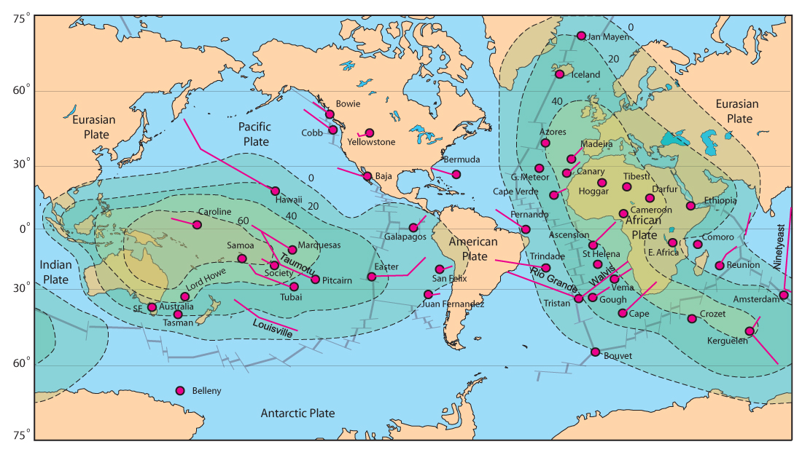
Hot Spots, Trails, and
Aseismic Ridges
Figure 14.1. Map of relatively well-established hotspots and selected hotspot trails (island chains or aseismic ridges). Hotspots and trails from Crough (1983) with selected more recent hotspots from Anderson and Schramm (2005). Also shown are the geoid anomaly contours of Crough and Jurdy (1980, in meters). Note the preponderance of hotspots in the two major geoid highs (superswells).
Notes:
The figure shows a plot of 43 well established hot spots. The circle at the end of the line shows the present position of the hot spot. This is a very active area of research. Some of the lines in this figure are much too short, with that of Yellowstone standing out. It is possible for OIB's to occur at plate margins, as the case of Iceland and the Azores illustrates.
Most chains are composed of isolated sea-mounts or islands. The speed of the plate motion carries the sea-mount a considerable distance before the connection is broken, and shifted to a new volcano. If plates move slower, the individual eruptions coalesce to produce an aseismic ridge. Aseismic ridges are not plate boundaries. If a plume is centered on a ridge, it may create two aseismic ridges, one on each divergent plate. Typically these intersect in a broad V. The plume presently located under the island of Tristan de Cunha has produced the Walvis and Rio Grande aseismic ridges in the south Atlantic. The ridge moved westward about 30 mybp, and the plume is now east of the MAR. It is possible that ridge associated creation and subsequent abandonment is true for several plumes.
Kinks are seen in some of the hot spots trails. The Hawaii-Emperor and Tuamotu trails both show conspicuous kinks that date to a change in the motion of the Pacific plate about 40-50 mybp.
Hot spots can and do occur beneath continents. The Snake River/Yellowstone chain is presently beneath the national park. When located beneath a continent, the rising magma interacts with the low melting continental crust, changing the volcanic character greatly. The huge caldera and dominantly rhyolitic magma of Yellowstone attest to this interaction.

Slide 3
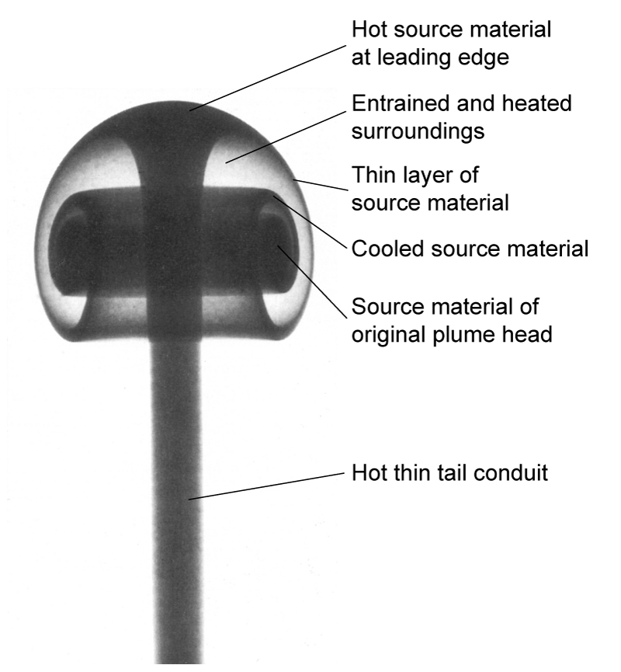
Plume Model
Figure 14.2 Photograph of a laboratory thermal plume of heated dyed fluid rising buoyantly through a colorless fluid. Note the enlarged plume head, narrow plume tail, and vortex containing entrained colorless fluid of the surroundings.
After Campbell (1998) and Griffiths and Campbell (1990).
Notes:
Current thinking is that plumes originate at the thermal boundary layer in the mantle which lies just above the core-mantle boundary. The photo shows a two-fluid model. Initially the plume meets resistance from overlying rock, represented here by a clear fluid.. Once sufficiently heated, buoyancy becomes sufficient for the hot plume material (dark fluid) to push upward. Plumes are thought to reach 300-400 km in diameter before they can detach from the thermal boundary layer. Initially the plume forms a flattened bulbous head, which rises trailing a thin tail. As the head rises, it captures some of the clear fluid in the model experiments, and grow to much larger diameters, perhaps 800-1200 km within the earth. When the plumes reach the surface, they can cause tremendous volcanic outpourings, such as seen on the Snake River and Deccan plateaus. These are often called a Large Igneous Province, or LIP.
The thermal effects of a plume beneath the ocean are much greater. The high heat flow causes the plate to swell for about 600 km around the plume, with an average height above sea-bed of 1200 m at the plume location. Hot spots are not as geographically fixed as once thought. Relative motion between plumes in the Pacific averages several mm a⁻¹, while that in the Atlantic is faster, at several cm a⁻¹. The movement of the lithospheric plates above the plume is much faster than any plume motion, however, and leads to volcanic tracks on the surface.
Not all oceanic intraplate volcanism is associated with hot spots. Several of these appear to be transient volcanic episodes, not associated with hot spot trails or aseismic ridges.

Slide 4
OIB Magma Types
There are two principal magma series seen in OIB
  OIT – stands for Ocean Island Tholeiite
    Hawaii is a good example
  OIA – Ocean Island Alkaline Basalt
    Examples: Canary Islands, the Azores, Ascension, Tristan de Cunha, and Gough Islands in the Atlantic, as well as Tahiti in the Pacific.
    Silica undersaturated subseries is the more common type
    Slightly silica saturated is less common
Notes:
There are two principal magma series seen in OIB. One parent type is a tholeiite, known as OIT. The other is alkaline basalt, known as OIA. The alkaline series has two subseries. The more common is silica undersaturated, while the less common type is slightly silica saturated. Many islands, including Hawaii are dominantly tholeiitic. There are some islands that are dominantly alkaline. These include the Canary Islands, the Azores, Ascension, Tristan de Cunha, and Gough Islands in the Atlantic, as well as Tahiti in the Pacific.

Slide 5
Hawaii
Best studied of the oceanic islands, by far
Typical eruption sequence
  Pre-sheild
  Shield-building
  Post-shield
  Post-erosional
Notes:
Hawaii is by far the best studied of the oceanic islands. A typical sequence of eruptions has been discovered, beginning before the shield volcano has formed. The sequence is:
Pre-shield stage - Submarine eruptions of alkaline basalt and highly alkaline basanites, followed by tholeiitic basalt. Loihi seamount, situated about 35 km southeast of the island of Hawaii, is at this stage. The alkaline basalts represent low degrees of partial melting. Basanite is a fine-grained alkaline igneous rock dominated by essential olivine, plagioclase, and feldspathoid, usually nepheline, leucite and/or analcite. Basanites also contain a mafic mineral, usually a clinopyroxene such as augite, aegirine-augite, or aegirine. Olivine and pyroxene usually occur as phenocrysts. Phonolitic basanites also contain alkali feldspars. Tephrite is an olivine-free basanite. The coarse-grained equivalent to a basanite is an olivine feldspathoid gabbro or monzogabbro, also termed an olivine theralite.
Basanites are most commonly associated with continental rift and ocean island magmatism
2. Shield-building stage - Tremendous outpourings of tholeiite begin to build a shield volcano. The island of Hawaii is comprised of five shields. Mauna Loa and Kilauea, the most active shields, are presently in this stage. Mauna Loa already represents 40,000 km³ of basalt. 98-99% of all lava in Hawaii results from this stage.
3. Post-shield stage - Mauna Kea, Hualalai, and Kohala, the remaining three shields on the island of Hawaii, have reached this stage. Activity slows, becomes episodic (as opposed to nearly continuous), alkaline, and more violent. Lavas are much more varied as the result of shallow fractionation. Activity fades, entering a period of dormancy for about 0.5 to 2.5 m.y.
4. Post-erosional stage - Highly-alkaline, silica undersaturated magmas erupt. Rock types include alkali basalts, basanites, nephelinites, and nepheline melilites.
The last two alkaline stages total about 1% of the total eruptions. The alkaline stages bring a wide variety of xenoliths to the surface. Some are mafic to ultramafic cumulates from early tholeiite magma chambers. Others are mantle xenoliths representing various stages of depletion. These include dunites, harzburgites, spinel lherzolites, and two rare garnet types, a lherzolite and a pyroxenite. The latter two may represent primitive or nearly primitive mantle.

Slide 6
Is Hawaii Typical?
Do the Hawaiian Islands represent a broad trend in the evolution of oceanic intraplate volcanos?
  There is a great lack of data for most other islands
  Many are small, and most have not been extensively studied
  If the Hawaiian processes are general, than alkaline islands should be tholeiitic underwater
  This has not been tested because of cost constraints, and the very real difficulties of drilling in the turbulent waters near an island
Notes:
The Hawaiian pattern shows OIT and both sub-types of the OIA in a single location. The pattern has been related to:
1. Early, very limited partial melting
2. Much more extensive partial melting, followed by a gradual decrease in the degree of partial melting as the heat source is reduced
3. Tholeiite to alkaline evolution as the result of fractional crystallization in the magma chamber. This latter point is controversial. The Mg#s of tholeiite and alkaline basalts overlap, and they follow separate differentiation trends. The low-pressure thermal divide also separates the two series. Only at high pressures could OIT evolve to OIA.

Slide 7
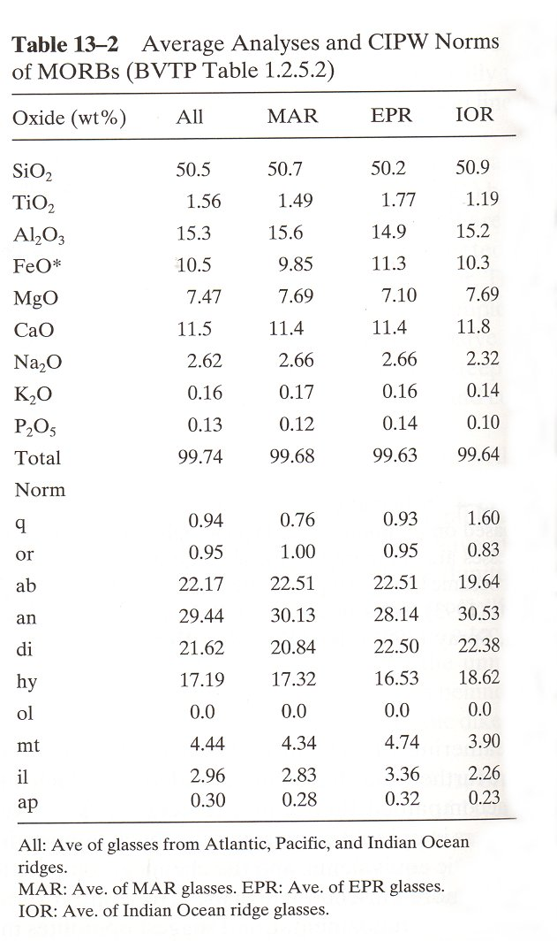
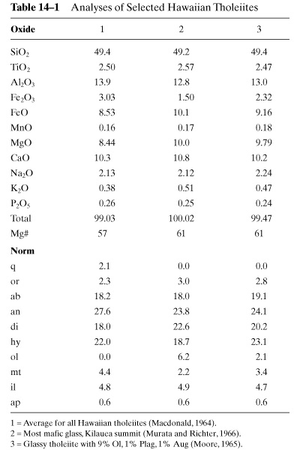
OIT vs. MORB Chemistry
Notes:
OIB Petrography and Major Element Chemistry
OIT are similar to MORB, but there are distinguishing characteristics.
Table 14-1 shows the analysis of several Hawaiian OIT's. Comparison with table 13-2, which shows similar data for MORB’s reveals that for a given Mg#, OIT's have:
Higher K₂O, TiO₂, and P₂O₅
Lower Al₂O₃
Magma types range from silica-saturated to slightly undersaturated olivine tholeiites and picrites. The evolution of many Hawaiian basaltic magmas can be modeled by the fractional crystallization of olivine alone. Plagioclase and cpx are typically seen only in the groundmass of OIT's. Occasional megacryst cpx is found. These are more Mg-rich than groundmass cpx, and are not in equilibrium with the liquid at low pressure. They are likely xenocrysts, either cumulate minerals or phenocrysts from greater depths. In evolved magmas, olivine and Cr-spinel are joined by cpx and plagioclase. The last mineral is an Fe-Ti oxide. Early removal of Mg-rich olivine leaves the magma increasing Fe rich. Crystallization of Fe-Ti oxide drives the composition in the opposite direction toward an alkali-rich derivative liquid. Some tholeiites may crystallize opx (hypersthene) or pigonite, both of which are Ca poor, as the result of plagioclase formation.
Primary OIT magma's are very hard to identify. The Al₂O₃/TiO₂ is about 20 in MORB, but close to 5 in OIT. Since olivine is the only mineral removed early, and it does not contain either Al or Ti, fractional crystallization cannot be responsible. This suggests that a different source exists for MORB tholeiite than for OIT tholeiite.
Comparison of alkaline rocks (OIA’s) with MORB and OIT shows the chemistry of the OIA to have much greater variation. Of course, the alkali contents are higher, and silica is lower. This results in olivine not only being present as phenocrysts, but being extensively found in the groundmass. The compositional range of the olivine is also large, Fo₃₅₋₉₀. Pyroxenes are usually limited to Ti-rich augites. Amphiboles, indicating high volatile content, are sometimes present, as phenocrysts. Amphiboles become unstable at low pressures above 1000̊C, so they are very rare in the groundmass, and the phenocrysts show signs of reaction (resorption, or rims of anhydrous minerals). In addition, the groundmass usually contains an alkali feldspar, as well as one or more feldspathoids.

Slide 8
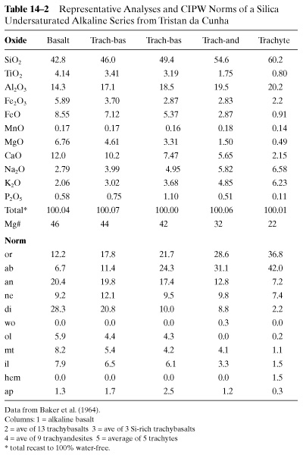
Chemistry of Silica Undersaturated Alkaline Series
Notes:
Table 14-2 shows chemical data from Tristan de Cuhna. Magma there is alkaline and silica undersaturated, which is the more common case.

Slide 9
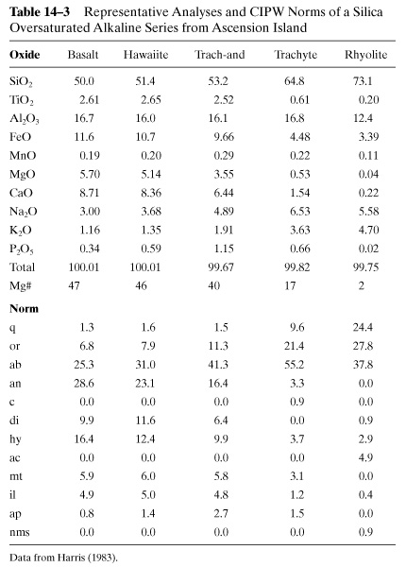
Chemistry of Silica Oversaturated Alkaline Series
Notes:
Table 14-3 shows a similar chemical analysis for Ascension Island, which is alkaline but silica oversaturated.

Slide 10
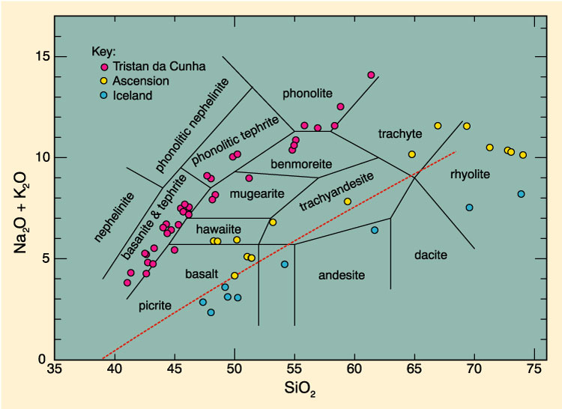
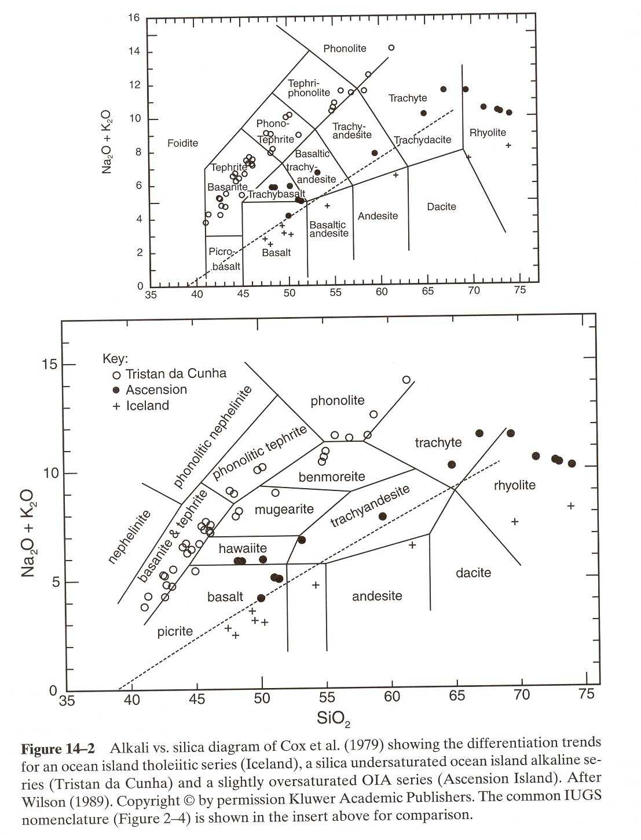
Alkali vs. Silica
Notes:
Figure 14-2 shows a plot of the data from both islands on an alkali (Na₂O+K₂O) vs Si basis. This figure introduces the rock names first proposed by Cox et al. for alkaline series. These differ from those originally used by IUGS, but are now accepted by IUGS. The original IUGS scheme is shown in the upper part of Figure 14-2.
The magma series at Tristan evolves from alkaline basalt through Hawaiite to an end product of alkaline trachytes, or from basanites to phonolite, if they are very silica poor. Feldspathoids commonly include leucite. Ascension starts with alkaline basalt, although less alkalic than Tristan, evolving through trachyandesites to trachytes, and then to alkali rhyolites, which are quartz-bearing. There is a sudden increase in Si content at the end of the Ascension series. This is probably the result of fractional crystallization of alkali feldspar, which lowers alkali content and raises the effective Si content.

Slide 11
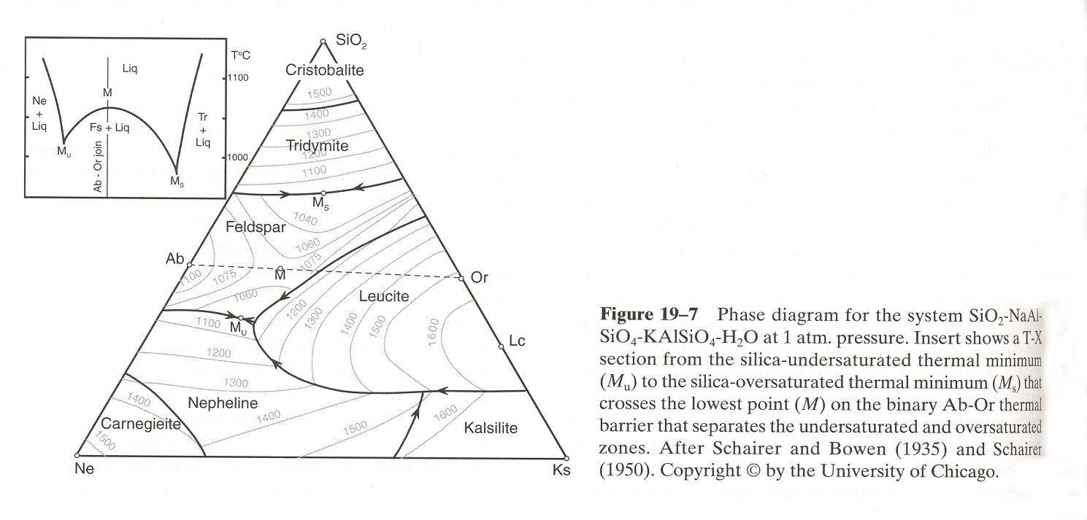
SiO₂- NaAlSiO₄- KAlSiO₄ - H₂O
Notes:
Figure 19-7 shows the phase diagram for silica-nepheline-kalsilite. The inset diagram is a back to back binary diagram, drawn from near the lower left corner toward the SiO₂ apex. It shows two binary eutectics (M_{u} and M_{s}). The crystallization of Tristan and Ascension seem to each follow one of these minima. The difference being determined by initial compositional differences.

Slide 12
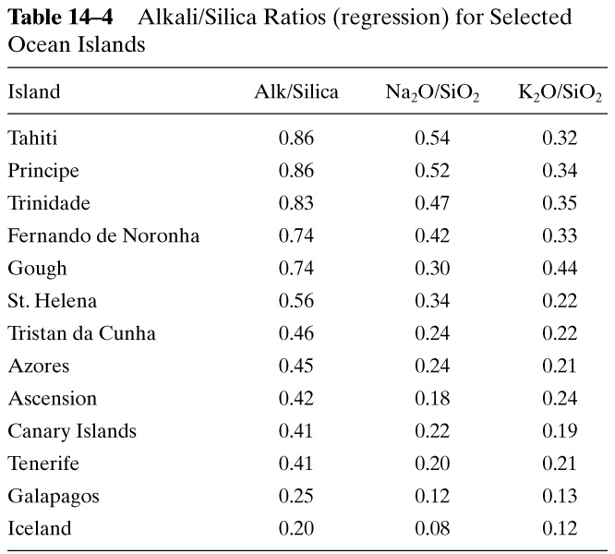
Alkali/ Silica Ratios, Ocean Islands
Notes:
It is useful to compare the alkali/SiO₂, together with Na₂O/SiO₂ and K₂O/SiO₂ ratios.
Table 14-4 shows the data for thirteen islands, in order of decreasing total alkalinity. Each ratio represents a least-squares fit of the alkali vs. silica variation diagrams for each island. For islands on which rhyolites occur, highly evolved samples with large alkali depletion were omitted, in order to avoid skewing the data. The last two islands listed, Galapagos and Iceland, are actually tholeiitic.
The alkali elements are incompatible, expected to show little effects from early fractional crystallization, even up to 50%. A look at the Na vs. K numbers shows large differences, again arguing for at least two mantle sources.
Thus we have seen that OIT’s are chemically distinct from MORB’s. The OIT’s are the result of either:
1. Less extensive partial melting than MORB
2. Melting of less depleted mantle, possibly from the region below 660 km
The OIA situation is even more complicated. Possibilities include:
1. Complex melting processes
2. An even more heterogeneous mantle
3. Both

Slide 13
OIB Trace Element Chemistry
LIL – Large-Ion Lithophile ions
  K, Rb, Cs, Ba, Pb²⁺, and Sr
  Incompatible with silicate minerals, except for Ba and Sr in plagioclase
HFS – High-Field Strength Ions
  Th, U, Ce, Zr, Hf, Nb, Ta, and Ti
Notes:
Careful examination of trace element chemistry can also yield important information. We have previously discussed incompatible elements, without much differentiation. It is useful to distinguish types of incompatible elements. Two examples are the LIL’s and HFS elements. LIL stands for Large-Ion Lithophile elements, which include K, Rb, Cs, Ba, Pb²⁺, and Sr. They are incompatible with silicate minerals, except for Ba and Sr in plagioclase. HFS stands for High-Field Strength Elements, which include Th, U, Ce, Zr, Hf, Nb, Ta, and Ti.
LIL elements are all enriched in OIB relative to MORB. They can be used to evaluate three things.
1. Source composition
2. Degree of partial melting and residual phases
3. Subsequent fractional crystallization
They cannot always discriminate between these processes, however. Typically, the ratios of incompatible elements are used, as we have seen. For the LIL elements, the ratio of K/Ba has proven useful.

Slide 14
K/Ba Ratio
Notes:
All four of these rocks appear to have separate sources.
The HFS data is also revealing. The ratio most commonly used is Zr/Nb. For N-MORB’s, it is typically > 30, whereas for OIB it is < 10. Ratios for N–MORB near ocean island plumes generally show Zr/Nb (and Y/Nb) values which fit a mixing line between the N–MORB and the adjacent OIB.
Compatible elements can also be useful. Ni and Cr both are accommodated in the olivine structure. OIA rocks are depleted in both Ni and Cr relative to OIT and MORB. This indicates the OIA’s have experienced fractional crystallization of olivine prior to eruption.
REE elements are useful, as we have seen.

Slide 15
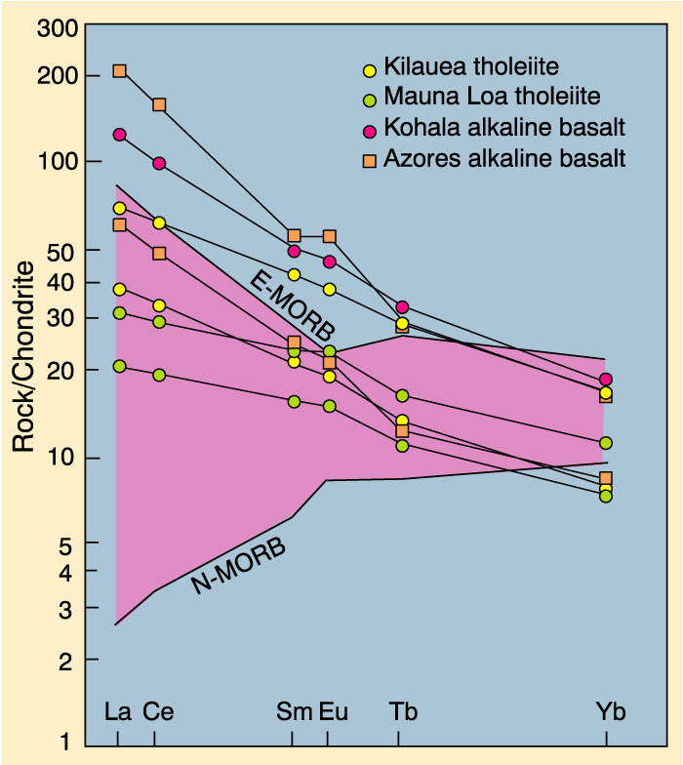
REE for OIB,
N-MORB, and
E-MORB
Figure 14.4. After Wilson (1989) Igneous Petrogenesis. Kluwer
Notes:
Figure 14-4 shows a number of REE curves, for both tholeiite and alkaline basalts. Also shown are the range of N-MORB data. The alkaline basalts have steeper slopes, implying greater LREE enrichment. The tholeiites are similar to E-MORB, although they do fall within the upper range of N-MORB’s. If partial melting is greater than 10%, there should be little inter-element fractionation. The La/Sm slopes should be nearly the same for the source magma and the derivative magma. Thus, the data of 14-4 suggest heterogeneous source regions. The HREE elements also show fractionation, not seen in either E-MORB or N-MORB. The only common mineral that affects HREE patterns is garnet. The HREE fractionation tells us garnet was a likely residual phase. Since garnets exist only at depth, separation of the OIB melts from their residuum probably occurred deeper than 60 kms.
E-MORBS have a negative slope, whereas N-MORB has a positive slope. This suggests that all of these rocks have a magma source in the lower, enriched mantle. (It is also possible to get LREE enrichment form very low degrees of partial melting of a slightly depleted source.)
Spider diagrams may also be used.

Slide 16
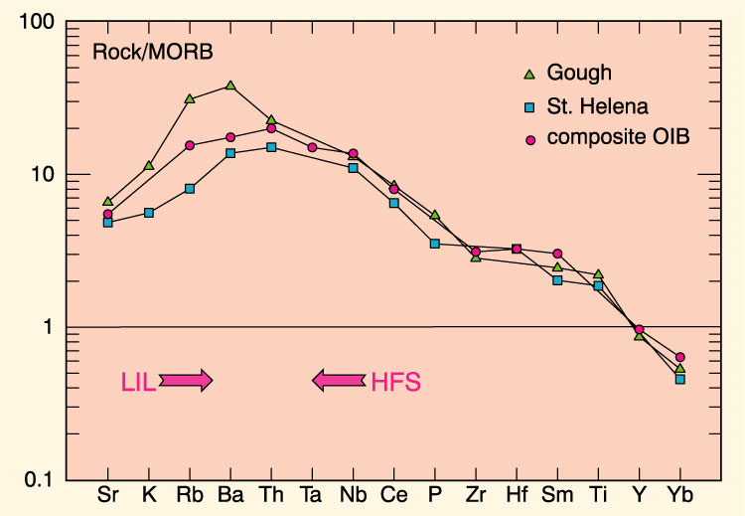
Spider Diagram for OIB
Figure 14-5. Winter (2010) An Introduction to Igneous and Metamorphic Petrology. Prentice Hall. Data from Sun and McDonough (1989).
Notes:
Figure 14-5 shows a spider diagram for Gough and St. Helena, as well as a composite OIB. All show enrichment in incompatible elements versus MORB. The LIL elements (Sr - Ba) are enriched, with enriching enrichment toward the most incompatible element, Ba. The HFS (Yb-Th) ions are also enriched, with increasing enrichment toward the least compatible element, thorium. A single-stage magmatic differentiation, likely partial melting, of a four phase lherzolite, would produce such a pattern. This is a typical pattern for melts generated from relatively undepleted source rocks in intraplate environments.

Slide 17
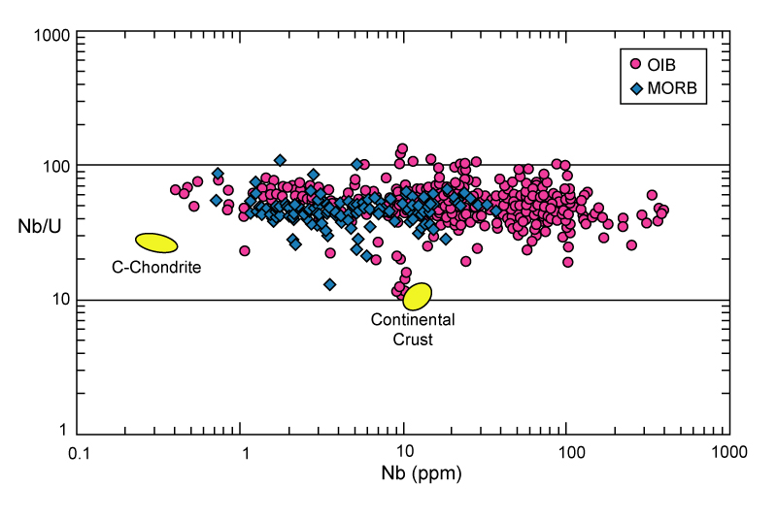
Nb/U ratio
Figure 14.6. Nb/U ratios vs. Nb concentration in fresh glasses of both MORBs and OIBs. The Nb/U ratio is impressively constant over a range of Nb concentrations spanning over three orders of magnitude (increasing enrichment should correlate with higher Nb). From Hofmann (2003). Chondrite and continental crust values from Hofmann et al. (1986).
Notes:
Another approach has been taken by A.W. Hofmann and colleagues, who use numerous ratios in addition to La/Sm. One example is shown in figure 14-6.
Over a range of three orders of magnitude in Nb concentration, this ratio does not appear to change significantly, and is nearly constant in MORB and OIB. Both MORB and OIB are significantly enriched in Nb and U relative to C-type condrites, implying the mantle has evolved over time, with enrichment in these elements. Hofmann et al. argued for an early fractionation of the primitive mantle into a continental crust enriched in Nb, but with a lower Nb/U ratio than the depleted mantle. They argue the depleted mantle was then rehomogenized over time. This implies that little, if any, primitive mantle exists on earth.
Thus, the trace element data again paint a picture of heterogeneous sources. However, differences in degrees of partial melting, and the possibility of fractional crystallization of high-pressure phases, such as garnet and pyroxene, at great depth may produce some of the observed data. Thus examination of isotopic data is necessary.

Slide 18
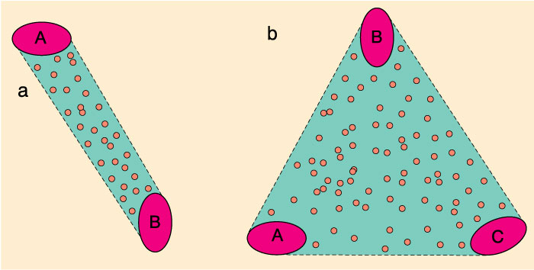
Mixing of Reservoirs
Binary
All analyses fall between two reservoirs as magmas mix
Ternary
All analyses fall within triangle determined by three reservoirs
Figure 14.7. Winter (2001) An Introduction to Igneous and Metamorphic Petrology. Prentice Hall.
Notes:
OIB Isotope Chemistry
When isotopic ratios are observed to vary over a spectrum of values, we generally assume that two or more reservoirs are responsible.
Mixing between two reservoirs, each with limited variability of its own, can produce a linear distribution of values, such as is seen in figure 14-7a. If three reservoirs mix, a triangular pattern would result (figure 14-7b). Note that these diagrams are schematic only. The triangle does not need to be equilateral, for example.

Slide 19
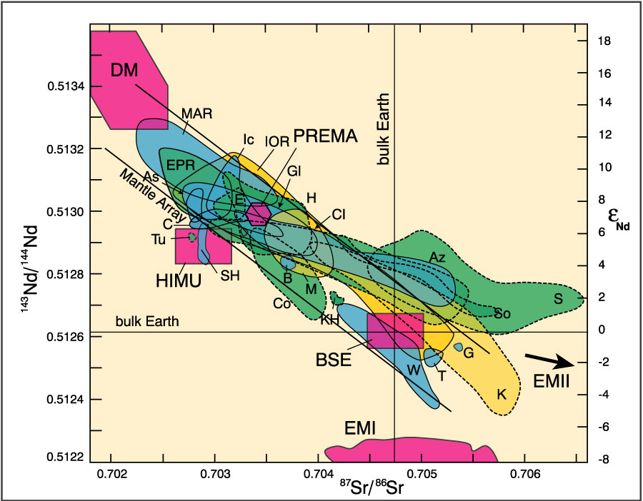
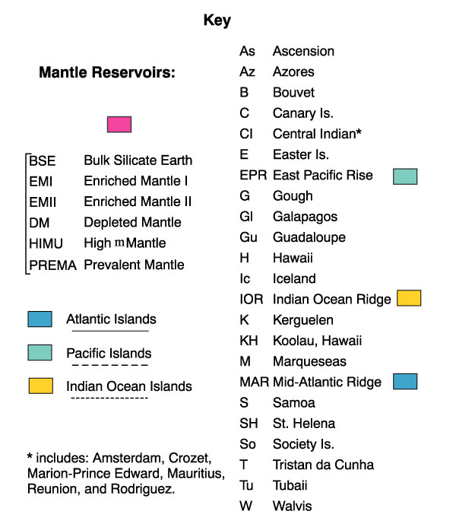
Isotope Ratios for OIB and MORB
Figure 14-8. After Zindler and Hart (1986), Staudigel et al. (1984), Hamelin et al. (1986) and Wilson (1989).
Notes:
Returning to the Sr and Nd isotopes, a plot of potential mantle reservoirs, together with the measured ratios of about two dozen oceanic islands can be produced.
The result is a very busy diagram (figure 14-8). This diagram includes six proposed mantle reservoirs!

Slide 20
Mantle Reservoirs
1. DM (Depleted Mantle) = N-MORB source
Figure 14.8. After Zindler and Hart (1986), Staudigel et al. (1984), Hamelin et al. (1986) and Wilson (1989).
Notes:
DM (upper left) stands for depleted mantle, and represents the well-established values for rock thought to originate in magma of the upper mantle.

Slide 21
2. BSE (Bulk Silicate Earth) or the Primary Uniform Reservoir
Figure 14.8. After Zindler and Hart (1986), Staudigel et al. (1984), Hamelin et al. (1986) and Wilson (1989).
Notes:
The reservoir labeled BSE (Bulk Silicate Earth) is a hypothetical reservoir which would occur if the primitive mantle were to evolve (via radioactive decay) without any further fractionation of radioactive elements. Some oceanic islands have this isotopic signature, but it is not really necessary as a reservoir. The same composition may come from mixing of other reservoirs. NOTE: Just because a reservoir is not necessary does not mean it doesn't exist, just that we cannot be sure it does, based on the available data.

Slide 22
5. PREMA (PREvalent MAntle)
Figure 14.8. After Zindler and Hart (1986), Staudigel et al. (1984), Hamelin et al. (1986) and Wilson (1989).
Notes:
PREMA (Prevalent Mantle) is another proposed reservoir which corresponds to several oceanic islands, including Easter Island, Hawaii, the Galapagos Islands, and Iceland. But it is in the middle of the mantle array, and can be made but mixing of other reservoirs. The reason for considering it as a separate reservoir is the frequent occurrence of this composition, in geographically diverse locations.
Although not a mixing end-member, PREMA represents another restricted isotopic range that is very common in ocean volcanic rocks
Although it lies on the mantle array, and could result from mixing of melts from DM and BSE sources, the promiscuity of melts with the PREMA signature suggests that it may be a distinct mantle source

Slide 23
3. EMI = enriched mantle type I has lower ⁸⁷Sr/⁸⁶Sr (near primordial)
4. EMII = enriched mantle type II has higher ⁸⁷Sr/⁸⁶Sr
(> 0.720), well above any reasonable mantle sources
Figure 14.8. After Zindler and Hart (1986), Staudigel et al. (1984), Hamelin et al. (1986) and Wilson (1989).
Notes:
The extension of the Nd/Sr data beyond the BSE reservoir requires at least one reservoir with even greater enrichment. In fact, two reservoirs have been proposed. They are called EMI (Enriched Mantle I) and EMII (Enriched Mantle II). EMI has values of ⁸⁷Sr/⁸⁶Sr which are near the primodal value of 0.704-0.706. EMII, as proposed, has much higher values of ⁸⁷Sr/⁸⁶Sr, (>0.720). There is no known mantle source with a value this high. All island compositions, as well as all other reservoirs, can be made by various mixtures of DM, EMI, and EMII. The high ⁸⁷Sr/⁸⁶Sr in EMI, and especially EMII, require a high parental Rb content. Rb concentrates in the continental crust. EMI would require a continental crust component, and more than 1 Ga to produce. Oceanic crust has less Rb, so the production times would need to be longer.

Slide 24
Pb Isotopes
Pb produced by radioactive decay of U & Th
²³⁸U → ²³⁴U → ²⁰⁶Pb
²³⁵U → ²⁰⁷Pb
²³²Th → ²⁰⁸Pb
Notes:
Another isotopic system can be usually employed. These are the uranium-lead and thorium-lead systems. Three reactions are involved.
Lead is a large, incompatible ion. It will quickly segregate itself into a liquid phase, and will migrate upward to become incorporated in oceanic or continental crust. Thus, there is relatively little lead in the mantle.

Slide 25
Pb Is Quite Scarce in the Mantle
  Mantle-derived melts are susceptible to contamination from U-Th-Pb-rich reservoirs which can add a significant proportion to the total Pb
  U, Pb, and Th are concentrated in sialic reservoirs, such as the continental crust, which develop high concentrations of the radiogenic daughter Pb isotopes
  ²⁰⁴Pb is non-radiogenic, so ²⁰⁸Pb/²⁰⁴Pb, ²⁰⁷Pb/²⁰⁴Pb, and ²⁰⁶Pb/²⁰⁴Pb increase as U and Th decay
  Oceanic crust has elevated U and Th content (compared to the mantle) as will sediments derived from oceanic and continental crust
  Pb is perhaps the most sensitive measure of crustal (including sediment) components in mantle isotopic systems
  Since 99.3% of natural U is ²³⁸U, the ²⁰⁶Pb/²⁰⁴Pb will be most sensitive to a crustal-enriched component
Notes:
Mixing of mantle material with crustal material will greatly change the observed lead-lead isotopic ratios, with ²⁰⁶Pb/²⁰⁴Pb being the most sensitive to crustal contamination. Plots of ²⁰⁷Pb/²⁰⁴Pb versus ²⁰⁶Pb/²⁰⁴Pb can thus yield information about possible contamination. If no contamination of mantle material has occurred, the data should plot along the geochron, with the ratio depending only on the age of the sample.

Slide 26
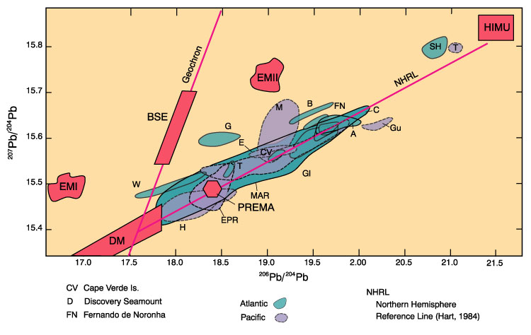
Pb Isotope Ratios for MORB’s and OIB’s, Atlantic and Pacific
Figure 14-9. After Wilson (1989) Igneous Petrogenesis. Kluwer.
Notes:
Figure 14-9 shows such a plot. Essentially none of the oceanic island data plot on the geochron. Examination of the triangle formed by DM-EMI-EMII shows that most volcanoes do not lie within the boundaries. This strongly suggests that at least one more reservoir is required. This reservoir is called HIMU (High μ), because μ = ²³⁸U/²⁰⁴Pb, used in U-Pb systems for evaluation of parental lead enrichment. HIMU was plotted in 14-6, but is not distinctive. In 14-7, it is very distinctive, with most volcanoes, especially those in the northern hemisphere, plotting along a line between DM and HIMU. The line connecting DM-HIMU is called NHRL, for Northern Hemisphere Reference Line.
What could this HIMU reservoir represent? It is not enriched in Rb, because the ⁸⁷Sr/⁸⁶Sr ratio is low. Since ²⁰⁶Pb/²⁰⁴Pb is high, it must be enriched in uranium. The Nd/Sr suggest it is over 1 Ga, since it has appropriate isotopic ratios in this system. Several ideas have been proposed for the origin of HIMU.

Slide 27
Origin of HIMU
μ = ²³⁸U/²⁰⁴Pb, and is used to evaluate uranium enrichment
The HIMU reservoir is quite distinctive in the Pb system, having a very high ²⁰⁶Pb/²⁰⁴Pb ratio, suggestive of a source with high U, yet not enriched in Rb, and old enough (> 1 Ga) to develop the observed isotopic ratios by radioactive decay over time
Several models have been proposed for this reservoir, including subducted and recycled oceanic crust (possibly contaminated by seawater), localized mantle lead loss to the core, and Pb-Rb removal by those dependable (but difficult to document) metasomatic fluids
The similarity of the rocks from St. Helena Island to the HIMU reservoir has led some workers to call this reservoir the “St. Helena component”
Notes:
Although the NHRL fits the Northern Hemisphere data well, data from Southern Hemisphere volcanoes depart from the NHRL line, with increased ²⁰⁸Pb/²⁰⁴Pb. This suggests an enrichment in Th, as well as U. Contamination by another reservoir, likely one of the EM's, is suspected.

Slide 28
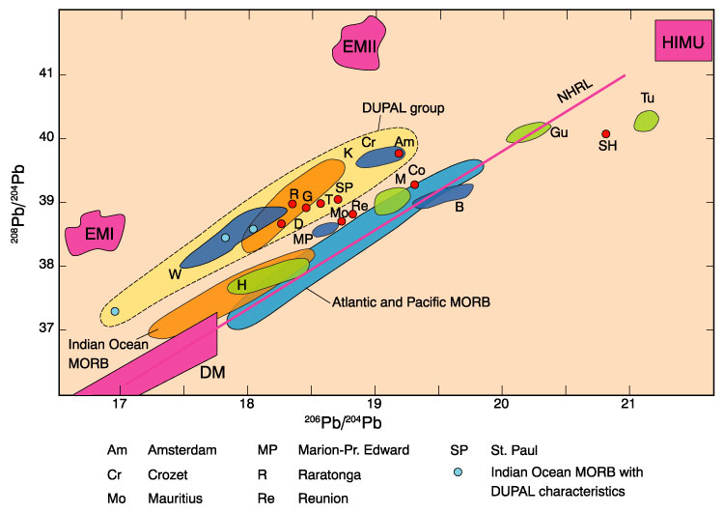
Pb Isotope Ratios for MORB’s and OIB’s, Atlantic, Pacific & Indian Oceans
Figure 14.10 After Wilson (1989) Igneous Petrogenesis. Kluwer. Data from Hamelin and Allègre (1985), Hart (1984), Vidal et al. (1984).
Notes:
Figure 14-10 shows a plot of ²⁰⁸Pb/²⁰⁴Pb versus ²⁰⁶Pb/²⁰⁴Pb. The thorium content of the EM's is not well known, so their positions on 14-10 is an approximation. A group of Indian Ocean volcano's, first identified by Dupré and Allègre and called DUPAL in their honor, seems to be a mix between HIMU and either EMI or EMII.
The available data suggest the mantle is certainly heterogeneous. There appear to be several reservoirs within the mantle. The reservoirs appear to have remained distinct for over 1 Ga, with no homogenization.

Slide 29
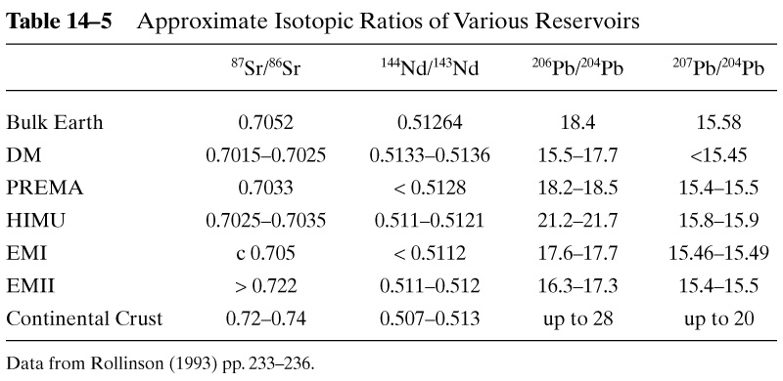
Isotopic Ratios of Various Reservoirs
Notes:
Table 14-5 summaries the isotopic values for various reservoirs.
The differences between the DUPAL and NHRL volcanoes suggest a geographic relationship. One measure of the degree of EM contamination is Δ8/4, which is shorthand for the deviation of ²⁰⁸Pb/²⁰⁴Pb from the NHRL line.

Slide 30
Pb Isotope Anomaly Contours
Figure 14.11. From Hart (1984) Nature, 309, 753-756.
Notes:
Figure 14-11 shows a contour plot of the Δ8/4 data. The thorium enriched volcanoes plot as a band near 30̊S latitude. The reason for this is still a mystery.
The biggest problem with the data interpretations are the reservoirs EMI, EMII, and HIMU. Although solid data supports the existence of each reservoir, the enrichments they appear to have are beyond the ability of any known mantle process to produce. EMI, which is only slightly enriched, may correspond to lower continental or oceanic crustal contamination. EMII is strongly enriched in Rb, U, and Th, which suggests contamination with upper continental crust, or oceanic island crust. The only known method of introducing such material into the mantle is subduction. The data suggest they have remained isotopically distinct, indicating homogenization has not occurred.
Petrogenesis of OIB's
The OIB major and trace element chemistry both suggest a source of magma distinct from that of N-MORB. One possibility is the mantle below 660 km, previously proposed as the source of E-MORB.

Slide 31
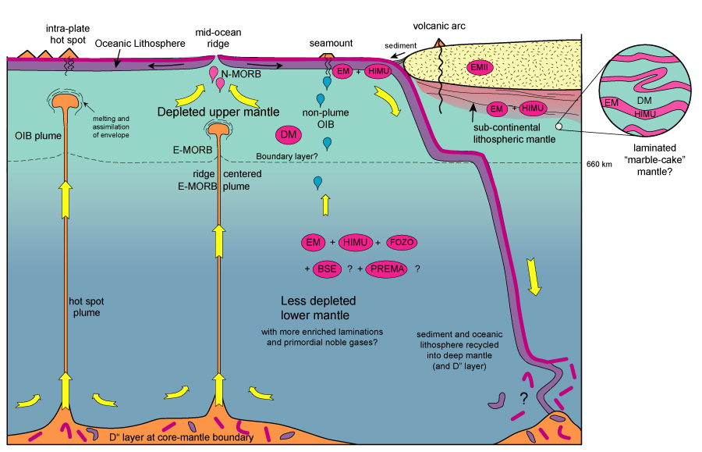
Oceanic Volcanism Model
Figure 14.19. Schematic model for oceanic volcanism. Nomenclature from Zindler and Hart (1986) and Hart and Zindler (1989).
31
Notes:
Figure 14-19 is a schematic illustration of a two-layer mantle with various reservoirs included. The upper mantle is depleted (DM) and is the source for N-MORB. The lower mantle is the source for E-MORB and OIB. This latter zone contains chemically and isotopically distinct zones. These include a non-depleted zone (BSE), a somewhat depleted zone (PREMA) and three enriched zones, EMI, EMII, and HIMU. All of the latter are thought to be derived from crustal rock, either ancient oceanic crust or sediment, derived from either oceanic or continental crust. This implies they have been subducted to a level below 660 km and partially recycled.
How can light crustal rock be pushed so deep into the earth? The mafic rocks of the oceanic crust will transform into eclogite (via metamorphosis) which includes a dense pyroxene, omphacite, and garnet. Eclogite is denser than olivine-pyroxene lherzolite. However, the oceanic crust is only about 10 kms thick, while the entire subducted plate is about 100 km thick. The remainder is upper mantle material. However, this is relatively cold, and therefore dense. Apparently the density of the combined crust-mantle lithosphere is great enough to drive subduction to the 660 km level.
It is known that lithospheric plates do not penetrate more than about 700 kms. Recent evidence also suggests that plates break off, flatten out (horizontal orientation), and accumulate at this depth. Both the mantle lherzolite and eclogite both change at the 660 km boundary. Their densities may become similar. Some subducted material may reach all the way to the core-mantle boundary, possibly acting as a source of hot-spot plumes.
OIA appears to be generated by plume volcanism. Laboratory mixtures of basalt and peridotite melt to yield both tholeiite and alkaline basalt, similar to OIB. The basalts melt first, but maintain equilibrium with the peridotite, and the resulting melt has the character of a mantle melt. The volume of melt is much greater than for peridotite alone. Plumes start as rising diapirs of solid rock at the 660 km boundary. Decompression melting in the 5-15% range produces alkaline magma. Tholeiites form from 15-30% melting, or even less if eclogites from subducted basalt is included. Melts segregate somewhere between 50-80 km below the surface, behaving independently above that depth. Fractional crystallization in shallow magma chambers can produce further evolution of the magma.

Slide 32
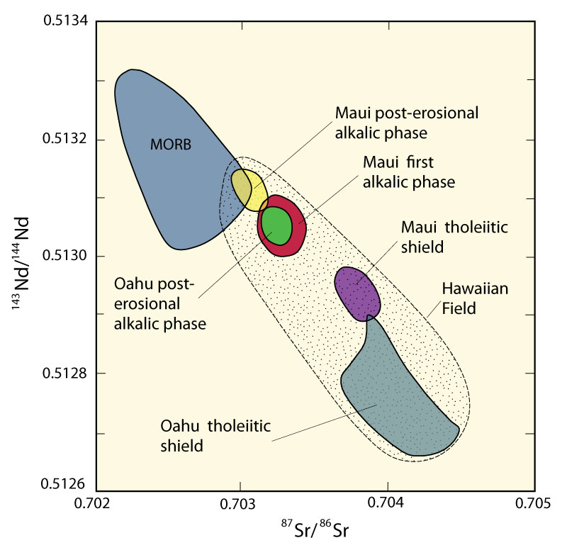
¹⁴³Nd^{/ 144}Nd vs. ⁸⁷Sr^{/ 86}Sr, Hawaii
Odd:
Tholeiites exhibit enriched isotopic characteristics and alkalic is more depleted (opposite to usual mantle trends for OIA-OIT).
Probably due to more extensive partial melting in the plume axial area (→ tholeiites) where the deep enriched plume source is concentrated
Less extensive partial melting (→ OIA) in the margins where more depleted upper mantle is entrained
32
Figure 14.21. ¹⁴³Nd/¹⁴⁴Nd vs. ⁸⁷Sr/⁸⁶Sr for Maui and Oahu Hawaiian early tholeiitic shield-building, and later alkaline lavas. From Wilson (1989). Copyright © by permission Kluwer Academic Publishers.
Notes:
Hawaii presents a special problem. Figure 14-21 shows that the alkaline magmas, which are enriched in major and trace elements, are isotopically depleted, whereas the tholeitic basalts of Oahu are major and trace element depleted, but isotopically enriched. Pb isotope data suggests there are three source components, including one which is oceanic lithosphere. Models suggested include different degrees of lithospheric assimilation, partial melting of a heterogeneous mantle, possibly low degrees of melting of isotopically depleted mantle mixed with larger melting percentages of enriched mantle sources.

