Slide 1
Petrology Lecture 4
Igneous Structures and
Field Relationships
GLY 4310 - Spring, 2019
Notes:
Igneous petrology can be studied at levels from the submicroscopic, through the microscopic, macroscopic (hand specimens), in the field at the outcrop level or deposit level, to landforms, and to truly large scale observations from aerial photography, satellite imagery or satellite remote sensing. Relating the properties of magmas and rocks in the laboratory to field observations and to the overall behavior of the earth is one important aspect of petrology.
Magma properties
Two of the most important properties of magma are its viscosity and its volatile (gas) content. Volcanic eruptions occur in a number of ways. Understanding how and why volcanoes erupt in certain ways gives important clues to the danger each poses. Volcanic deposits are also of interest. Both the type of eruptions and the type of deposits depend on the physical properties of magma.

Slide 2
Viscosity and Temperature
Anhydrous rhyolitic magma
  1400°C - 10⁵ poise
  1000°C - 10⁸ poise
Notes:
Viscosity depends on three factors:
Temperature - as temperature increases, viscosity drops

Slide 3
Viscosity and Composition
Anhydrous olivine basalt
  1400°C - 10 poise
Anhydrous rhyolitic magma
  1400°C - 10⁵ poise
Notes:
Composition - the higher the silica content the higher the viscosity. Bonding in liquids mimics the bonding seen in the minerals that are eventually produced from the melt. Felsic magmas have a great deal of Si and Al, which tend to form chains like Si-O-Si-O or Si-O-Al-O. The bonds in which oxygen is between two Si ions or an Si and an Al ion are called bridging bonds. Bonds to cations like magnesium or iron are weaker, and are non-bridging. Bridging results in polymerization. The longer the polymerized chains, and the more chains that form, the higher the viscosity.

Slide 4
Viscosity and Volatiles
Anhydrous rhyolitic magma
  1000°C - 10⁸ poise
Rhyolite melt, 2 wt. % H₂O
  1000°C - 10⁶ poise
Rhyolite melt, 8 wt. % H₂O
  1000°C - 10⁴ poise
Notes:
Volatile content - The presence of water and alkali elements (volatiles) reduces viscosity. This occurs because these substances substantially reduce the chain length in polymers.
Volatile content plays another role for shallow intrusives or extrusives. As the magma rises, confining pressure is reduced. Volatiles begin to escape from solution, forming a separate phase. When gas pressure > confining pressure, the gas may produce an explosive eruption, with a rapid loss of volatiles. Gases associated with magmas:

Slide 5
Gases Associated with Magmas
Common: H₂O, CO₂
Others: SO₂, H₂, HCl, Cl₂, F₂, H₂S
Basaltic magma: Volatile content about 0.5 wt%
Rhyolitic magma: Volatile content exceeds 5.0 wt%
Notes:
NOTE: Although reported as wt. %, volatile content is actually much higher when considered on a molecular basis.

Slide 6
Gases on Molecular Basis
Albite has a molecular weight of 262 g/mol, while water has a weight of 18 g/mol.
  If a sample has 1 wt. % water, it is one gram of water and 99 grams of albite - On a molecular basis, that is 0.056 moles of water, and 0.38 moles of albite, or 13.3 mol % water
  At 10 wt % water, the number increases to 62 mol % water
Notes:
Volatiles are low in density and size. They diffuse rapidly, and tend to concentrate near the top of shallow magma chambers. Most eruptions are initially violent, and rapidly become less violent as the volatile content is used up. If viscosity is low, volatiles move easily and escape before much pressure builds up. Hawaiian volcanoes are characterized by lava fountaining, followed by lava flows which form lava rivers and lakes. Late escaping gases may cause some spattering, but not with enough force to be dangerous. High viscosity magmas make volatile diffusion more difficult, with the gases reaching very high pressures. When a breech in the overlying rock occurs, the volatiles erupt violently from solution, forming a rapidly expanding gas phase underground. The gases push magma, and often rock fragments, outward and upwards. When Krakatau exploded in 1883, the waves if created in the ocean traveled half way around the earth, being detected by tidal gauges in the English channel.
Escaping volatiles also effect rocks.

Slide 7
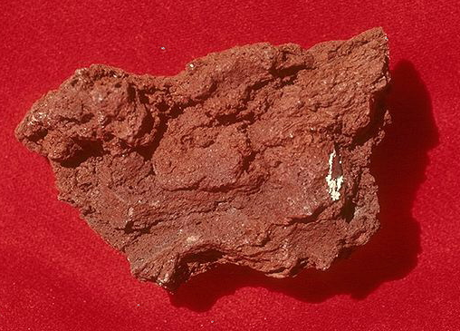
Scoria
When volatiles remain in magma on the surface, they rise to the surface
In basalts, the magma isn’t too vicious, and there isn’t a large initial volatile content
The result of rising magma is a vesicular rock called scoria
Notes:
Photo #0464055_.jpg on Cinema Expeditions “Rock” CD-ROM, in the extrrusiv/scoria dbase.

Slide 8
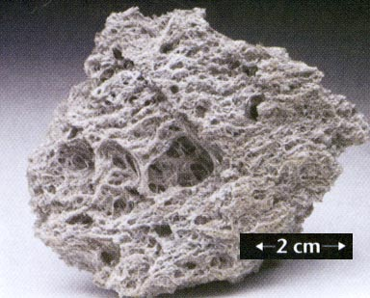
Pumice
In a rhyolitic magma, the initial volatile content is high, and so is viscosity
After loss some volatiles to the atmosphere, the viscosity increases rapidly
When the remaining volatiles reach the top of the magma, a frothy, glassy rock known as pumice is formed
Notes:
Photo: http://www.calstatela.edu/faculty/acolvil/igneous/pumice.jpg
Volcanic vents
Volcanoes may erupt from a central vent, or from long fractures. Central vent eruptions produce the more spectacular landforms. The eruptions from fractures produce the greatest magma volumes, covering huge areas of land.
Central vent eruptions occur in several kinds. The vent itself is the top of a cylindrical, pipe-like conduit. The vent is often marked by a bowl-shaped depression, or volcanic crater. Magma follows the path of least resistance, along fractures or fracture intersections, to the surface. At the end of an eruption, the remaining magma solidifies in the vent, sealing the fractures and the crater. Future eruptions may find new paths to the surface, creating multiple vents.

Slide 9
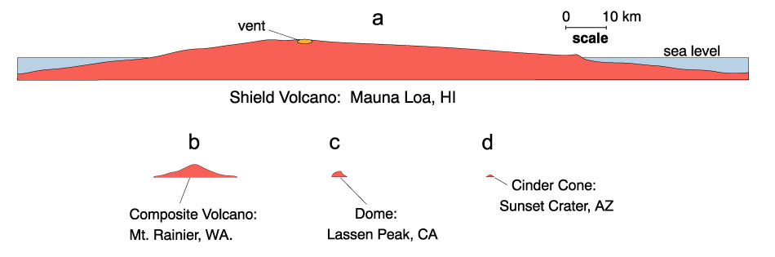
Types of Central Vent Volcanoes
Notes:
Shield volcanoes form when fluid lavas, usually basalt, erupt. Typically the eruption may start as a small pyroclastic explosion but typically subsides to a predominantly flow mode quickly. The fluid character of the lava creates a low flow angle of 2-3̊, and never more than 10̊. Individual flows are a few meters thick. In Hawaii, some flows have traveled more than 50 kilometers. Volcanoes over hot spots, like Hawaii, are volumetric giants - >40,000 km³ . The Hawaiian volcanoes, Mauna Loa and Mauna Kea, are the largest mountains on earth, when measured from their true base, the ocean floor, which is over 9 kilometers deep. On Mars, Nix Olympica is so large that it stretches the equivalent of the distance from Los Angles to Chicago, and rises 90,000 feet, clear out of the Martian atmosphere. Shield volcanoes may develop vent eruptions on the sides (flank eruptions) or eruptions through fractures along the side (fissure eruptions).
Composite, or stratovolcanoes, are composed of layers (strata) of different types of lavas. The dominant type is usually andesite. Compositions range from basalt to dacite, and even occasionally rhyolite. On average they are more silicic than shield volcanoes. This results in steeper cones, with slope angles up to about 36̊. Their sides are concave-upward, with the steepest slopes near the peak. The Cascade Volcanoes, Including Mounts Rainier and St. Helens, the Andes mountains, Mt. Fuji, and Mt. Vesuvius, are examples. In terms of volume, they are about 1% as large as a big shield volcano.

Slide 10
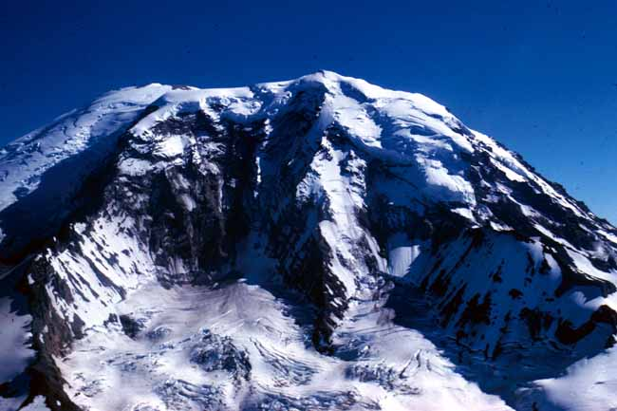
Stratovolcano Crossection
Figure 4.3 (above). Illustrative cross section of a stratovolcano. After Macdonald (1972), Volcanoes. Prentice-Hall, Inc., Englewood Cliffs, N. J., 1-150.
Right Deeply glaciated north wall of Mt. Rainier, WA, a stratovolcano, showing layers of pyroclastics and lava flows. © John Winter and Prentice Hall.
Notes:
Eruption types vary with the type of magma. Basaltic eruptions are usual small fountains associated with flows. The more common andesitic eruptions are explosive. Mt. St. Helens, like Mount Lassen in 1915, was dacitic and therefore very explosive. Shallow magma chambers often feed parasitic cones on the flanks of the volcano. Over time, the shape of the cone changes. Weathering and erosion tear away the cone, new eruptions build it up.

Slide 11
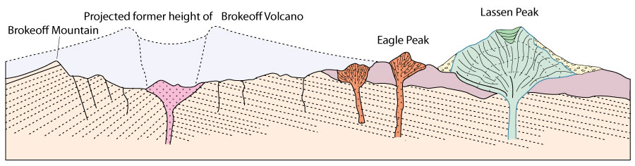
Lava Dome
Figure 4.4. Schematic cross section of the Lassen Peak area.
After Williams (1932), Univ. of Cal. Publ. Geol. Sci. Bull., 21.
Notes:
Plugging of the central vent may lead to future eruptions in the same general area, a distributed system called a volcanic complex. The area around Mt. Lassen is an example.
Domes are the result of a viscous, silicic magma (rhyolite to dacite, occasionally andesite) which has lost volatile content oozes slowly and quietly to the surface. Although they sometimes form early in an eruptive sequence, they are typically late. They may erupt in the center of a crater, following an explosive eruption.

Slide 12
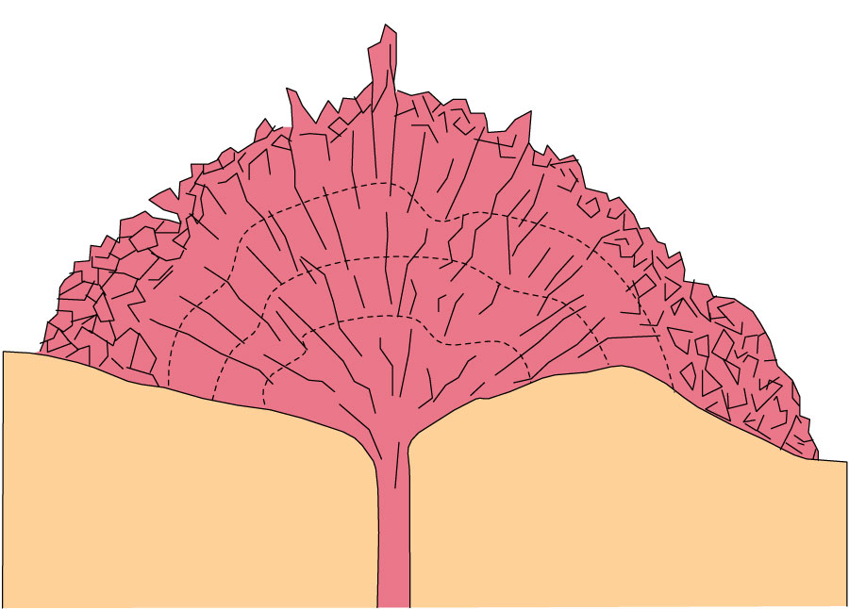
Cross-section of a Lava Dome
Figure 4.7. Schematic cross section through a lava dome.
Notes:
The surface of a dome cracks as expansion continues, forming a brecciated surface. Blocks fall off and roll downhill, accumulating at the base of the dome as talus. Cracks and fractures in the outer surface may allow some sections to push up or out as spines.

Slide 13
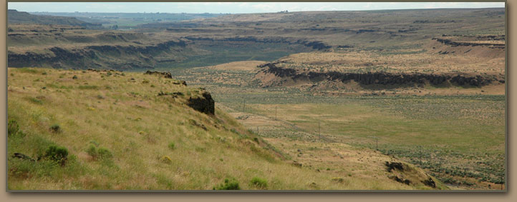
Washtucna Coulée
Coulée in Scablands Region, Eastern Washington
Notes:
Picture source: http://hugefloods.com/Ice-Age-Floods-Coulees.html
Domes grade from steep-sided, nearly symmetric cones, such as Mt. Lassen, to flattened, elongated domes that form by downhill flow (coulées, often seen in the Scabland region of Washington state), to thick flows. Couléees and thick rhyolite to obsidian flows are very viscous, never flowing far from the source. Some are glassy throughout. Glass is usually the product of quick chilling, but some flows are thick enough that chilling cannot have been that rapid. The highly silicic lava may be so strongly polymerized that crystallization in nearly impossible. It is also possible that the motion involved in flow retards crystallization. Flows are generally so viscous that pressure ridges develop on the surface. The magma underneath is warmer and less viscous. It continues to flow, dragging the partially solidified surface with it. Cryptodomes form when gas under a dome inflates the dome like a balloon.
The term coulee must be used with caution, since it has a number of meanings in geology. The word coulee comes from the Canadian French coulée, from the French word couler meaning "to flow".
1. In the western United States, tongue-like protrusions of solidified lava, forming a sort of canyon.
2. The dry, braided channels formed by glacial drainage of the Scablands of eastern Washington, such as Grand Coulee and Moses Coulee.
3. Aside from those formed by volcanic eruptions, they are commonly canyons characterized by steep walls that have been shaped by erosion.
And more….
Calderas
Calderas are large scale collapse features, formed late in the eruptive cycle. In some cases, they may be post-eruptive. Dense solid layers above a shallow magma chamber collapse back into the chamber, either as it empties, or after the eruption is over. Magma may drain as a flank eruption, or by moving through cracks in the overlying rocks. If basaltic magma is involved, the roof may settle into the chamber, displacing lava upwards, and creating a lava lake. When the magma is silicic, the resulting eruptions can be spectacular.

Slide 14
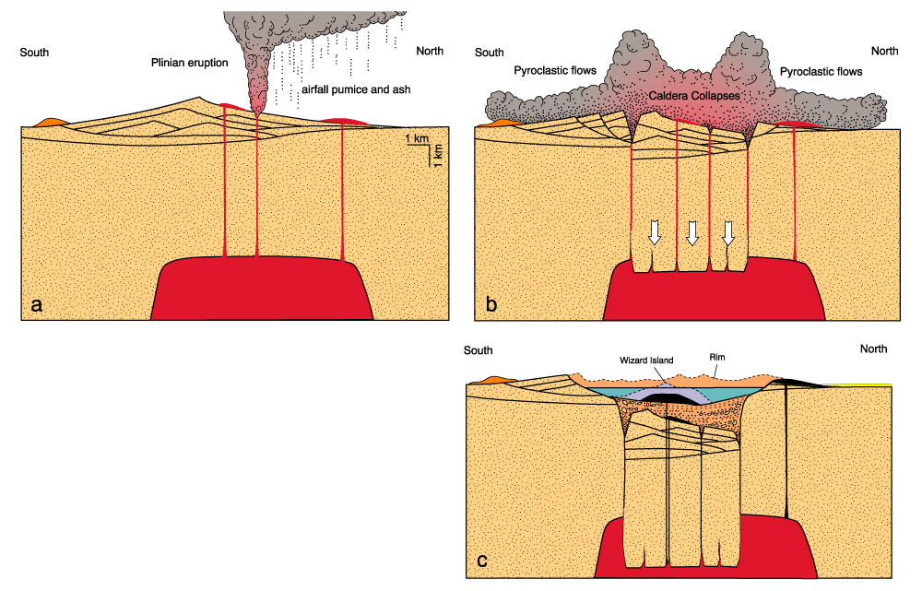
Crater Lake Caldera
Figure 4.9. Development of the Crater Lake caldera.
After Bacon (1988). Crater Lake National Park and Vicinity, Oregon. 1:62,500-scale topographic map. U. S. Geol. Surv. Natl. Park Series.
Notes:
Crater Lake sits atop an ancient stratovolcano, called Mt. Mazama. In a series of eruptions from about 7015 to 6850 ybp, Mazama emptied a very large magma chamber. It collapsed, with magma forming a ring-dike complex. Total ejected material was about 50 km³. Later eruptions produced cinder cones, such as Wizard Island, which is one of the largest of its type in the world.
Even larger calderas can be produced by rhyolitic pyroclastic eruptions. Examples include Yellowstone Caldera, Long Valley in eastern California, and the Valles Caldera of New Mexico. Yellowstone Caldera formed by an eruption of 2500 km³ of material about 2 mybp. A later eruption, about 600,000 years ago erupted only 1000 km³ of magma, producing what is now the West Thumb of Yellowstone lake. Such calderas are too big to see from side to side, which accounts for Yellowstone not being recognized until the 1950's (by a lab geologist!). The center of Yellowstone has risen again, forming a resurgent caldera. The area around Silverton, Colorado is known to be a caldera. It has been argued that this may be part of the largest caldera on earth.

Slide 15
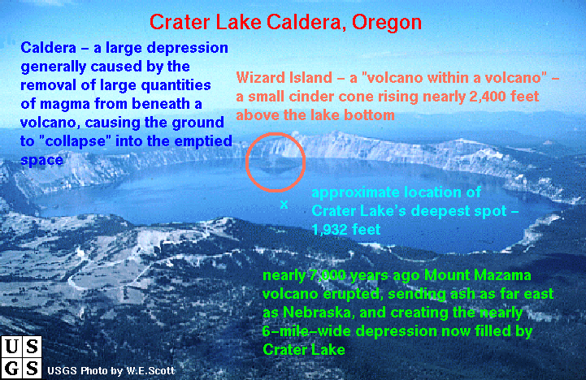
Crater Lake N.P. , Oregon
Notes:
Lake dimensions are approximately 5 x 6 miles. Caldera rim ranging in elevation from 7,000 to 8,000 feet
Picture: crater_lake_caldera.gif

Slide 16
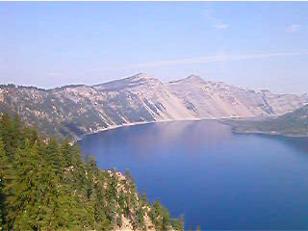
Crater Lake Panorama
Notes:
Video: 20020824 - Crater Lake National Park, OR - Pan of entire lake.wmv

Slide 17
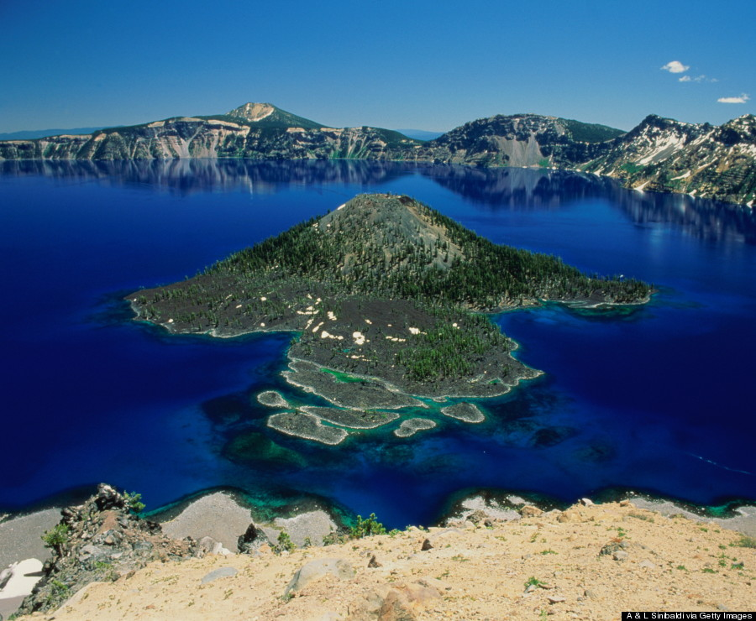
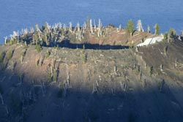
Wizard Island
Wizard Island is a cinder cone rising about 732 feet above lake level
Lake depth: 1949 feet, deepest in the U.S.
Notes:
In the world, it ranks ninth for maximum depth, and third for mean (average) depth.
Photos:
Left: https://www.huffpost.com/entry/wizard-island-is-oregons_n_5674779
Right: http://www.craterlakeinstitute.com/planning-visit/activities/trail-wizard-island-summit.htm
Photo by Robert Mutch

Slide 18
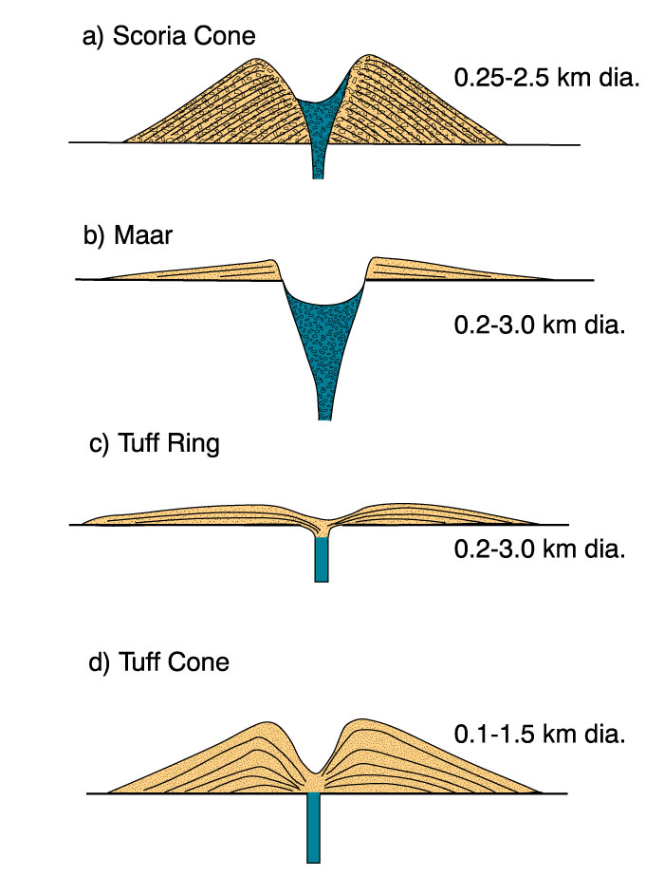
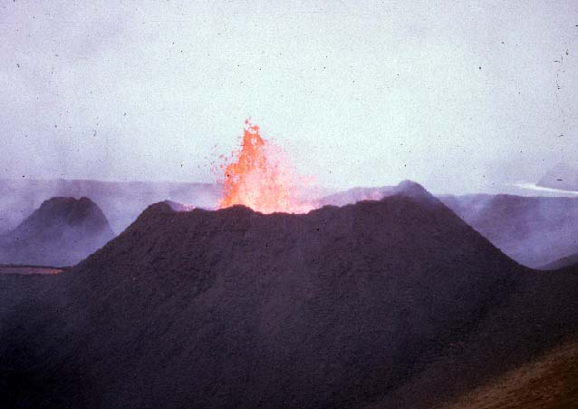
Scoria Cone
Figure 4.5. (above) Cross sectional structure and morphology of small explosive volcanic landforms with approximate scales. After Wohletz and Sheridan (1983), Amer. J. Sci, 283, 385-413.
Figure 4.6 Scoria cone, Surtsey, Iceland, 1996 (© courtesy Bob and Barbara Decker).
Notes:
There are several types of small volcanic vents. Scoria or cinder cones are a type of pyroclastic cone formed from airborne eruptions (ash through blocks) falling back to earth around a central vent. Most are less than 300 meters high, up to about 2 kilometers in diameter, and have slope angles of 33̊, the angle of repose of loose scoria. The composition is usually basaltic. They may be asymmetrical because of elongation along a fissure, or elongation in the direction of a strong prevailing wind
All bedding dips outward.

Slide 19
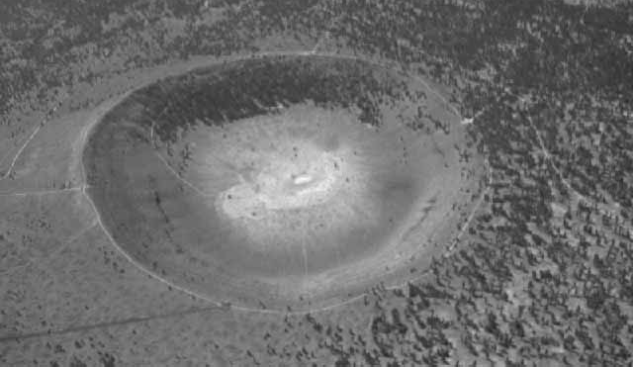
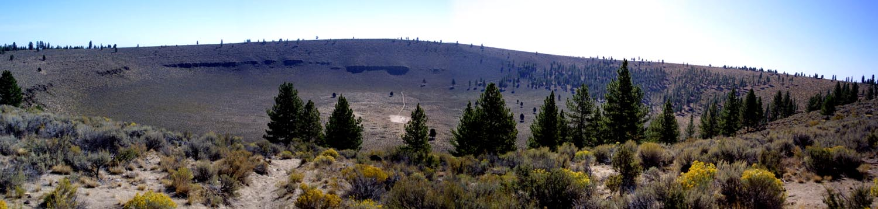
Maar
Figure 4.5. (above) Cross sectional structure and morphology of small explosive volcanic landforms with approximate scales. After Wohletz and Sheridan (1983), Amer. J. Sci, 283, 385-413.
Figure 4.6. Maar, Hole-in-the-Ground, Oregon (upper courtesy of USGS, lower John Winter).
Notes:
Maars are negative topographic features, with craters excavated by hydromagmatic (phreatic) explosions. Such explosions occur when magma interacts with meteoritic water (either surface or groundwater). The water flashes into steam, with a huge increase in volume.
All bedding dips outward.

Slide 20
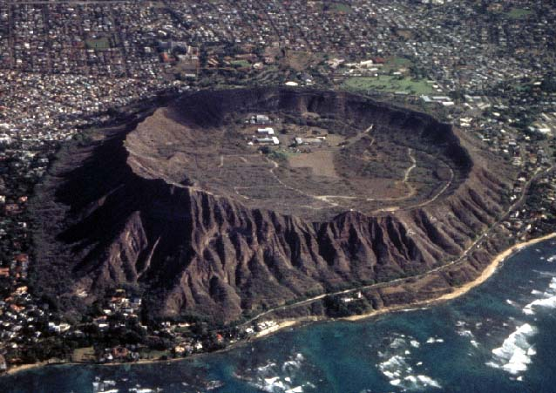
Tuff Ring
Figure 4.5. (above) Cross sectional structure and morphology of small explosive volcanic landforms with approximate scales. After Wohletz and Sheridan (1983), Amer. J. Sci, 283, 385-413.
Figure 4.6 Tuff ring, Diamond Head, Oahu, Hawaii (courtesy of Michael Garcia).
Notes:
Tuff rings and tuff cones are also the result of magma reactions with meteoritic water, under somewhat different conditions.
Tuff rings form when a basaltic magma gets close to the surface before encountering meteoritic water. The magma:water ratio is high. Layers of scoria plus ash dip inward and outward at the same angle. Diamond Head in Hawaii is an example.

Slide 21
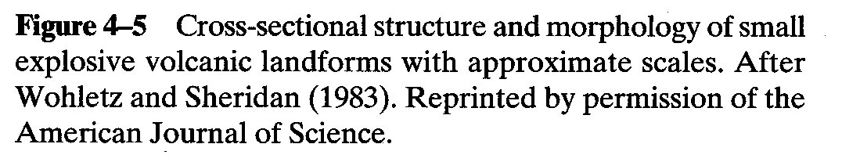
Tuff Cone
Notes:
Tuff cones are smaller, have steeper sides, and smaller central craters. They result from magma interacting with shallow surface water. They resemble scoria cones, but have bedding that dips inward at a steep angle and outward at shallower angles. In scoria cones, all bedding dips outward.

Slide 22
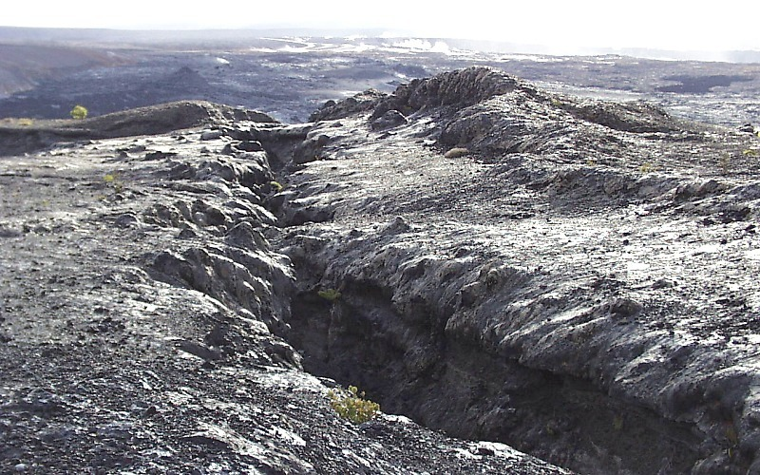
Fissure Eruption
Eruptive fissure on southeast rim of Kilauea caldera, Hawaii
Notes:
This eruptive fissure was active briefly during an eruption in July 1974
Source : http://volcanoes.usgs.gov/Products/Pglossary/fissure.html
Fissure eruptions allow magma to escape through a long, more or less linear crack, or set of cracks. When the eruption ends, magma freezes in the fractures. Later erosion may expose the solidified magma as a dike structure, called a feeder dike. Fissure eruptions are sometimes associated with a central vent.
The magma chamber inflates prior to the eruption, and bulges the surface upwards. The dikes may radiate out from the center, or occur in concentric circles around the vent. Fissure eruptions also accompany regions experiencing Extensional tectonics, such as the African Rift Valleys, rifts in the Basin and Range, and Iceland, among others. The best example of fissure eruptions is hidden from view at the mid-ocean ridges. Iceland is the only place where this type of fissure is exposed on the surface. Flood basalts, such as the Columbia Plateau, are mostly fed by fissure eruptions. Because of their great volume, they are usually classified separately

Slide 23
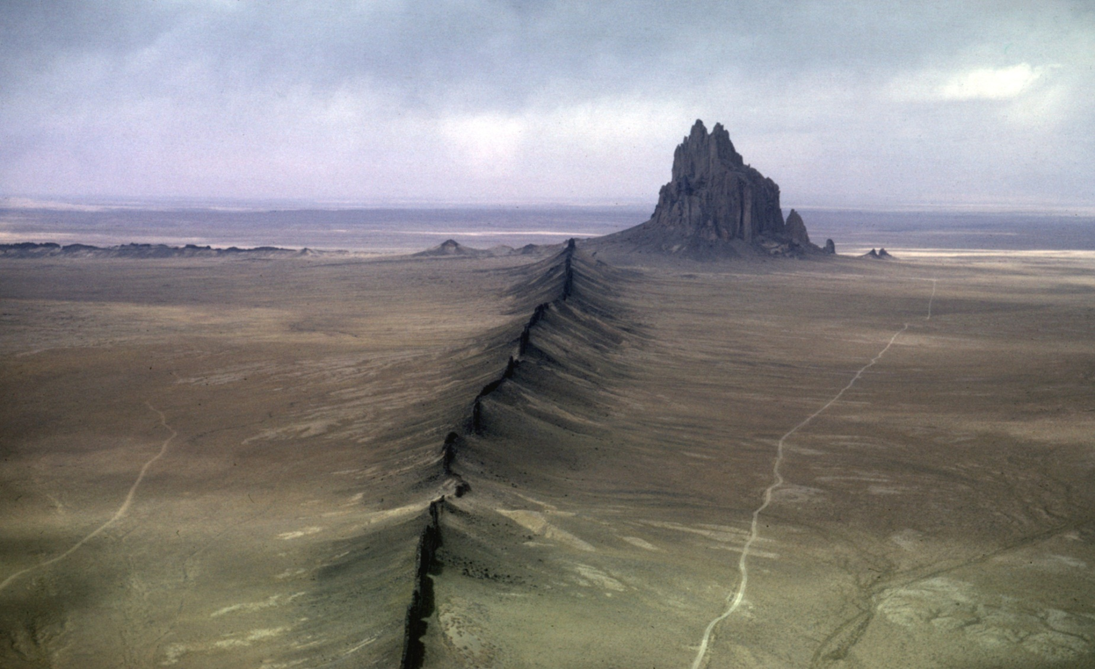
Shiprock, New Mexico
Dike radiates from center
Notes:
Image: From geology by Light Plane, ftp://ice2.geology.wisc.edu/pub/air/113-20k2.jpg
Caption: Shiprock (7178 ft) from over the southern dike, southwest of Shiprock, NM. View to the NNW. (11Apr66)
Lava Flow Features
Most lava flows are composed of basaltic magmas that have lost much of their volatile content. The loss of volatiles during the early part of the eruption increases viscosity somewhat, so most flows are relatively slow. They can cause great property damage, but usually cause little loss of life. The Hawaiian volcanoes generally erupt magma around 1200̊C, of very low viscosity.

Slide 24
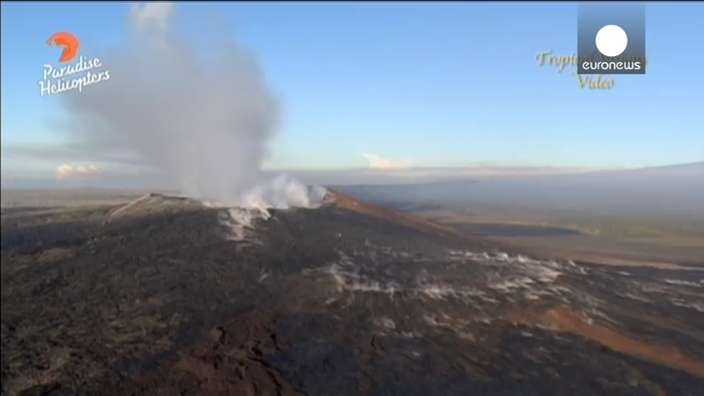
Very Hot Lava
Notes:
Video: Molten lava streams down Hawaii's Kilauea volcano, helicopter footage.mp4
Source: https://www.youtube.com/watch?v=yoLGc1rNxLA
Running time: 1 minute 52 seconds

Slide 25
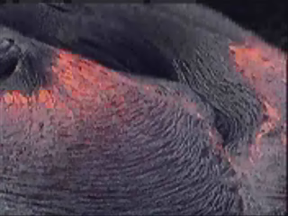
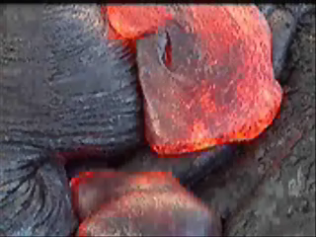
Pahoehoe Flow
Kilauea, Hawaii
Notes:
Left, Phhropes.wmv, converted from phhropes.avi
Right, phhffmerge.wmv, converted from phhffmerge.avi
The result is a series of ropy protrusions, creating a pahoehoe texture. Pahoehoe is seen only in low-viscosity basalts. Continued flow may result in the crust breaking into blocks, which are found on the top of the flow, as well as accumulating at the base. When these blocks are broken into finer particles, the result is aa lava. Often this is the result of a basalt flow becoming more viscous as it flows.

Slide 26
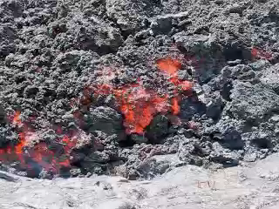
Aa Flows
Kilauea, Hawaii
Notes:
Video: https://www.youtube.com/watch?v=iyIV5fd1Aww
This video shows a sluggish a'a lava flow from the ongoing July 21 fissure eruption east of Pu'u O'o cone. The lava is flowing over a smoother pahoehoe flow from the 1980's. The hardened clinkers are constantly being floated to the front by the liquid interior. Recorded October 6, 2007.
Running time: 1 minute 24 seconds

Slide 27
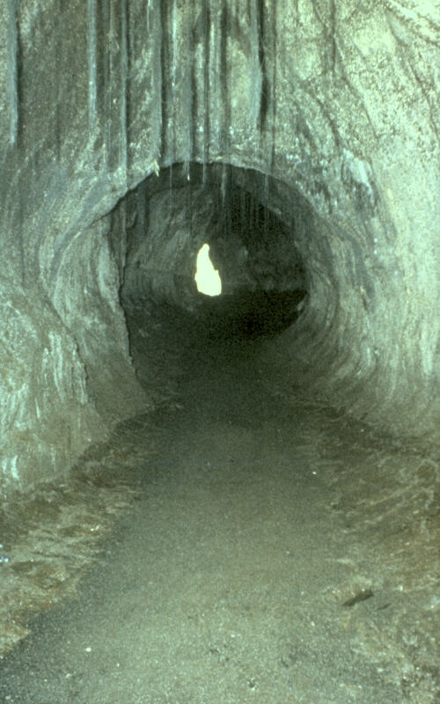
Lava Tube
Thurston (Nahuku) lava tube
Near summit caldera of Kilauea Volcano, Hawaii Volcanoes National Park
Notes:
Source: http://volcanoes.usgs.gov/Products/Pglossary/LavaTube.html

Slide 28
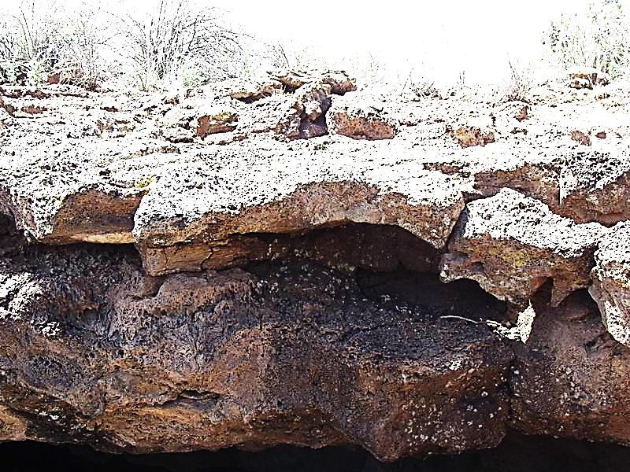
Lava Flow
El Malpais NM
Photo: Dr. Anton Oleinik, from SFC, 2001
Notes:
Lava tubes or tunnels form when lava breaks through the leading edge of the flow and escapes. Inflated flows occur when an initially thin flow (20-30 cm) begins to solidify. More magma is injected from below, inflating and cracking the surface.

Slide 29
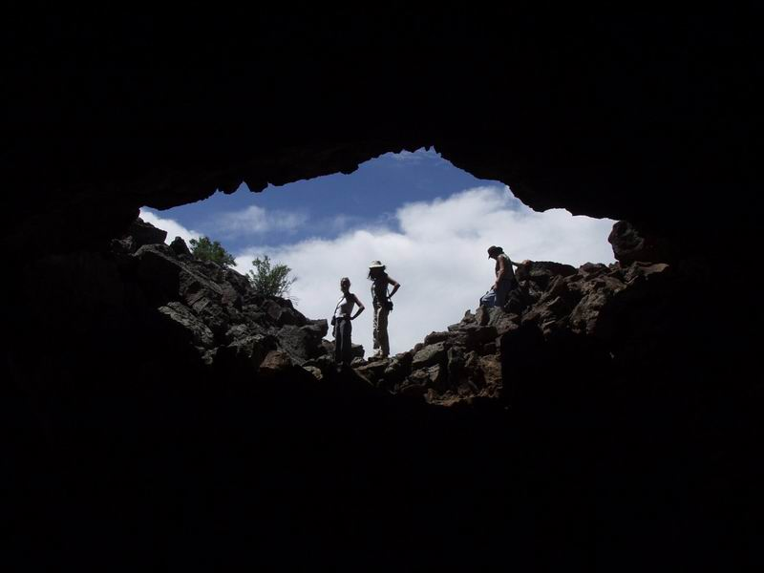
Lava Tube
El Malpais NM
Photo: Dr. Anton Oleinik, from SFC, 2001

Slide 30
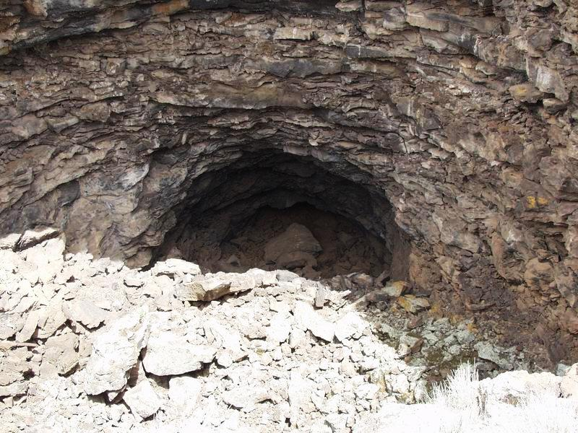
Lava Tube
El Malpais NM
Photo: Dr. Anton Oleinik, from SFC, 2001

Slide 31
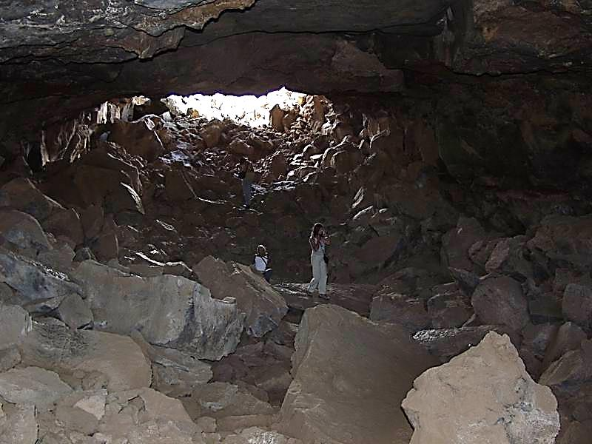
Lava Tube
El Malpais NM
Photo: Dr. Anton Oleinik, from SFC, 2001
Notes:
Contrast increased to show detail

Slide 32
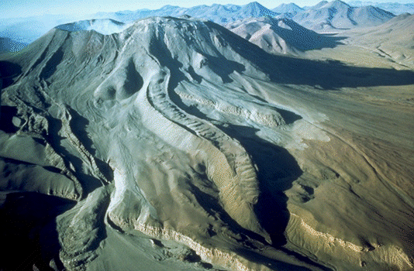
Andesitic Volcano
Volcan Láscar (Chile)
Notes:
Volcan Láscar (Chile) 5,641 m, is the most active volcano in the central Andes
Since 1988 a silicic lava dome has been growing in the summit crater, and there have been several recent eruptions
Andesitic lavas, much more viscous than basalt, often form aa or block lavas. Block lavas are larger than aa, and are smooth-sided. Block lavas appear to result from a nearly solid lava being ejected by pressure from below, into piles which may exceed 100 m in height. Thicker intermediate (andesite) to silicic (dacite to rhyolite) flows often show flow foliation, with aligned phenocrysts, color banding, and interspersed pumice bands. The latter may have resulted from localized shearing that resulted in degassing and vesiculation. Most rhyolite flows are aphric, meaning without phenocrysts.

Slide 33
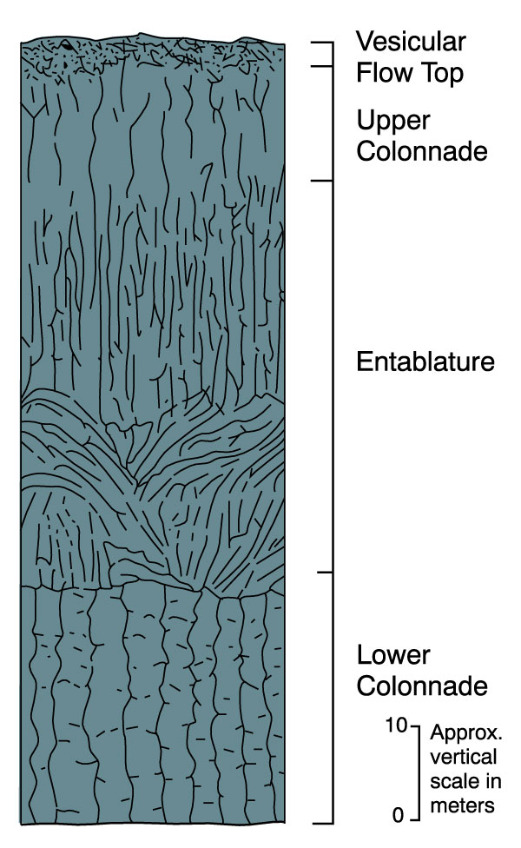
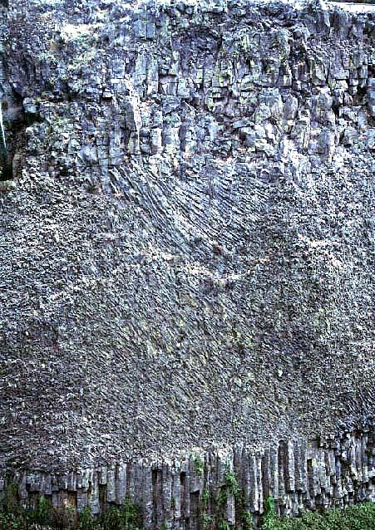
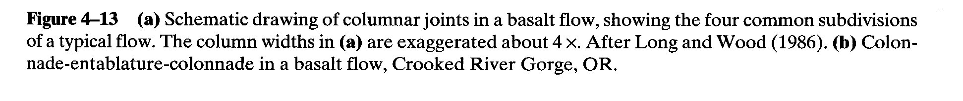
Columnar Joints
Notes:
Lava flows and some shallow intrusions develop columnar joints. Their origin is controversial, but the most commonly accepted idea involves contraction during cooling. The top and bottom of the flow cool faster, whereas the center stays hot. Tensional cracking develops as the contracting lava pulls away into polygonal columns. Characteristics vary, but an idealized example is shown in Figure 4-13a. The top and bottom are composed of regular straight columns, with 4-7 sides. The middle often has an entablature, with irregular curved columns. The very top layer is vesicular and brecciated by volatiles rushing toward the top. This structure may involve continued disturbance of this layer, which remains ductile after the top and bottom have cooled sufficiently to become rigid.

Slide 34
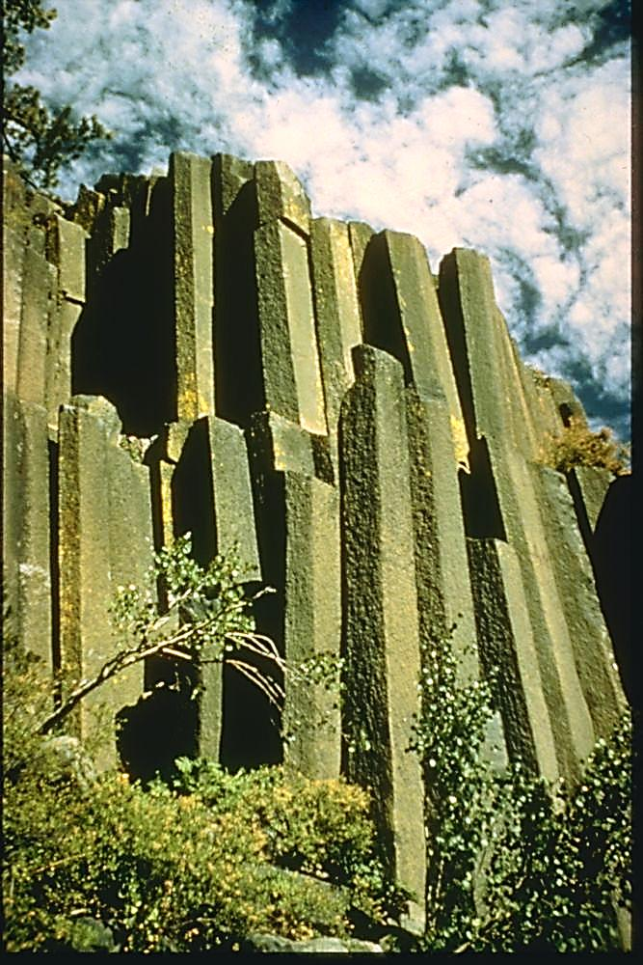
Devil’s Postpile N.M.
Extreme columnar jointing

Slide 35
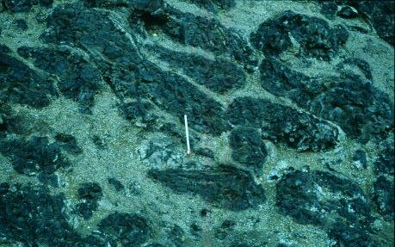
Pillow Basalt
Columbia River Basalt Group
Notes:
Photo by Thor Thordarson Photo CRB97-F4.jpg
http://volcano.und.nodak.edu/vwdocs/volc_images/north_america/crb2.html
Submarine flows or eruptions result in pillow basalts

Slide 36
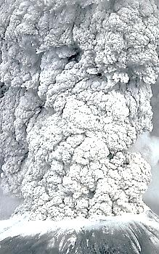
Pyroclastic Eruption
Mt. St. Helens, 1980
Notes:
From http://volcanoes.usgs.gov/Hazards/What/Tephra/tephra.html
Any fragmental aggregate of volcanic material, regardless of origin, can be called volcaniclastic. Pyroclastic deposits are a special type of volcaniclastics. They form either from explosive volcanism, or from aerial expulsion of rock by the volcanic blast.

Slide 37
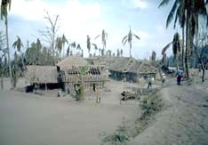
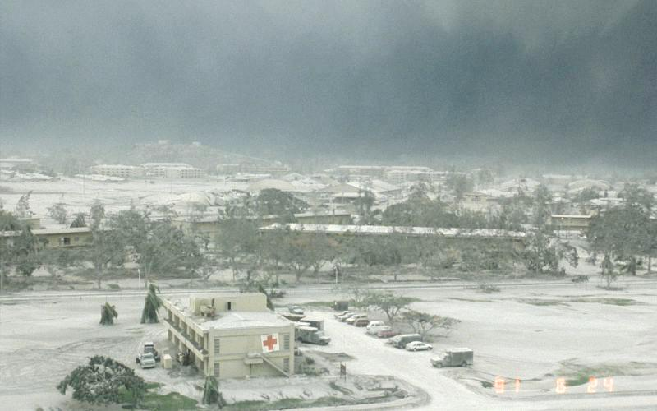
Tephra
The village of Galunggung, Indonesia, buried in volcanic ash
Mount Pinatubo (Philippines - 1991)
Notes:
Right: Volcanic ash falls to ground and creates darkness, Mount Pinatubo in the Philippines
Photograph by E. Wolfe on 24 June 1991
Source: http://volcanoes.usgs.gov/Products/Pglossary/tephra.html
The individual particles are called pyroclasts, while the collective term for deposited material is tephra.
Fall deposits
Plinian eruptions occur when pyroclasts are propelled forcefully upwards, as well as being held aloft by convection currents and the buoyancy of hot gases above a volcanic vent. The largest eruptions can drive material up 50 kilometers, well into the earth's stratosphere. Winds begin to spread the plume.

Slide 38
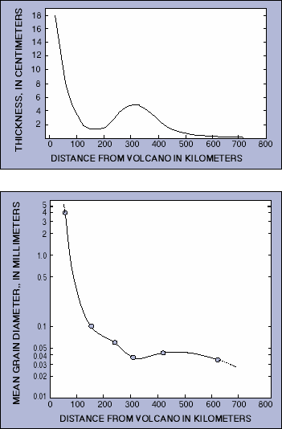
Ash Transport, Mt. St. Helens
Thickness and mean-grain diameter of tephra that fell to the ground downwind of Mount St. Helens
Eruption on May 18, 1980
Notes:
The volcano ejected a minimum of 1.1 km³ of uncompacted tephra, which is equivalent to 0.20-0.25 km³ of magma and solid rock
Peak wind velocity during the eruption varied between 80 and 140 km/hour as measured 400 km downwind of the volcano at about 12 km above sea level
Note the increased thickness about 300 km downwind
Unusual increase in tephra thickness is thought to have resulted from the sticking together of individual grains due to moisture in the eruption cloud
http://volcanoes.usgs.gov/Hazards/What/Tephra/tephra.html

Slide 39
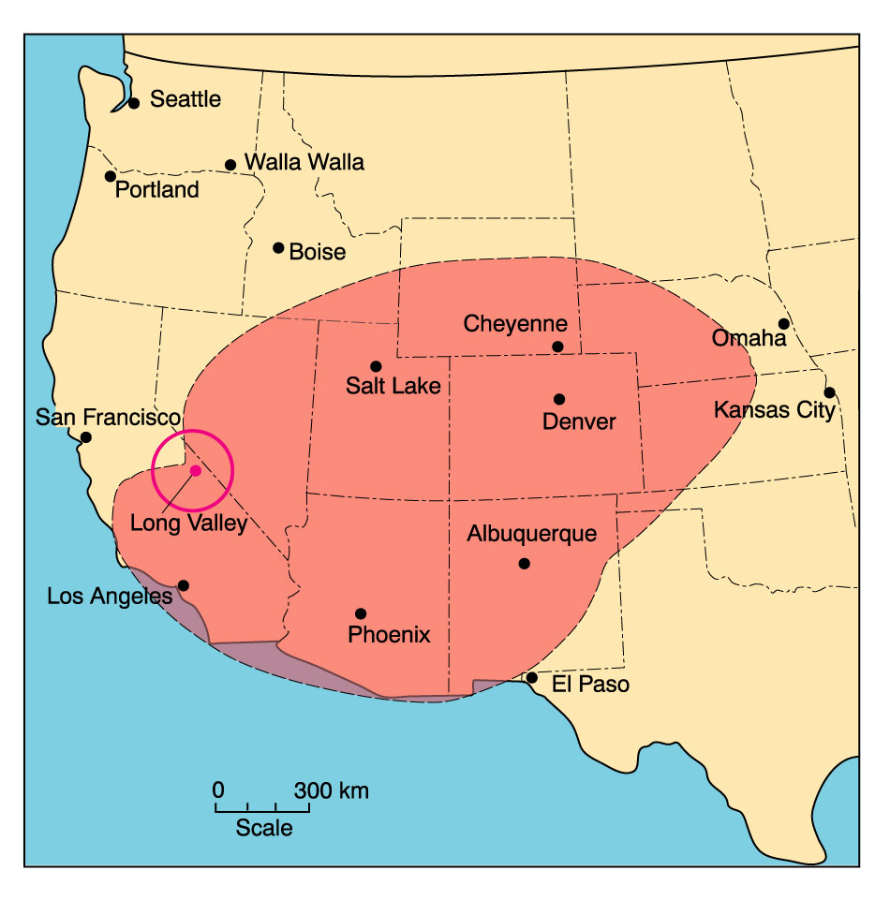
Areal Extent, Bishop Ash Fall
Notes:
The largest deposits are from the rare rhyolitic eruptions. The Yellowstone eruptions have totaled over 3800 km³ in the last 2.2 million years. Figure shows a depositional map of the Long Valley Caldera eruption that occurred about 700,000 years ago. The one-meter isopach was out to 75 km or more, and the 1 cm isopach extended to Kansas.
Flow deposits
Dense clouds of pyroclastic debris can be produced in several ways:
1. Collapse of a vertical cloud from a Plinian eruption, which produces the largest flows - Mt. Pinatubo, 1991 was one example
2. Lateral blast- the 1980 eruption of Mt. St. Helens began this way
3. A low pressure eruption, with magma boiling over the vent and downhill (Mt. Lamington, Papua)
4. Dome collapse - the 1902 eruption of Mt. Pelèe
All of these mechanisms produce a very hot (400-800̊C), dense cloud of particles, consisting of pumice and ash, which is denser than surrounding air. It rolls downhill, fluidized by the trapped volcanic gases and air. Unlike Plinian eruptions, topography controls both the path of the flow, and the deposition. The cloud may flow around obstacles, or up and over them. Deposition is concentrated in valleys or basins, and is not uniform. If the cloud > 650̊C, the particles will be incandescent, and the cloud is called a nuée ardente (Fr. glowing cloud"). Cloud velocities are usually in the 50-200 km/hr range, but initial lateral blasts are much faster. In the case of Mt. St. Helens, velocities are estimates at 540 km/hr at maximum.

Slide 40
Deposits from Pyroclastic Eruptions
Ignimbrites - Greek, fire cloud material
Tuff
Welded tuff
Notes:
Deposits from pyroclastic flows are called ignimbrites (Gk., fire cloud material). The rocks from the deposits are called tuff. The lower portions of the deposit, which stay hot the longest, often become welded together, forming an extremely tenacious rock called welded tuff. This part of the flow generally has vesicles severely squeezed, to the point they may disappear. The color becomes black, as opposed to the light gray of vesicular pumice. The flow itself may be unsorted, or may have dense, lithic blocks on the bottom, and lighter pumice on the top.
Pyroclastic flow deposits are rare, but devastating when the do occur. Flows from Mt. Vesuvius buried the cities of Pompeii and Herculaneum in Italy in AD 79. There are no historical accounts of truly large eruptions. The Long Valley Caldera eruptions covered over 1500 km³ to a depth of 10's to 1000's of meters.
A special type of pyroclastic flows are the surges. These are extremely turbulent flows, with lower particle density and thus lower density. They hug the ground. However, their rapid movement and lower density allows more mixing, and the deposits mantle the ground, although with some concentration in depressed areas. The turbulence causes rapid loss of momentum, and they are typically deposited close to the vent.

Slide 41
Plutons
Tabular
  Concordent
  Discordent
Non-tabular
Notes:
Intrusive Deposition
Deep intrusive bodies are called plutons. Many are composed of felsic minerals, and are less dense than surrounding rock. Over time, they tend to rise, but they are rarely completed exposed at the surface by weathering and erosion. Geophysical studies and drilling or tunneling associated with mining have unlocked some of their secrets.
The plutons may be classified as tabular or non-tabular, based on whether the shape is sheet-like or not. They may further be said to be concordant, if their orientation is parallel to country rock structure, and discordant if it isn't.

Slide 42
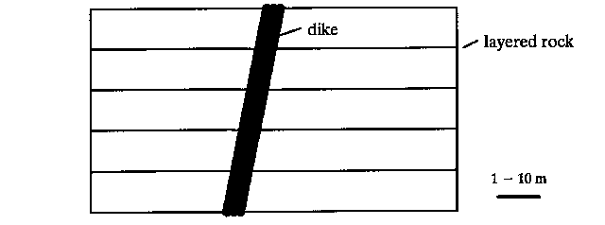
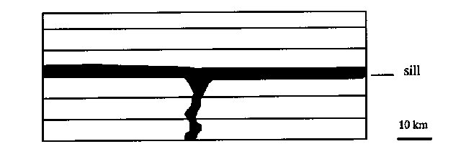
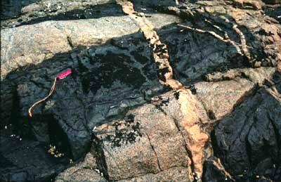
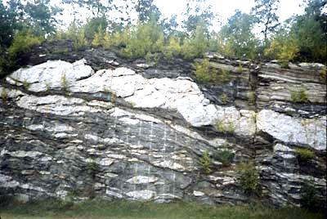
Tabular Plutons
Notes:
Tabular Intrusive Bodies
Tabular bodies result from magma intruding a fracture, often opening and enlarging it. If the fracture is between layers, the intrusion is concordant, and is called a sill. If the fracture cuts across country rock structure, the intrusion is a dike. Fractures may form in response the intrusion of magma, as a means of pressure release.

Slide 43
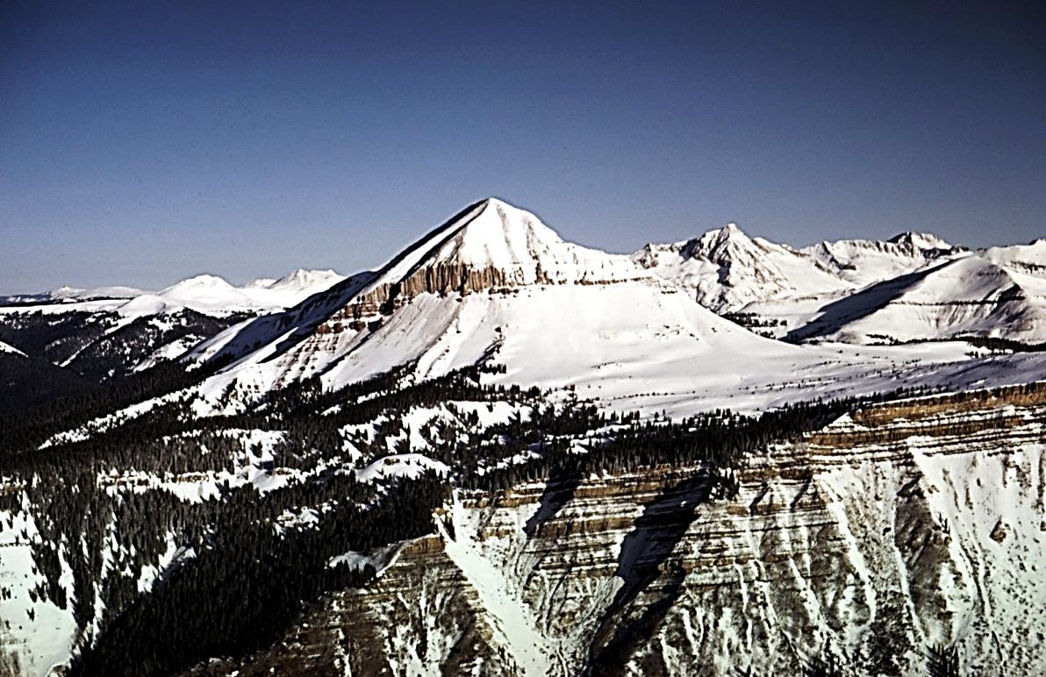
Engineer Mountain Sill
Engineer Mountain (12,968 ft) and Coalbank Hill, San Juan Mountains, Colorado
Coalbank Hill in foreground is Hermosa formation (Pennsylvanian)
Engineer Mountain (a sill) is quartz trachyte
View to the northwest
Notes:
From Geology by Lightplane, Louis J. Maher, Jr. - http://www.geology.wisc.edu/~maher/air.html
Photo 115-08k2.jpg from ftp://geology.wisc.edu/pub/air
Most sills have feeder dikes associated with them, unless the beds are steeply dipping. It is possible for magma to be injected and harden, and then have another injection of magma. If the successive injections are of the same composition, the body is called a multiple dike or sill. If the composition is different, then term composite is used. It is common for dikes to occur in sets, called dike swarms. Extensional tectonics often produces multiple fractures, and the magma simply fills all of them. Unless erosion is extensive, it may be difficult to determine if a sill is solitary or part of a swarm.
Tabular bodies are the result of injection under pressure. The pressure of the injected magma often dilates the fracture walls.
Rising magma plumes often crack the rock above them. Magma filling the fractures can produce several types of structures.

Slide 44
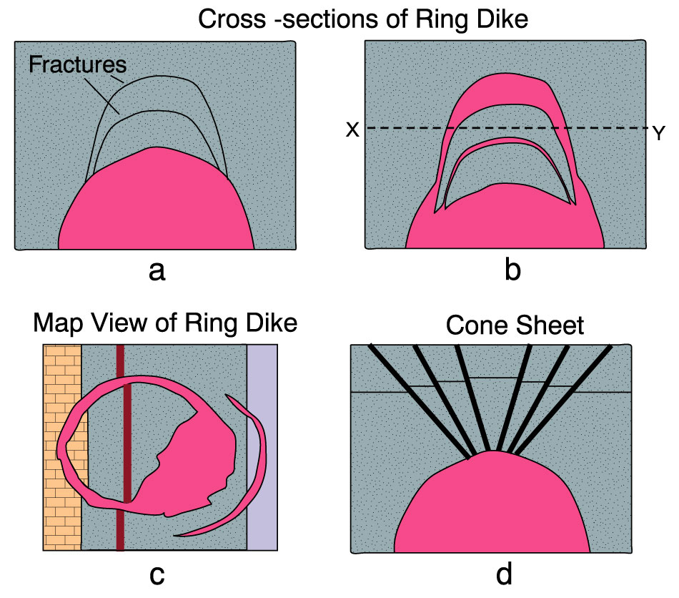
Ring Dike and Cone Sheet
Figure 4-23. The formation of ring dikes and cone sheets. a. Cross section of a rising pluton causing fracture and stoping of roof blocks. b. Cylindrical blocks drop into less dense magma below, resulting in ring dikes. c. Hypothetical map view of a ring dike with N-S striking country rock strata as might result from erosion to a level approximating X-Y in (b). d. Upward pressure of a pluton lifts the roof as conical blocks in this cross section. Magma follows the fractures, producing cone sheets. Original horizontal bedding plane shows offsets in the conical blocks. (a), (b), and (d) after Billings (1972), Structural Geology. Prentice-Hall, Inc. (c) after Compton (1985), Geology in the Field. © Wiley. New York.
Notes:
Ring dikes - The pressure from the magma is less than load pressure. Cylindrical fractures may develop (see Figure 4-23a). If the magma is less dense than the overlying rock, blocks of country rock may sink in, letting magma squirt into the detached fracture (Figure 4-23b). The dikes may be vertical, or dip steeply away from the central axis.
Cone sheets - When the load pressure is less than the magma pressure, a different structure forms. The rising magma produces a series of fractures, which radiate from the high central point of the magma plume. The cone sheets always dip inward, toward the central axis. (See Figure 4-23d)

Slide 45
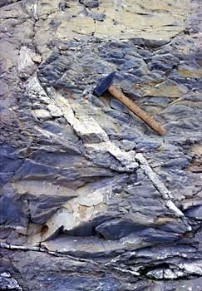
Igneous Vein
Extensional veins in a thick carbonate turbidite from the Liguride Complex in the Northern Apennines, Italy
Photo David Bice, Carleton College
Notes:
Veins are small tabular bodies associated with ores. They may be either concordant or discordant. Veins are often the product of water-rich magma.
http://www.science.ubc.ca/~eoswr/cgi-bin/db_gallery/searchframe.html
Slide # 27.10546875Kb
Non-tabular Intrusive Bodies
The major types of non-tabular bodies are called stocks and batholiths. By definition, stocks have an exposed surface area of <100 km², whereas batholiths are > 100 km². Sometimes this is matter of the extent of erosion. As erosion proceeds a stock may "grow" into a batholith. Some people use geophysical evidence of a larger body at depth to call a structure a batholith. Unless there is actual drill data, this is a speculative process, however.
Stocks may be genuinely small bodies. The cylindrical magma conduit and magma chamber beneath a volcano, called a plug, is an example. After some erosion, the uppermost part of the conduit may be exposed. Such exposures are called volcanic necks. (Church rock, Shiprock are examples).
Specialized types of plutons include laccoliths and lopoliths.

Slide 46
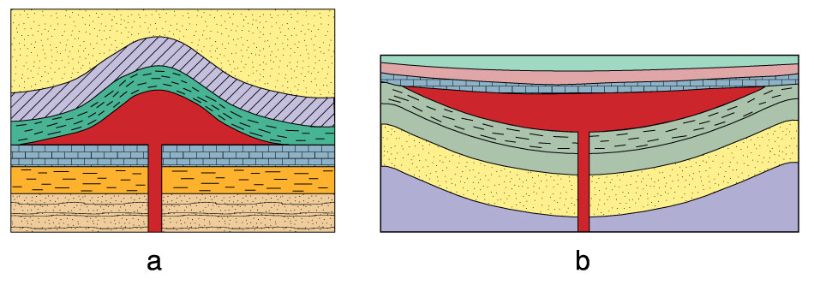
Laccolith and Lopolith
Figure 4-26. Shapes of two concordant plutons. a. Laccolith with flat floor and arched roof. b. Lopolith intruded into a structural basin. The scale is not the same for these two plutons, a lopolith is generally much larger. © John Winter and Prentice Hall.
Notes:
Laccolith - Concordant intrusion with flat floor and arched roof. Injection pressure lifted the rocks above the central part of the intrusion. Magma is viscous, limiting horizontal flow. (Figure 4-26a)
Lopolith - Concordant intrusion into a basin. The floor is curved, the top is flat. Lopoliths are much larger than laccoliths. They are usually mafic, and the magma is less viscous than that in a laccolith. The basin may result from sagging due to the weight of the intruded magma. Another possibility is evacuation of a deeper magma chamber, creating an opening. Many geometries are possible, and the resulting terminology is complex.

Slide 47
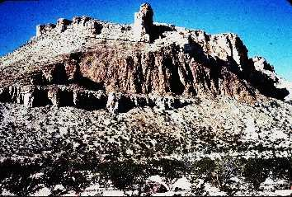
Laccolith

Slide 48
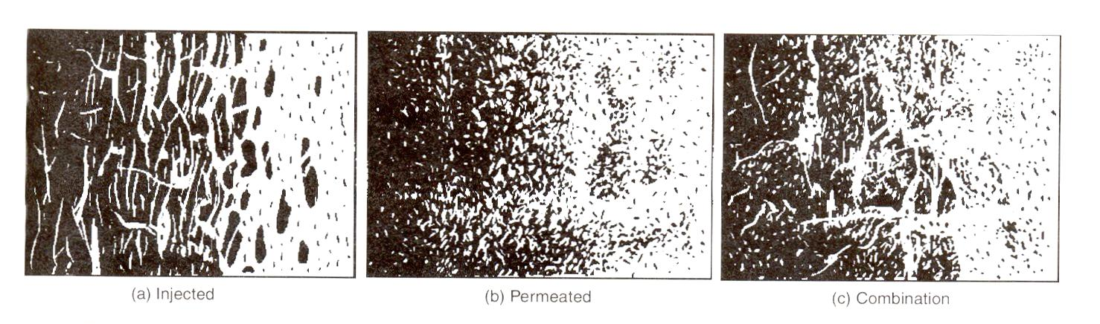
Border Zone
Figure 4-27. Gradational border zones between homogeneous igneous rock (light) and country rock (dark). After Compton (1962), Manual of Field Geology. © R. Compton.
Notes:
Border Zones
The contact zone between a pluton and country rock can reveal considerable information. The magma is hot, and often volatile saturated. The border is much cooler, solid, and generally of different composition. If the country rock is much colder than the magma, a chilled border zone may result. The magma chills quickly, with little chance for any differentiation or assimilation processes to operate. Chilled border zones may be recognized by their relatively finer grain size. Chemical analysis of the chilled border zone is often used to give a good estimate of the original magma composition
Examination of the border zone can reveal other features. The border may be sharp or gradational. Sharp border zones occur when there is a large temperature difference between the magma and country rock, usually at shallow depth. Gradational borders occur when the temperatures are closer, usually at depth. Figure shows injection, permeation, and a combination. Injection occurs strictly because of pressure. A fluid-rich magma may permeate the country rock. The fluid can alter the country rock, or even partially melt it. Assimilation occurs when some of the country rock melts, changing the magma composition.

Slide 49

Contact Metamorphism
Proximity to a heat source may cause new minerals to form
Zone of contact metamorphism is known as contact aureole
Notes:
Shallow intrusions often produce another change. The heat, and possibly fluid from the magma, alter the country rock.. Recrystallization over a narrow range occurs. Grain size and recrystallization degree decrease rapidly as distance from the magma border increases. The zone of change is called a contact metamorphic aureole.
Within the magma, we find the chilled border zone. Chilling increases the viscosity of the magma. In already viscous magmas, flow within the magma will produce a sheared zone. the more viscous the magma, the thicker the shear zone. Within the sheared zone, a foliation, and sometimes lineation, develops parallel to the contact. Disc-shaped masses of flattened mineral aggregates, or sometimes ductile xenoliths, are produced, and are called schlieren. Shearing makes a sharp boundary less so, and makes an otherwise homogeneous igneous rock look like a metamorphic gneiss. (See Figure 4-27)
Contact zones frequently suffer from post-depositional alteration as well. The country rock and the igneous intrusion typically have much different mechanical properties. Shearing affects the two sides differently, and leaves a tectonic "overprint" on the contact. If shearing is strong enough faulting moves the rocks, and the igneous rock is now next to a completely unrelated rock. At that point, the contact is purely tectonic.

Slide 50
Relation to Other Geologic Events
Plutonic emplacement is often related to other events, especially orogenesis
Using the time of orogenesis as a reference, we may define three possible temporal relationships
  Pre-tectonic
  Syn-tectonic
  Post-tectonic
Notes:
Plutonic emplacement is often related to other events, especially orogenesis. Using the time of orogenesis as a reference, we may define three possible temporal relationships.
Pre-tectonic plutons - Emplacement occurs before major tectonic movements. The orogenic events impart both a tectonic and a metamorphic imprint on the pluton. Internal foliation is established, and it parallels that of the country rock. Regional metamorphism may curve around the pluton, particularly if there are ductility differences. Pre-tectonic plutons are relatively cold, and likely to be mechanically strong. Most deformation will be concentrated at the border zone.
Syn-tectonic plutons - When the pluton is formed during orogenesis, it is syn-tectonic. Like the pre-tectonic pluton, it will be affected by orogenic tectonic, often to a greater degree. The syn-tectonic pluton is very warm and therefore ductile. Deformation will be seen throughout the pluton, not limited to the margins. Syn-tectonic plutons may elongate more than pre-tectonic plutons, in the direction of foliation.
Post-tectonic plutons - Emplaced after the tectonic movement and its associated metamorphism, the plutons lack foliation. Any regional deformation fabrics in the country rock will end discordantly at the pluton, or may end concordantly if a significant contact metamorphic aureole and schlieren exist.
To complicate matters further, many orogenic belts are multiple. A pre-orogenic pluton may actually be a syn-tectonic or post-tectonic pluton from an earlier orogenic event.

Slide 51
Depth of Intrusion
Epizone
  Depth of emplacement < 10 km
Mesozone
  Depth of emplacement > 5 km, < 20 km
Catazone
  Depth of emplacement > 10 km
Notes:
Depth of Intrusion
Plutons may be shallow, intermediate, or quite deep. One exposed at the surface, we need criteria to distinguish their original emplacement depth. The following may be useful.

Slide 52
Epizone Characteristics
Discordant with sharp contacts
No regional metamorphism of country rock
Country rock often brecciated
Numerous dikes and off-shoots from main igneous body
Chilled borders and some contact metamorphism
Country rock temperature less than 300°C
No planar foliation in the pluton
Plutons are often associated with volcanoes of the same age
Top of pluton penetrates the roof rocks irregularly
Generally post-tectonic
Most epizonal plutons are small (stocks)
Petrofabrics are isotropic, except for shear against wall rock
Miarolitic cavities are common
Notes:
The upward movement of the pluton often fractures rock above it. Epizonal plutons may still be hot, perhaps with some associated magma. Fluids from the magma, and from interaction with meteoritc water, may produce extensive hydrothermal alteration, with ore mineralization concentrated along fracture zones. Contact metamorphism may be dramatic if there has been no previous or subsequent regional metamorphism. Juvenile fluids released at low pressures may form miarolitic cavities, with euhedral inward projections of minerals into the cavity.
Miarolitic cavities (or miarolitic texture) are typically crystal-lined irregular cavities or vugs, most commonly found in granitic pegmatites, and also in a variety of igneous rocks.

Slide 53


Miarolitic Cavity Photos
Elbaite
Quartz
Notes:
Photos from https://www.researchgate.net/publication/319914367_Lithium-Boron-Beryllium_Gem_Pegmatites_Oxford_Co_Maine_Havey_and_Mount_Mica_Pegmatites
From a presentation Lithium-Boron-Beryllium Gem Pegmatites, Oxford Co., Maine: Havey and Mount Mica Pegmatites
by William B. Simmons, Alexander U. Falster, Karen L. Webber, Myles M. Felch, and Dwight C. Bradley

Slide 54
Mesozone Characteristics
Partially concordant, partially discordant, contacts sharp to gradational
Country rock 300-500°C
Low grade regional metamorphism
Planar foliation, sometimes with lineation, is generally present, especially near the contact
Contact metamorphic aureole is usually present
No relation to volcanoes
No chilled border zone (or very minor)
Most major batholiths are mesozonic
Generally late stage syn-tectonic, or post-tectonic
Spotted slates and phyllites are common

Slide 55
Catazone Characteristics
Concordant - country rocks ductile; sheared and rotated until they are parallel
Depth of emplacement > 10 km
Country rock 450-600°C
More extensive regional metamorphism
Gneissic foliation common
No noticeable contact metamorphism
Plutons are syn-tectonic
Gradational contacts
No chilled borders
Internal fabric of pluton is often foliated, and foliation passes into country rock - makes recognition of the plutonic rock as igneous difficult
Partial melting of country rock at depth can produce catazonic plutons
Notes:
Multiple Intrusions
Careful examination of many batholiths has shown them to be composed of multiple injections of magma. A now classic study of the Tuolumne Intrusive Series in Yosemite NP by Bateman and Chappell has shown the small batholith was emplaced as a series of small intrusions. The outermost part is diorite, the next layer in is granodiorite, and the center is a “porphyritic” granite. This suggests fresh, more alkaline, magma surges within an already hardening outer shell. Some of the later intrusions cross-cut the existing rocks. Assimilation of wall rock has also lead to some differences in composition.

Slide 56

Tuolumne Intrusive Series
Figure 4.32. Developmental sequence of intrusions composing the Tuolumne Intrusive Series (after Bateman and Chappell, 1979), Geol. Soc. Amer. Bull., 90, 465-482.
a. Original intrusion and solidification of marginal quartz diorite.
b. Surge of magma followed by solidification of Half Dome Granodiorite.
c. Second surge of magma followed by solidification of porphyritic facies of Half Dome Granodiorite.
d. Third surge of magma followed by solidification of Cathedral Peak Granodiorite and final emplacement of Johnson Granite Porphyry.
Notes:
Figure 4-32 shows the sequence of intrusion proposed by Bateman and Chappell. The number of separate intrusions in the Sierra Nevada “Batholith” is now known to be in the hundreds. Better terminology are the words Batholith Belts.
“Room Problem”
What makes a pluton rise toward the surface, and how does it push upwards? The first question is easy. Magmas at depth are less dense than their surrounding rock. Their low density exerts a buoyant force upwards. This is the same force that creates salt diapirs. If the magma forms in the mantle, it rises through ductile rock. If the viscosity of the magma is similar to the that of the surrounding rock, it can rise by pushing the overlying rock aside, in a radial pattern. Problems occur when the magma diapir reaches less ductile rock. Then it must find other means of pushing rock around.

Slide 57

Pluton Emplacement Mechanisms
Figure 4-34. Diagrammatic illustration of proposed pluton emplacement mechanisms. 1- doming of roof; 2- wall rock assimilation, partial melting, zone melting; 3- stoping; 4- ductile wall rock deformation and wall rock return flow; 5- lateral wall rock displacement by faulting or folding; 6- (and 1)- emplacement into extensional environment. After Paterson et al. (1991), Contact Metamorphism. Rev. in Mineralogy, 26, pp. 105-206. © Min. Soc. Amer.
Notes:
Figure 4-34 illustrates some of the possibilities. Laccoltihs push the roof rocks up, either by folding or by lifting along faults. (#1) Buoyancy may not be sufficient to accomplish the lifting, so it has been proposed that magmatic overpressure helps. Magmatic overpressure exists when the pressure inside the magma chamber exceeds the load pressure.
Another possibility is that magma melts wall and roof rocks, melting its way upwards in a process called assimilation. (#2) This process can substantially change the composition of the magma over time.
Another possibility exists if the roof rock is brittle. Blocks of the roof may break, and fall into the magma chamber. This process is called magmatic stoping. (#3) (Named after mining terminalogy, where the roof of an underground mine is quarried.) Evidence for this process is easily seen in some plutons. Blocks of country rock, sometimes partly assimilated, are seen in the igneous rocks (xenoliths). The stoped blocks must be denser than the magma, and must be large enough to sink quickly through a viscous fluid. Stoping seems to be most effective in shallow environments.
Assimilation may occur simultaneously with stoping. The stoped blocks are at least partially melted. Since melting requires substantial heat, it is often accompanied by crystallization of the higher melting phases in another part of the magma chamber. This process is called zone melting or solution stoping.
At greater depths, ductile deformation, with an accompanying downflow, may occur. (#4) This requires that the viscosity of country rock be low.

Slide 58

Lateral Spread of Diapirs
Figure 4.35. Sketches of diapirs in soft putty models created in a centrifuge by Ramberg (1970), In Newell, G., and N. Rast, (1970) (eds.), Mechanism of Igneous Intrusion. Liverpool Geol. Soc., Geol. J. Spec. Issue no. 2.
Notes:
Ballooning, or expansion of the rising magma as load pressure decreases, is almost always present to some degree. This can produce ductile flow of roof rock at depth. Near the surface, it would lead to brittle failure of roof rocks, and possible physical compression of wall rocks, which might lead to low-angle faulting. (#5)
Another factor which might assist the magma diapir’s rise toward the surface is a tectonically extensional region. (#6) If the region is extending, the lateral pressure holding fractures together is reduced, making it much easier for magma to force them apart.
Despite all these possible mechanisms for the uplift of magma, the “room problem” still exists, and is still the subject of much study. Many people have assumed that the surface expression of a batholith is just the “tip of the iceberg” with much greater volume at depth. Hans Ramburg modeled diapir systems and found that diapirs rise until they are no longer buoyant, then spread sideways.

Slide 59

Boulder Batholith, Montana
Figure 4.36. Diagrammatic cross section of the Boulder Batholith, Montana, prior to exposure. After Hamilton and Myers (1967), The nature of batholiths. USGS Prof. Paper, 554-C, c1-c30.
Notes:
It may turn out that batholiths aren’t nearly as thick as we imagine them to be. (See Figure 4-36)

Slide 60

Hydro-thermal Systems Above Magma
Figure 4.38. Schematic section through a hydrothermal system developed above a magma chamber in a silicic volcanic terrane. After Henley and Ellis (1983), Earth Sci. Rev., 19, 1-50. Oxygen isotopic studies have shown that most of the water flow (dark arrows) is recirculated meteoric water. Juvenile magmatic water is typically of minor importance. Elsevier Science.
Notes:
Hydrothermal Systems
The region above hot, shallow intrusions usually consisted of fractured sedimentary and volcanic rocks. Both meteoritic and juvenile waters flow in the fractures, with meteoritic usually dominating (based on isotope studies). As water is heated, it expands and rises. It appears on the surface as hot springs, fumaroles, and sometimes geysers. It cools, and often returns to the underground system to sink and be reheated. Aqueous fluid flow in such systems can be quite high. It depends on permeability. Fracturing of the rock by the rising intrusion may create quite high permeabilities.
Figure 4-38 shows some of the possibilities.
Some systems have been drilled, to depths as great as 3 kms. Solutions found were brines, with temperatures up to 350̊C, and pH near neutral. Boiling occurring in shallow parts of the system typically produces CO₂ and H₂S. These may reach the surface to be released as gases in fumaroles, or they may react with country rock to form acidic sulfate/bicarbonate mixtures, seen in many geothermal fields. Fluid:rock ratios vary from about 0.001 to 4. This wide range produces a similarly wide range of products. Mafic minerals and glass in country rocks are most easily altered, although in persistant hydrothermal systems, almost all rocks will be altered to some extent. Temperature and chemical gradients may produce considerable zonation in the alteration products, on scales ranging from the sides of a vein to larger, concentric zones above the intrusion. Economic minerals are often associated with such systems. The elements involved are usually chalcophile (Au, Ag, Cu, Pb, Zn, and Mb).
In the oceans, black “smokers” represent similar hydrothermal systems, with similar sulfide deposition.

