Slide 1
Petrology Introduction
GLY 4310
Spring, 2019

Slide 2
Petrology Definition
“That branch of geology dealing with the origin, occurrence, structure, and history of rocks, especially igneous and metamorphic rock” (from Glossary of Geology, 2nd edition)

Slide 3
Petrography
Branch of geology dealing with the description and systematic classification of rocks, especially igneous and metamorphic rocks, and especially by means of microscopic examination of rock thin sections

Slide 4
Etymology
From Greek petra, meaning “rock”, and logos, meaning “knowledge”
Pronunciation (pə träl′ə jē)

Slide 5
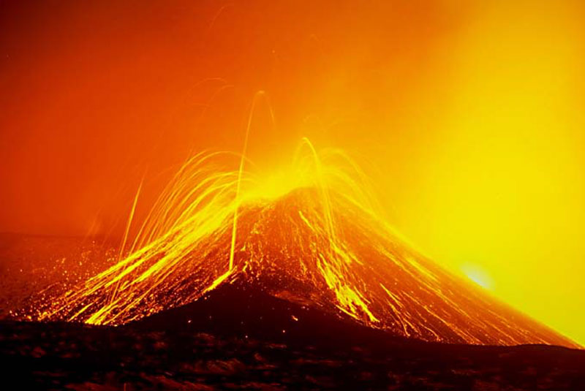
Igneous Petrology
Igneous petrology is the study of magma and the rocks that form as magma's cool
Magma is molten rock
Mt. Etna erupted spectacularly in 2001 June
Notes:
Source: http://apod.nasa.gov/apod/ap051002.html

Slide 6
Background for Petrology
Petrography
Experimental lab data
Chemistry
Earth’s structure and composition

Slide 7
Identification of Igneous Rocks
Since it is rarely possible to observe the crystallization process directly, criteria for the identification of igneous rocks must be developed
We can separate these criteria into field criteria and textural criteria
The latter are usually observed in the laboratory

Slide 8
Field Criteria
Intrusive
Extrusive

Slide 9
Textural Criteria
Careful examination of rocks in the laboratory, and the preparation of thin sections for microscopic examination, reveal features not observable in the field
Intrusive
Extrusive

